Slide 1
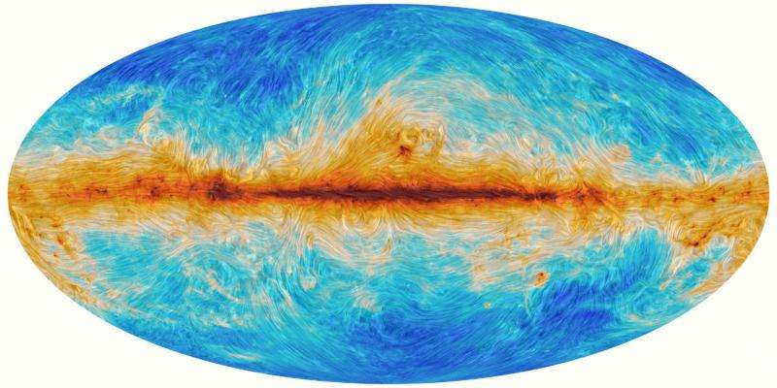
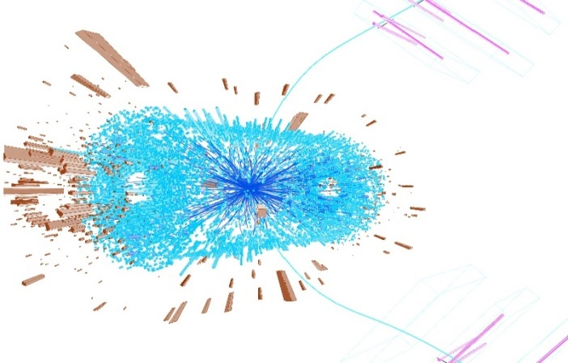
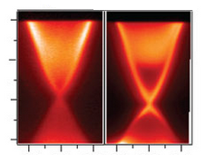
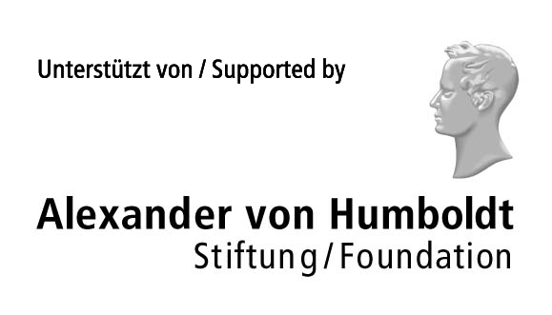
Numerical study of real-time chiral plasma instability
Pavel Buividovich
(Regensburg)

Slide 2
Anomalous Maxwell equations
Maxwell equations + ohmic conductivity + CME
Ohmic
conductivity
Chiral
magnetic
conductivity
Assumption:
Plane wave solution

Slide 3
Chiral plasma instability
_{Dispersion relation}
At k < χ = μ_{A}/(2 π²): Im(w) < 0
Unstable solutions!!!
Cf. [Hirono, Kharzeev, Yin 1509.07790]
Real-valued solution:

Slide 4
Helical structure
Helical structure of unstable solutions
Helicity only in space – no running waves
E || B - ``topological’’ density
Note: E || B not possible for oscillating ``running wave’’ solutions, where E•B=0
What can stop the instability?

Slide 5
What can stop the instability?
For our unstable solution with μ_{A}>0:
Instability depletes Q_{A}
μ_{A} and chi decrease, instability stops
Energy conservation:
Keeping constant μ_{A} requires work!!!

Slide 6
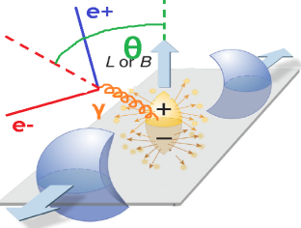
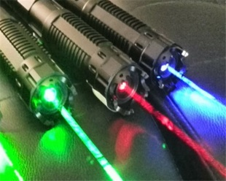
Chiral instability and Inverse cascade
Energy of large-wavelength modes grows
… at the expense of short-wavelength modes!
Generation of cosmological magnetic fields [Boyarsky, Froehlich, Ruchayskiy, 1109.3350]
Circularly polarized, anisotropic soft photons in heavy-ion collisions [Hirono, Kharzeev,Yin 1509.07790][Torres-Rincon,Manuel,1501.07608]
Spontaneous magnetization of topological insulators [Ooguri,Oshikawa,1112.1414]
THz circular EM waves from Dirac/Weyl semimetals [Hirono, Kharzeev, Yin 1509.07790]

Slide 7
Real-time dynamics of chiral plasma
Approaches used so far:
Anomalous Maxwell equations
Hydrodynamics (long-wavelength)
Holography (unknown real-world system)
Chiral kinetic theory (linear response, relaxation time, long-wavelength…)
What else can be important:
Nontrivial dispersion of conductivities
Developing (axial) charge inhomogeneities
Nonlinear responses
Let’s try to do numerics!!!

Slide 8
Real-time simulations: classical statistical field theory approach [Son’93, Aarts&Smit’99, J. Berges&Co]
Full real-time quantum dynamics of fermions
Classical dynamics of electromagnetic fields
Backreaction from fermions onto EM fields
Vol X Vol matrices,
Bottleneck for numerics!

Slide 9
Algorithmic implementation
[ArXiv:1509.02076, with M. Ulybyshev]
Wilson-Dirac fermions with zero bare mass Fermi velocity still ~1 (v_{F} << 1 in progress)
Dynamics of fermions is exact, full mode summation (no stochastic estimators)
Technically: ~ 10 Gb / (200x40x40 lattice), MPI
External magnetic field from external source (rather than initial conditions )
Anomaly reproduced up to ~5% error
Energy conservation up to ~2-5%
No initial quantum fluctuations in EM fields
(to avoid UV catastrophe)

Slide 10
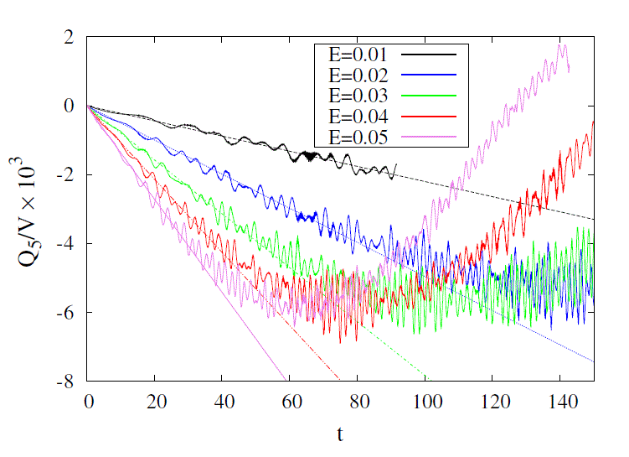
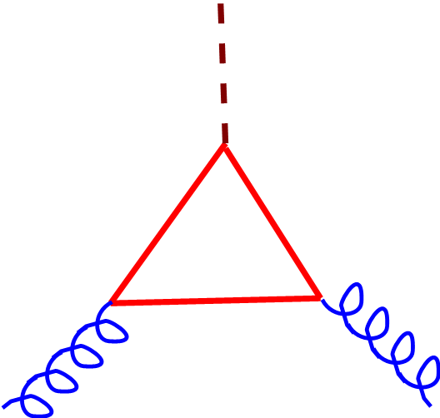
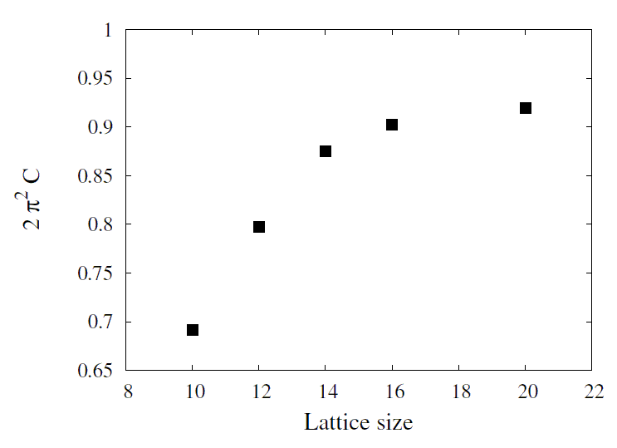
Chirality pumping, E || B
Still quite large
finite-volume effects
in the anomaly coeff.
~ 10%
Late-time: Q_{A} ~ Sin[E t/2]

Slide 11
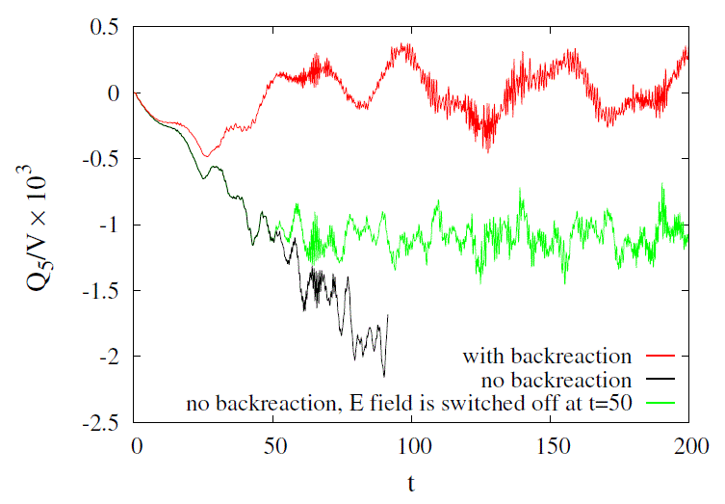
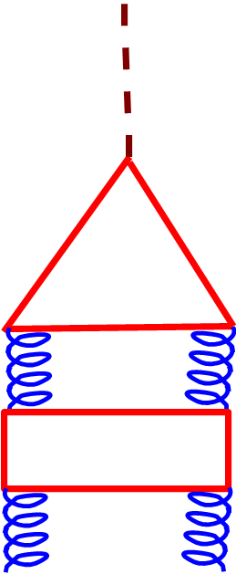
Chirality pumping: effect of backreaction

Slide 12
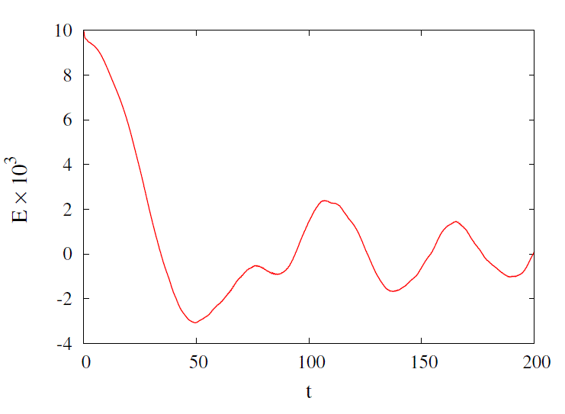
Chirality pumping: effect of backreaction
Screening of electric field by produced fermions

Slide 13
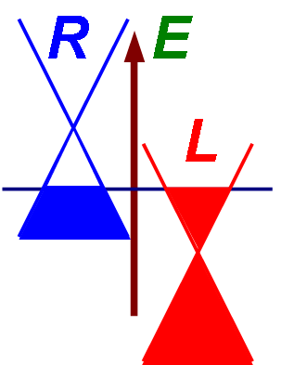
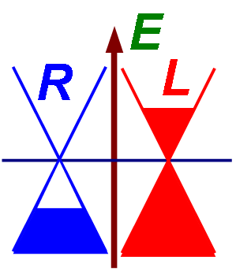
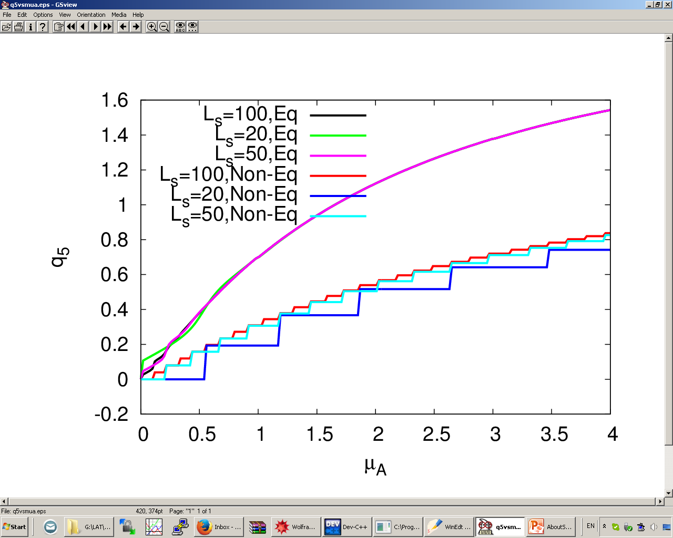
Chirality decay: options for initial chiral imbalance
Excited state with
chiral imbalance
Chiral chemical potential
Hamiltonian is
CP-symmetric,
State is not!!!
Equilibrium
Ground state

Slide 14
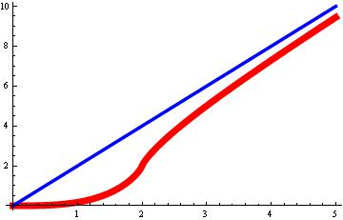
Equilibrium vs non-equilibrium CME
Our first try: equilibrium state… No instability!
Bulk CME current?
Conserved vector currents
[Rubakov’10]
Chiral Fermi
surface singularity
Asymptotic behavior
related to anomaly
[PB 1312.1843]
Also Bloch theorem …

Slide 15
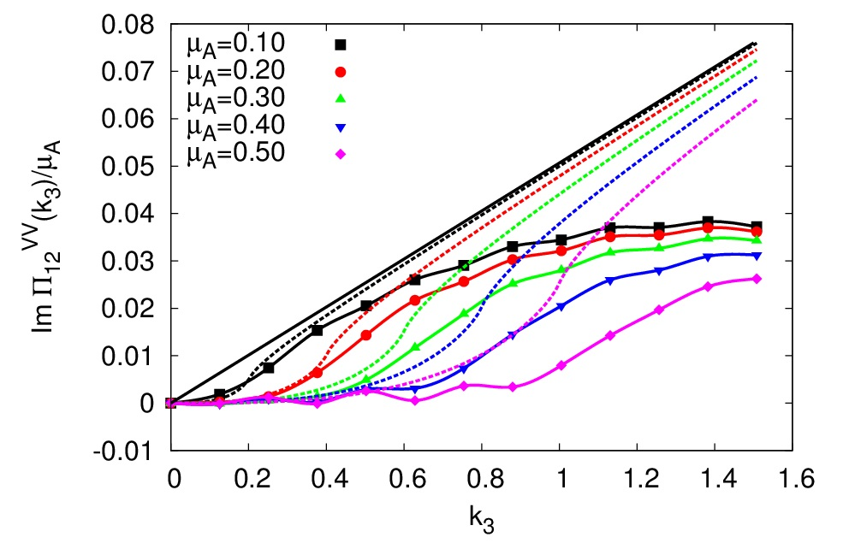
Equilibrium vs non-equilibrium CME
Static CME conductivity with overlap fermions
(Linear response approximation)

Slide 16
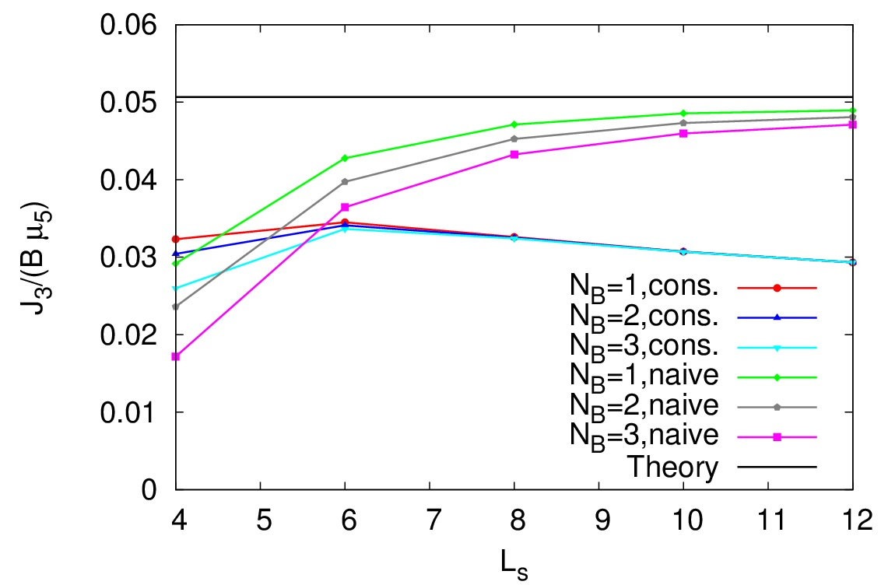
Equilibrium vs non-equilibrium CME
Static CME conductivity with overlap fermions
(Constant magnetic field, LLL dominated)

Slide 17
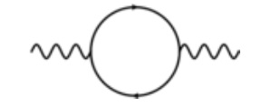
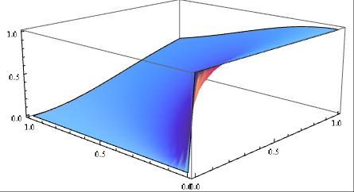
Dimensional reduction: 2D axial anomaly
Polarization tensor in 2D:
Proper regularization (vector current conserved):
[Chen,hep-th/9902199]
Final answer:
Value at k₀=0, k₃=0: NOT DEFINED
(without IR regulator)
First k₃ → 0, then k₀ → 0
Otherwise zero

Slide 18
Decay of axial charge and inverse cascade [PB, Ulybyshev 1509.02076]
Excited initial
state with
chiral imbalance
μ_{A} < 1 on the lattice
To reach k < μ_{A}/(2 π²):
200x20x20 lattices
Translational invariance in 2 out of 3 dimensions
To detect instability and inverse cascade:
Initially n modes of EM fields with equal energies and random linear polarizations
Hamiltonian is
CP-symmetric,
State is not!!!
[No momentum separation]

Slide 19
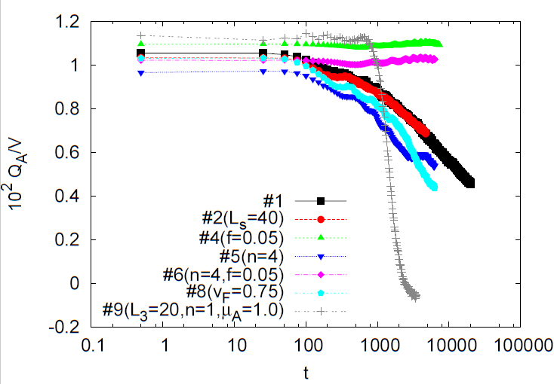
Axial charge decay
200 x 20 x 20 lattice, μ_{A}= 0.75
Note the amplitude dependence

Slide 20
Axial charge decay
200 x 20 x 20 lattice, μ_{A}= 1.5

Slide 21
Universal late-time scaling
Q_{A} ~ t^{-1/2}

Slide 22
Is axial charge homogeneous?
… yes, deviations only ~ 20% at late times

Slide 23
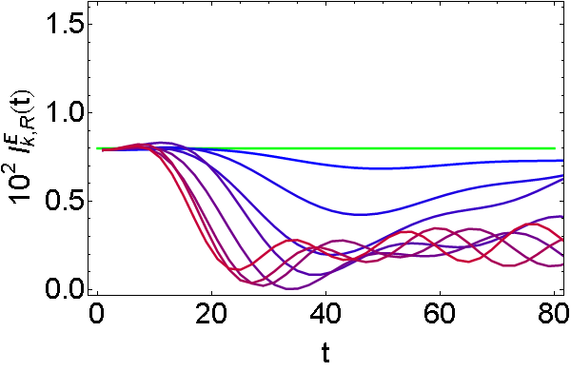
Power spectrum and inverse cascade
Fourier transform
the fields
Basis of helical
components
Smearing the
short-scale fluctuations

Slide 24
Power spectrum and inverse cascade
(L) Magnetic (R)
Electric
Small amplitude, Q_{A} ~ const

Slide 25
Power spectrum and inverse cascade
(L) Magnetic (R)
Electric
Large amplitude, Q_{A} decays

Slide 26
Power spectrum and inverse cascade
(L) Magnetic (R)
Electric
Large amplitude, large μ_{A}, Q_{A} decays

Slide 27
Power spectrum and inverse cascade
(L) Magnetic (R)
Electric
Smaller v_{F}, Q_{A} decays

Slide 28
Inverse cascade: correllation lengths
Average wavelength
of electric
or magnetic fields
Electric
Magnetic

Slide 29
Inverse cascade: summary
Magnetic VS electric instability!!!

Slide 30
Overall transfer of energy
Amplitude f = 0.2

Slide 31
Overall transfer of energy
Amplitude f = 0.05

Slide 32
Chiral instability: discussion and outlook
Axial charge decays with time
(nature doesn’t like fermion chirality)
Large-scale helical EM fields
Short EM waves decay
Non-linear mechanism!
Outlook
Role of inexact chiral symmetry?
Overlap fermions in CSFT?
Non-Abelian gauge fields
Quantum fluctuations in gauge sector

Slide 33
Back-up

Slide 34
Anomalous transport: why numerics?
The formula is a small iceberg tip
General relation (linear response):
CME
Π_{A}(k,w) related to anomaly only if:
Asymptotic values of k, w
Chiral symmetry unbroken [PB,1312.1843]
No dynamical photons
Notes:
Here we turn the picture upside down…

Slide 35
NMR in diagrammatic language
NMR response captured by box diagram
(similar to light-by-light scattering)
Dominant contribution from “pion” channel

Slide 36
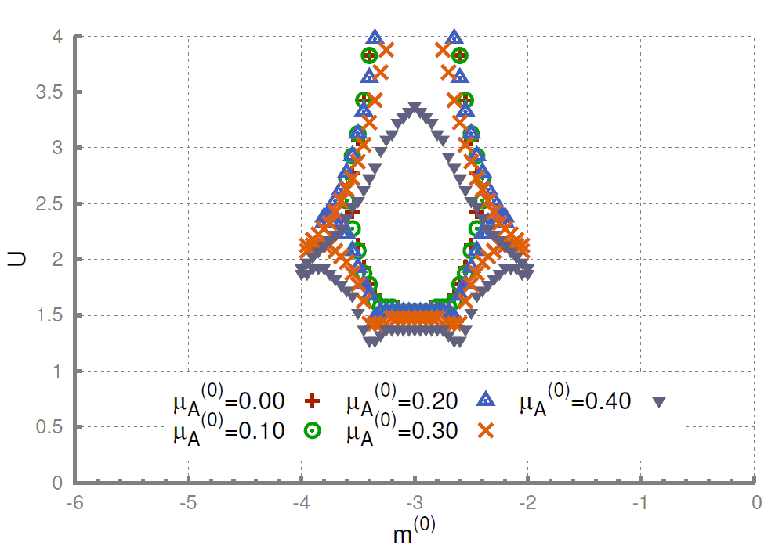
Effect of interactions in CME and NMR
Condensed matter setup
EM fields are dynamical
Short-range four-fermion interactions
Chiral symmetry is not exact
Mean-field study with Wilson fermions
(aka two-band Dirac semimetal)
[PB, Puhr,
Valgushev
1505.04582]
AI
“Aoki fingers”
TI
OI
TI

Slide 37
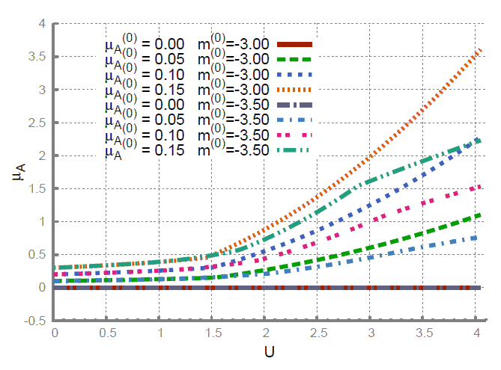
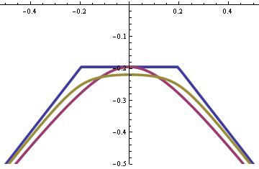
Enhancement of chiral chemical potential
The effect of μ_{A}
is similar to mass!!!
Mean-field value of chiral chemical potential is strongly enhanced by interactions in all phases
Outlook: real-time calculations with E and B?

Slide 38
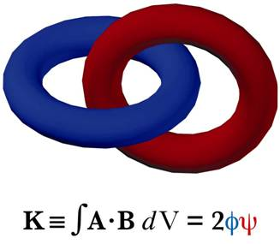
Chiral plasma instability
μ_{A}, Q_{A}- not “canonical” charge/chemical potential
“Conserved” charge:
Chern-Simons term
(Magnetic helicity)
Integral gauge invariant
(without boundaries)
Notes:
TODO: this slide should be removed

Slide 39
Classical statistical field theory
Good if classical gauge fields much larger
than quantum fluctuations (high occupation)
Fermions are exactly quantum!
Systematic derivation using Keldysh technique
Approximation validity wider than kinetic theory
First nontrivial order of expansion in ђ
Subtle issue: renormalizability of CSFT
Fermion dynamics requires extensive parallelization (up to 100 Gb RAM to store fermionic modes)

Slide 40
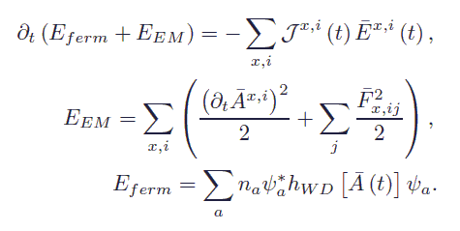
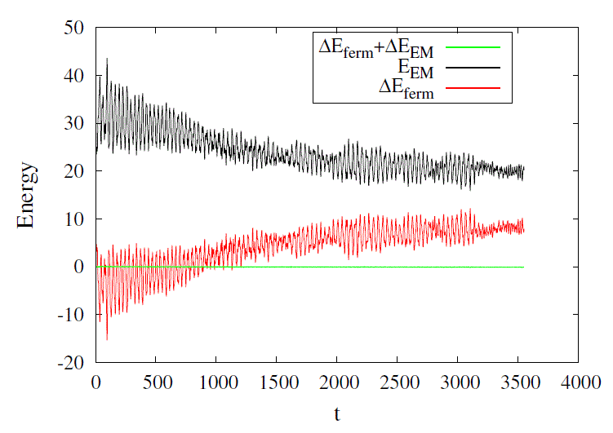
Conservation of energy
Slightly violated
for discrete evolution,
In practice negligible

