Slide 1
Oleocanthal: Discovery and Potential
Catherine Peyrot des Gachons and
Gary K. Beauchamp
Monell Chemical Senses Center
July 4, 2016

Slide 2
The Senses
Vision
Hearing
Touch
Smell
Taste

Slide 3
The Senses: Impact of Loss
Vision
Hearing
Touch
Smell
Taste

Slide 4
The Senses: Health Impact
Vision
Hearing
Touch
Smell
Taste

Slide 5
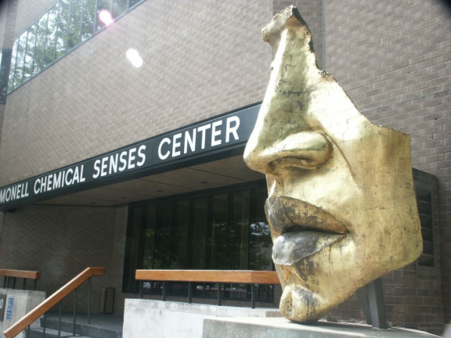
Monell Chemical Senses Center is an independent non-profit research institute founded in 1968, based in Philadelphia, USA.
Its mission is to advance scientific understanding of the mechanisms and functions of taste and smell.

Slide 6
Galen on Taste Function
Galen thought that the safest way to identify drugs was by tasting:
“Taste differentiates most [pecularities (sic)] of drugs whereas the sense of smell confirms poorly, as one says.”
R. E. Siegel, Galen On sense Perception, Karger: Basel, Switzerland, 1970.
Notes:
Galen was the leading physician of the Roman empire during the last half of the second century. Unlike some of his predecessors, Galen concluded that the brain controlled cognition and willed action. The initial evidence for this doctrine was that the brain was the site of termination of all of the five senses: touch, taste, smell, sight, and hearing. Galen presumed that the information from these five senses was organized by a part of the brain that generated a concept of an object common to all senses; this part of the brain he considered to be the area of common sense.

Slide 7
Brazil: Can organoleptic properties explain differential use of medicinal plants?
“The “taste” and smell of a plant can influence its differential medicinal use”
Medeiros e. al., J. Ethnopharmacology, 2015

Slide 8
Mexico: Organoleptic properties as selection properties for medicinal plants
Indigenous healers: “every plant is a potential medicine.” “Taste” helps to identify
Leonti et al., J. Ethnopharmacology, 2002

Slide 9
India: Concept of Rasa (“taste”)
in Ayurveda
Taste (Rasa):
Bitter
Astringent
Pungent
Sour
Salty
Sweet
“Taste assessment may be a preliminary step in the screening process of an unknown plant in Ayurvedic pharmacology”
Gilea & Barbulescu, J. Ethnopharmacology, 2015
Notes:
Ayurvedic medicine -- also known as Ayurveda -- is one of the world's oldest holistic (whole-body) healing systems. It was developed thousands of years ago in India

Slide 10
Borneo: Sensory attributes of medicinal plants among the Kenyah Leppo Ke
Describing “taste” properties of medicinal plants:
Bitter
Astringent
“Sanit,” piquant, spicy, burning or stinging
Sour, tart
Sweet
Salty or potent, strong
Irritating, burning, itchy
“Jeleme,” umami, msg
“Many native systems utilize organoleptic indicators for assembling their pharmacopoeia, favoring certain sensory cues”
Gollin, J. Ethnobiology, 2004
Notes:
And across Indonesia

Slide 11
Summary
The “taste” of a plant assists in identifying medicinal use in many cultures.
By taste most cultures include taste (in the strict sense) and irritation (chemesthesis) in its definition

Slide 12
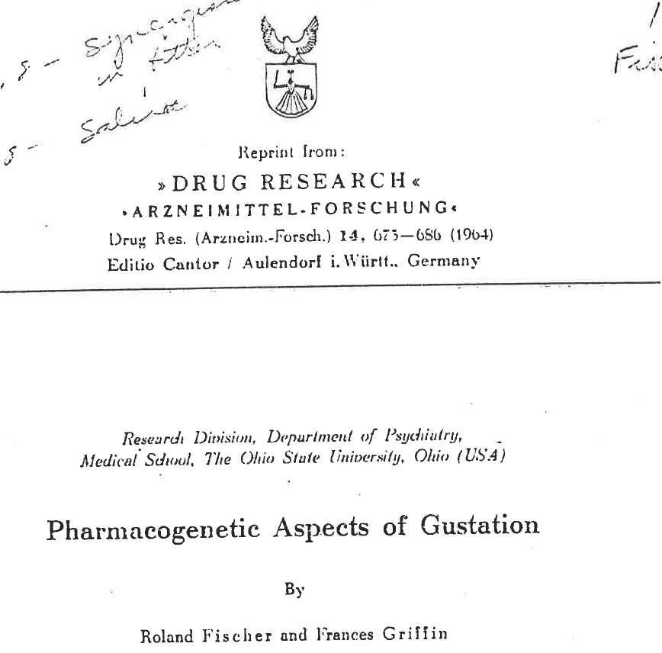
“Gustatory Pharmacology”

Slide 13
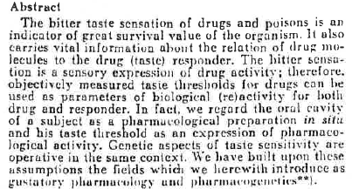
Fischer & Griffin, 1964

Slide 14
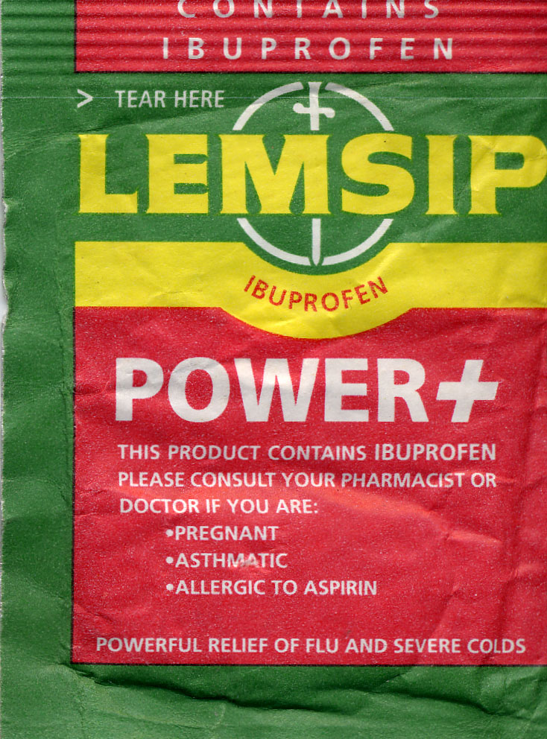

Slide 15
Ibuprofen
A widely used anti-inflammatory drug – blocks COX-1 and COX-2
Relieves pain
In some ways mimics aspirin without many of the side effects
Long-term consumption has been reported to reduce the risk of heart disease and some forms of cancer and to delay the onset of Alzheimer’s disease
“Tastes bad”

Slide 16
Ibuprofen sensations
Ibupofen
Ibuprofen: Strong Throat Irritation
24
Mouth Irritation
21
Ibupofen
+ NaBicarb
18
Mod
15
12
9
6
Weak
3
24
Barely Detect
21
Throat Irritation
18
Mod
15
12
Intensity (GeoM)
9
6
Weak
3
24
Barely Detect
21
Taste
18
Mod
15
12
9
6
Weak
3
0
Barely Detect
0
5
10
15
20
Time (min)
Breslin, Gingrich & Green, Chem Senses, 2001

Slide 17
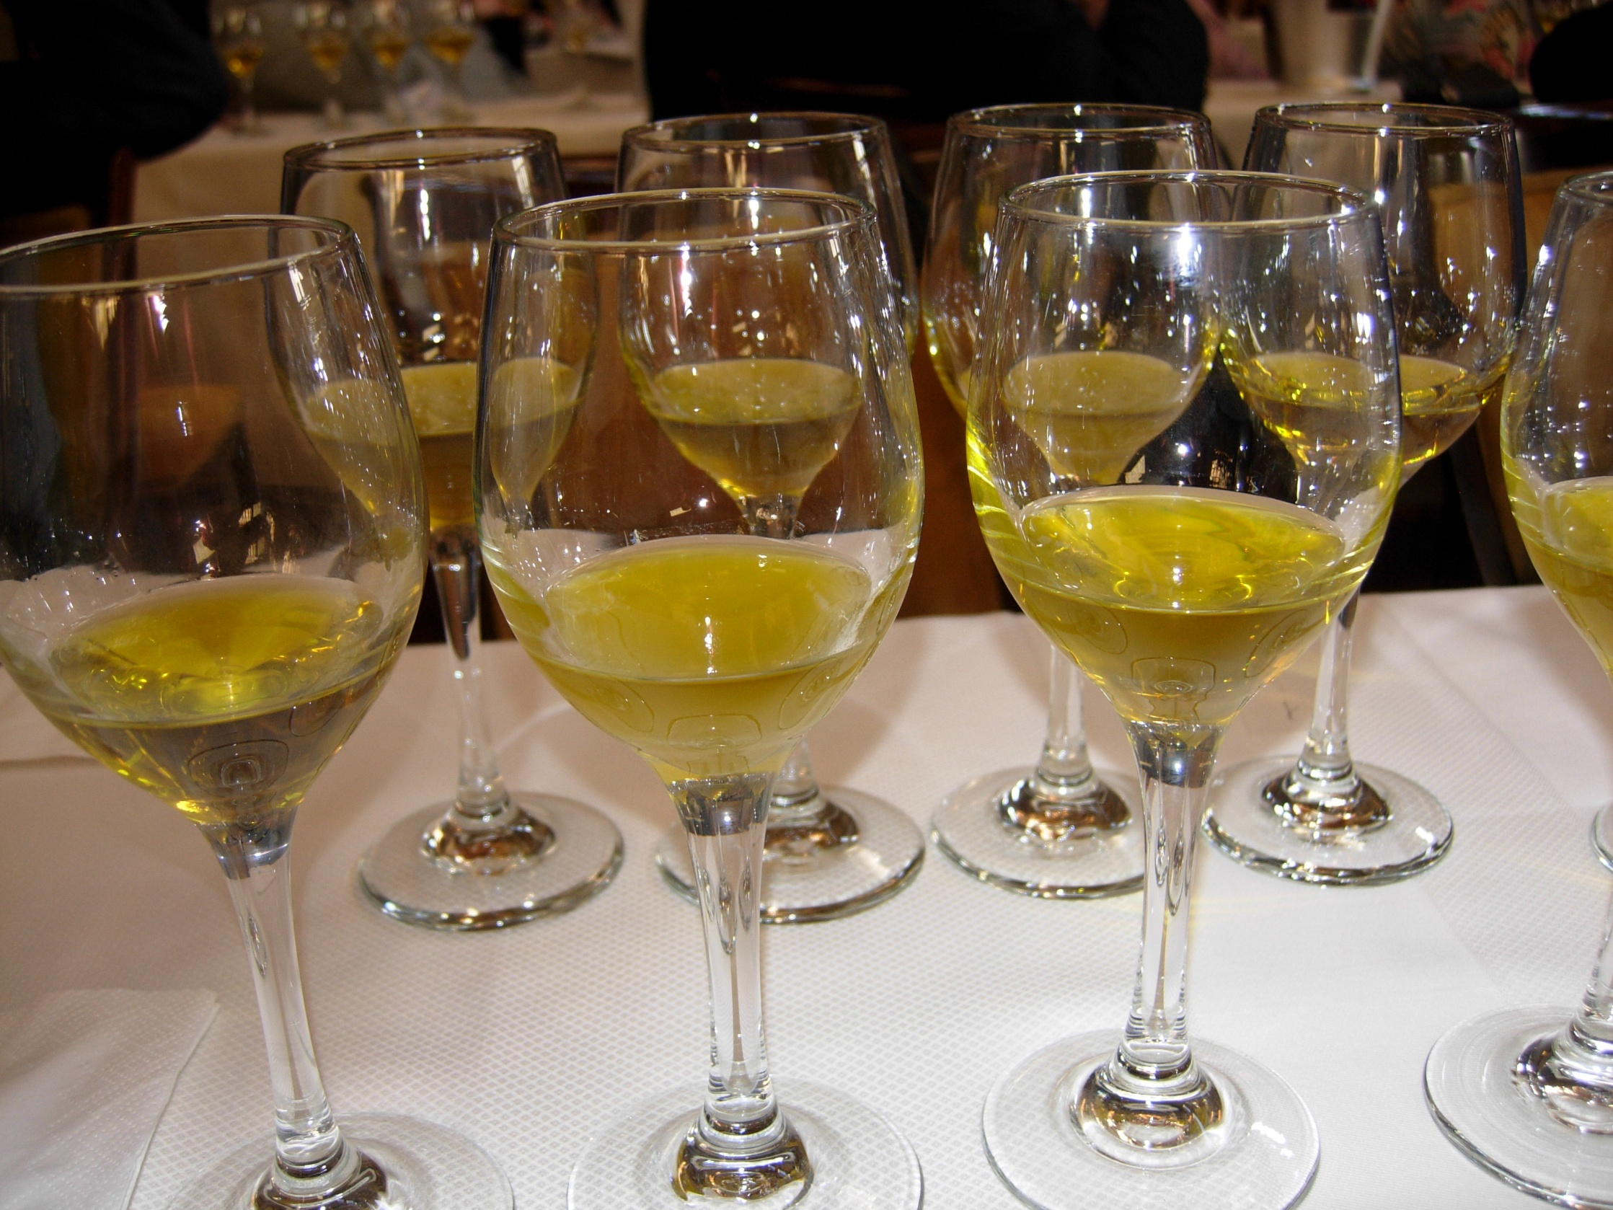
Molecular Gastronomy: Erice, Sicily, 1999

Slide 18
Sensory attributes may predict physiological activity
Fisher & Griffin (1964): The oral cavity is a pharmacological preparation in situ.
Health benefits of mediterranean diet include:
Reduced incidence of some forms of cancer
Reduced incidence of neurodegenerative diseases such as Alzheimers
Reduced incidence of heart disease
Is the throat irritating property in extra virgin olive oil, like ibuprofen, an anti-inflammatory?

Slide 19
Isolation of throat-localized pungency in
extra virgin olive oil
Beauchamp et al., Nature: 2005

Slide 20
Throat stinging compound:
(-)-decarbomethoxy-dialdehydic ligstroside aglycone
Oleocanthal
(oleo = olive; canth = sting; al = aldehyde)
Montedoro et al., J Ag Food Chem: 1992.
Andrewes et al., J Ag Food Chem: 2003. Beauchamp et al., Nature: 2005

Slide 21
Oleocanthal: 13 step synthetic scheme
(+)- and (-) Oleocanthal
Smith et al, 2005

Slide 22
COX-1 and COX-2 inhibition test
Oleocanthal inhibits the cyclooxygenases (Cox 1 and Cox 2) thereby reducing inflammation (data not shown)
Confirming phamarcological similarities between OC and Ibuprofen
Beauchamp et al., Nature: 2005

Slide 23
Is this similar pharyngeal irritation mediated by the same receptor?
And if yes, which one?
Peyrot des Gachons, et al.(2011). Journal of neuroscience, 31(3), 999-1009.

Slide 24
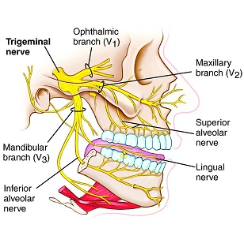
Pungency is mediated by activation of nociceptors on the trigeminal nerve fibers
Notes:
Cell bodies of the nerves in the ganglions.

Slide 25
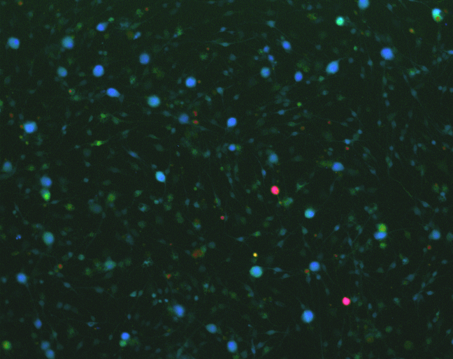
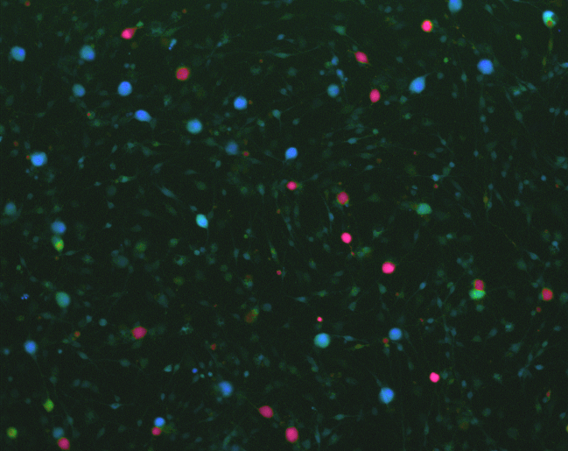
Calcium imaging on cultured rodent trigeminal neurons (neural activity in vitro model)
stimulus
Comparison with other stimuli
Use of specific receptor blockers
Fluorescence ratio (340/380)
Peyrot des Gachons, et al.(2011)
Notes:
Fura 2 is a fluorescent dye which binds to free intracellular calcium.
Fura-2 is excited at 340 nm and 380 nm of light, and the ratio of the emissions at those wavelengths is directly correlated to the amount of intracellular calcium.
Intensity of fluorescence plotted versus excitation wavelength for different calcium concentrations.
Via fura-2 the intracellular calcium concentration can be displayed by using ratio values 340/380.

Slide 26
Oleocanthal activation in rodent TG neurons
AITC sensory receptor: TRPA1
Notes:
Figure 1. Oleocanthal excites trigeminal neurons through TRPA1 channel activation. a, OC (5uM) evokes calcium influx into cultured rat trigeminal neurons as assessed by fura-2 ratiometric imaging (F340/F380). In a, the representative trace of one neuron shows that cells sensitive to OC are also activated by AITC (50uM). The horizontal bars indicate the duration of compound application. The 40 mM KCl solutions were applied as a control for neuronal activity. b, Dose–response curve for OC-evoked responses in rat trigeminal neurons. The curve was generated by averaging the peak amplitude of the responses (fura-2 ratio) of all the OC-sensitive cells (n 18 /data points). OC chemical structure is indicated on the graph. c, Sensitivity to OC (5 uM) is correlated to sensitivity to AITC (50 uM) in trigeminal neurons (n 40 per experiment). d, Rodent trigeminal neurons deprived of functioning TRPA1 are unresponsive to OC. HC-030031 (HC) (20uM) inhibited 5 uM OC-evoked rat trigeminal neuron activation (examined cells, n191) (left) and neurons from TRPA1/mice (n187, from 5 mice) are not excited by OC (right). *p0.05 versus control [vehicle for left panel; wild-type (WT) for right panel], t test. Error bars indicate SEM.

Slide 27
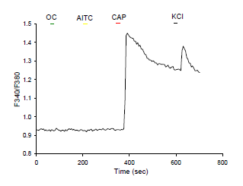
Oleocanthal activation in cultured cell lines expressing human TRPA1 channels
Use of genetically modified mice:
TRPA1 knockout mice (=non functional TRPA1)
Notes:
Figure 1. d, Rodent trigeminal neurons deprived of functioning TRPA1 are unresponsive to OC. HC-030031 (HC) (20uM) inhibited 5 uM OC-evoked rat trigeminal neuron activation (examined cells, n191) (left) and neurons from TRPA1/mice (n187, from 5 mice) are not excited by OC (right). *p0.05 versus control [vehicle for left panel; wild-type (WT) for right panel], t test. Error bars indicate SEM.

Slide 28
Ibuprofen activation in TG neurons and cells expressing human TRPA1 channel
Oleocanthal and ibuprofen exclusively activate the sensory receptor TRPA1
Notes:
Figure 3/4. (a) IBU (10 mM) evokes calcium influx into cultured rat trigeminal neurons as assessed by Fura-2 ratiometric imaging (F340/F380). In panel a, the representative trace of one neuron shows that cells sensitive to IBU are also activated by OC (5 mM) and AITC (50 mM). Horizontal bars indicate the duration of compound application. 40 mM KCl solutions were applied as a control for neuronal activity. Ibuprofen exclusively activates TRPA1 in HEK-293 cells expressing human TRP channels. (a) IBU activates hTRPA1-expressing HEK293 cells. Representative whole-cell current trace activated by IBU (10 mM) and AITC (100 mM) in the presence of extracellular Ca2+.Vh = -60 mV. (b) HEK293 cells expressing hTRPV1, hTRPV2 and hTRPV4 are not excited by IBU. 10mM IBU does not evoke calcium influx into hTRPV1 (n=95), 2 (n=82) and 4 (n=38) as assessed by Fura-2 ratiometric imaging (F340/F380). The channel specific ligands, capsaicin, lysophosphatidylcholine (LPC) and GSK1016790A were applied as controls for activity in HEK cells expressing TRPV1, TRPV2 and TRPV4 respectively. Curves in panel b were generated using mean values of peak amplitude.

Slide 29
TRP proteins play critical roles
in sensory physiology
Transient receptor potential (TRP) channel family play critical roles in the responses to all major classes of external stimuli: chemicals, light, temperature, and touch.
TRP channels are subject to extensive modulation and regulation
Notes:
TRP channels are subject to extensive modulation and regulation

Slide 30
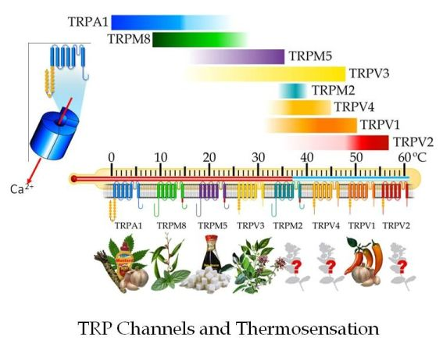
Other TRPA1 agonists display different sensory profile than OC/Ibu (irritate whole oral cavity)
Notes:
Many TRP channels are activated by a variety of different stimuli: TRPV1, for example, responds to stimuli ranging from physical heat to botanical compounds, protons and proinflammatory agents, … involving TRPV1 in many functions such as heat and pain detection or hyperalgesia after injury or inflammation.

Slide 31
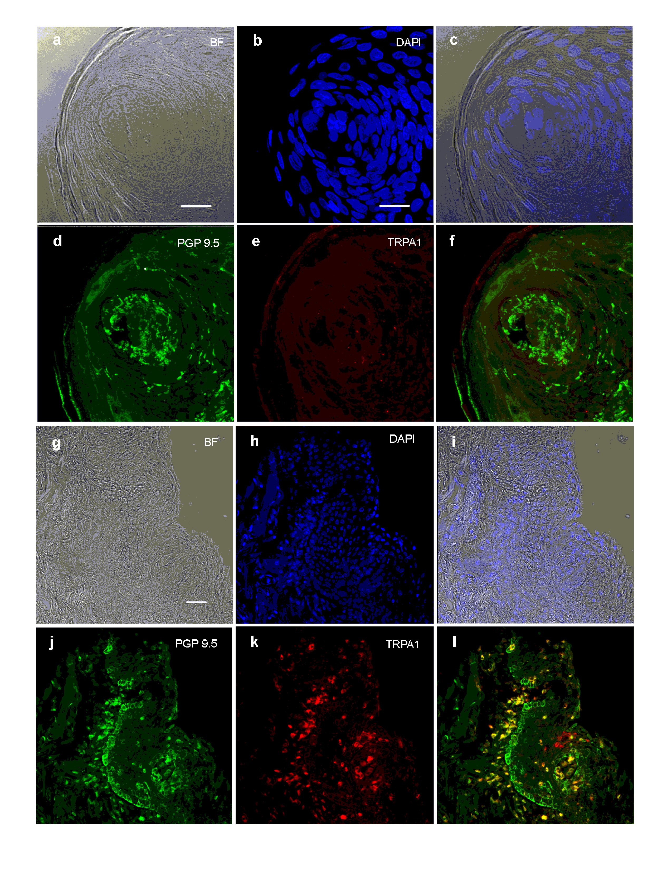
Immunohistochemical TRPA1 analyses
of human oral tissues
ANTERIOR TONGUE
THROAT TISSUE
Notes:
Figure 6: TRPA1 is expressed in a subset of nerve fibers in pharyngeal epithelium, but not in nerve fibers of taste buds within fungiform papillae. Histochemistry and immunohistochemistry of (a-f) human fungiform papilla containing a taste bud and (g-l) upper pharyngeal epithelium. Panels a and g show the bright field view of the tissue samples, panels b and h show the DNA stain DAPI (blue) to reveal the nuclei, panels c and i are the overlay of bright field and DAPI to reveal tissue structure, panels d and j show the neuronal marker protein PGP9.5 (green), panels e and k show the TRPA1 receptor (red), and panels f and l show the overlay of PGP9.5 and TRPA1; yellow depicts the superposition of TRPA1 reactivity (red) and neuronal PGP9.5 reactivity (green). 8 to 10 slides were examined for the pharyngeal tissue (from 1 subject) and the fungiform papilla tissue (from 4 subjects). Scale bars: 20 mM (a-f) and 40 mM (g-l).

Slide 32
Immunohistochemical TRPA1 analyses
of human lingual and nasal tissues

Slide 33
In humans, TRPA1 is richly expressed in nerve fibers in the pharyngeal and nasal epithelia but not in fibers innervating anterior tongue, including taste buds.
Overlap between expression pattern of TRPA1 and OC irritation location which suggests that this channel mediates the upper airway tissue sensitivity to OC.
The TRPA1 agonists, which irritate the anterior tongue in humans, may do so via:
Activation of additional ion channels
tissue specific expression of TRPA1 variant or heteromers, that does not react with our human TRPA1 antibody
Notes:
33
And would not be activated by OC
Existence of TRPA1/TRPV1 heteromers.

Slide 34
Conclusion
The differences observed in perceptual profiles are indicators of differences in sensory receptor expression.

Slide 35
Importance of TRP channels in health
Cellular sensors involved in: pain sensation, taste perception, thermosensation, mechano and osmolarity sensing
Important in normal physiology: involved in signal transmission
Implicated in various disease states
Notes:
TRP channels are cellular sensors involved in nociception (Patapoutian et al., 2009), taste perception (Nilius and Appendino, 2013), thermosensation (Tominaga, 2007), mechano- and osmolarity sensing (Pedersen and Nilius, 2007; Guilak et al., 2010). TRP channels also play a crucial role in normal physiological processes such as signal transmission (Minke, 2010; Wu et al., 2010). Dysfunction of TRP channels has been implicated in various disease states (summarized in Figure 2) ranging from chronic pain and overactive bladder (TRPV1) through obesity (TRPV4 and TRPM5), diabetes (TRPV1, TRPM4), chronic cough (TRPA1, TRPV1), and chronic obstructive pulmonary disease (COPD; TRPV4) to cardiac hypertrophy (TRPC6), familial Alzheimer’s disease (TRPM7), dermatological disorders (TRPV3 in Olmsted syndrome) and cancer (TRPC6, TRPV2 and

Slide 36
Importance of TRPA1 channel in health
TRPA1 is central to the mediation of pain sensation, vascular dilation, airway disease, itch and inflammation.
TRPA1 is primarily expressed in sensory neurons, but also present in non-neuronal tissues such as heart, small intestine, lung and pancreas.
“Because TRPA1 mediates neuropathic pain, and [those] other functions, it has the potential to be an excellent drug target.”*
*Kozai et al., Current Neuropharmacology 13, 2015
Notes:
TRP channels are cellular sensors involved in nociception (Patapoutian et al., 2009), taste perception (Nilius and Appendino, 2013), thermosensation (Tominaga, 2007), mechano- and osmolarity sensing (Pedersen and Nilius, 2007; Guilak et al., 2010). TRP channels also play a crucial role in normal physiological processes such as signal transmission (Minke, 2010; Wu et al., 2010). Dysfunction of TRP channels has been implicated in various disease states (summarized in Figure 2) ranging from chronic pain and overactive bladder (TRPV1) through obesity (TRPV4 and TRPM5), diabetes (TRPV1, TRPM4), chronic cough (TRPA1, TRPV1), and chronic obstructive pulmonary disease (COPD; TRPV4) to cardiac hypertrophy (TRPC6), familial Alzheimer’s disease (TRPM7), dermatological disorders (TRPV3 in Olmsted syndrome) and cancer (TRPC6, TRPV2 and

Slide 37
Few antagonists are currently tested in clinical trials for pain control.
Animal studies suggest that the therapeutic value of TRPA1 antagonists extends beyond pain, to severe itching, asthma and cough.
Inhibition of TRPA1 seems the most logical approach for drug development, nevertheless several studies have shown that certain activators, including acetaminophen metabolites, display anti-nociceptive properties via activation of TRPA1, or via desensitization of the receptor.

Slide 38
Relationship between sensory response and pharmacological activity

Slide 39
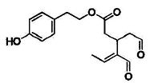
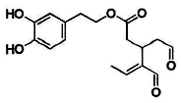
Two compounds of interest in EVOO
Oleocanthal
Oleacein

Slide 40
Both oleocanthal and oleacein are
anti-inflammatory
Peyrot des Gachons et al., unpublished

Slide 41
Both oleocanthal and oleacein elicit
trigeminal neuron activity
Peyrot des Gachons et al., unpublished

Slide 42
Oleacein does not seem to elicit strong
human throat irritation
Control Oleacein Oleocanthal
Peyrot des Gachons et al., unpublished

Slide 43
Oleacein apparently does not elicit
human throat irritation
Control Oleacein Oleocanthal
Why?
Does it highlight in vivo differences
in TRPA1 access?

Slide 44
Future Research
TRPA1 channels are molecular sentinels of cellular stress, tissue damage and potentially harmful compounds (such as many pollutants).
The peculiar sensory profile of Oleocanthal (pharyngeal pungency and weak cough elicitor) seem particularly adapted to the study of TRA1 involvement in asthma, cough and other respiratory disease.
TRPA1 activation should also be studied when considering OC and EVOO health benefits.

Slide 45
Scientific Collaborators
Gary K. Beauchamp
Paul A. S. Breslin
Maureen O’Leary
Amos B. Smith III
Bruce Bryant
Jeffrey B. Sperry
Russell Keast
Diane Morel
Jianming Lin
Jana Pika
Makoto Tominaga
Asako Shima
Quiang Han
Chi-Ho Lee
Current Collaborators
Past Collaborators

Slide 46

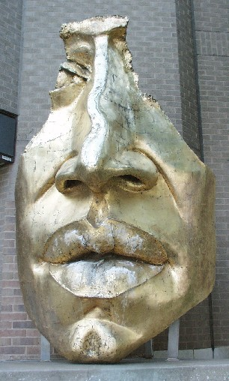



Monell Chemical Senses Center
www.monell.org
MonellCenter
@MonellSc

