Slide 1
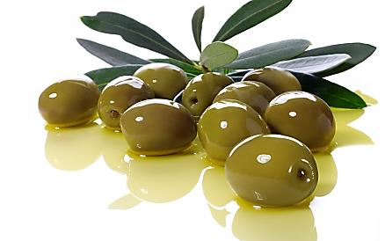
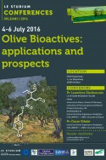
NEW DRUGS FROM OLD FOODS: OLEOCANTHAL
AS POTENTIAL PHARMACOLOGICAL TOOL
FOR BONE AND CARTILAGE DISEASES
Oreste GUALILLO, PharmD, PhD
Orleans (France)
July 4th- July 6th

Slide 2
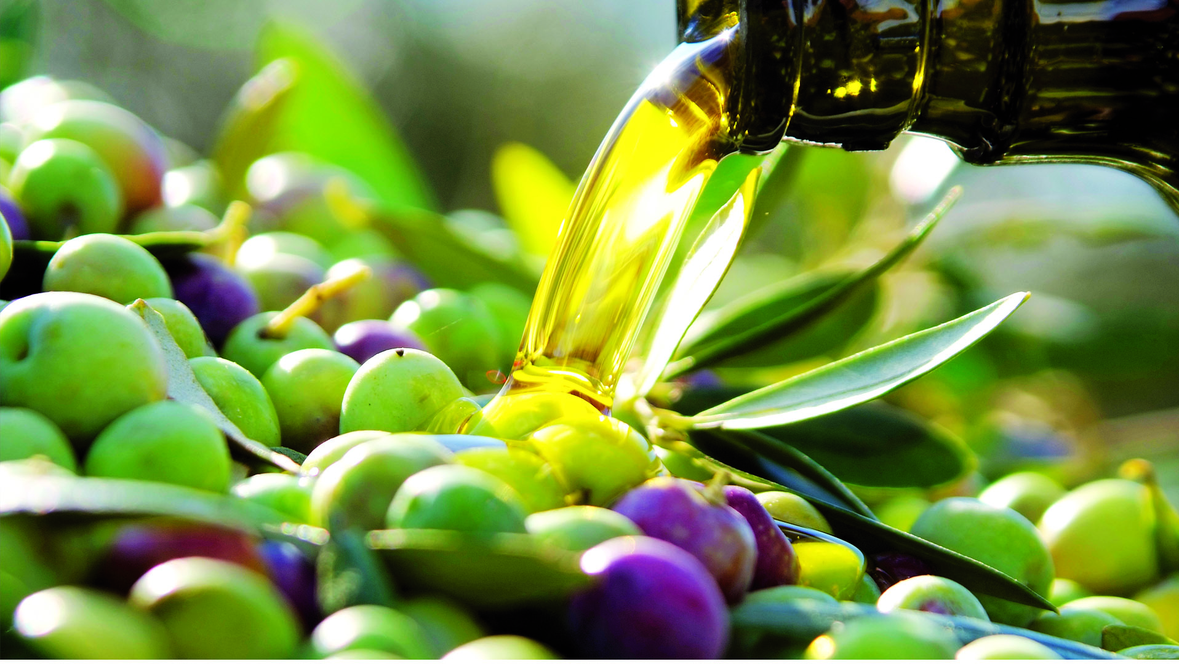
Extra-virgin olive oil, a principal component of the Mediterranean diet, is one of the most ancient known foods and has long been associated with health benefits.
EXTRA-VIRGIN OLIVE OIL
MEDITERRANEAN DIET

Slide 3
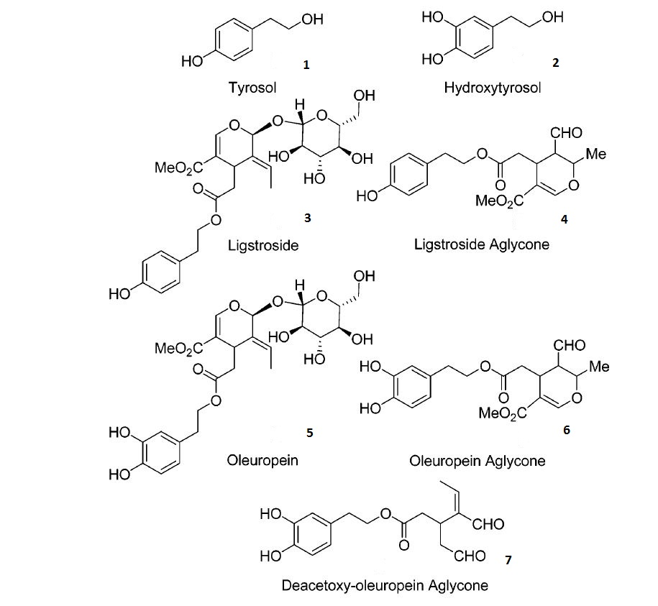
Phenolic compounds of extra-virgin olive oil show a wide spectrum of bioactive properties, including antioxidant and anti-inflammatory effects

Slide 4
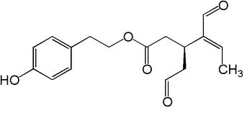
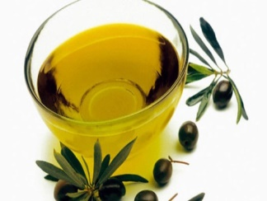
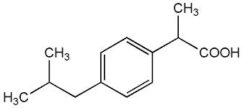
Chemical Structures. (a) The structure of oleocanthal (OC) compared with that of ibuprofen and (b) chemical structure of the OC pharmacophore.
”Throat burn”
OLEOCANTHAL
(oleo-for olive, canth-for sting, and –al for aldehyde)
IBUPROFEN
TRPA1
The NEIRID Lab ©: Drug Discovery Today, Volume 20, Issue 4, 2015, 406–410
Figure 1 B

Slide 5
Summary of the pharmacological effects of oleocanthal (OC)
The NEIRID Lab ©: Drug Discovery Today, Volume 20, Issue 4, 2015, 406–410

Slide 6
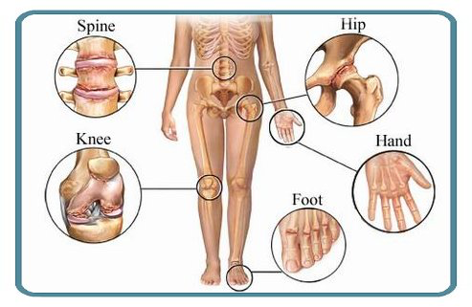
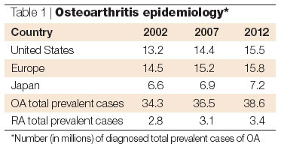
The NEIRID Lab © 2015

Slide 7
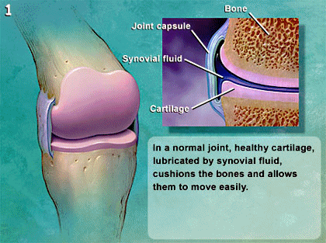
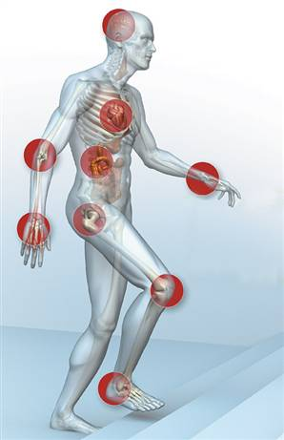
The NEIRID Lab ©

Slide 8
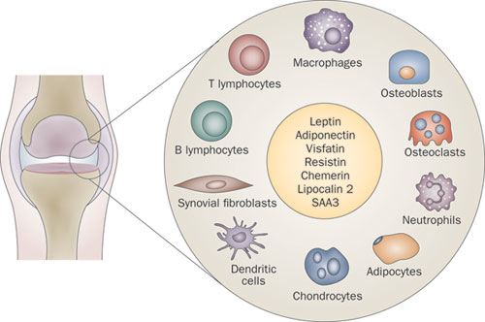
Potential cellular targets of Oleocanthal in Joint Degenerative, Autoimmune and Inflammatory Diseases.
OLEOCANTHAL
The NEIRID Lab ©

Slide 9
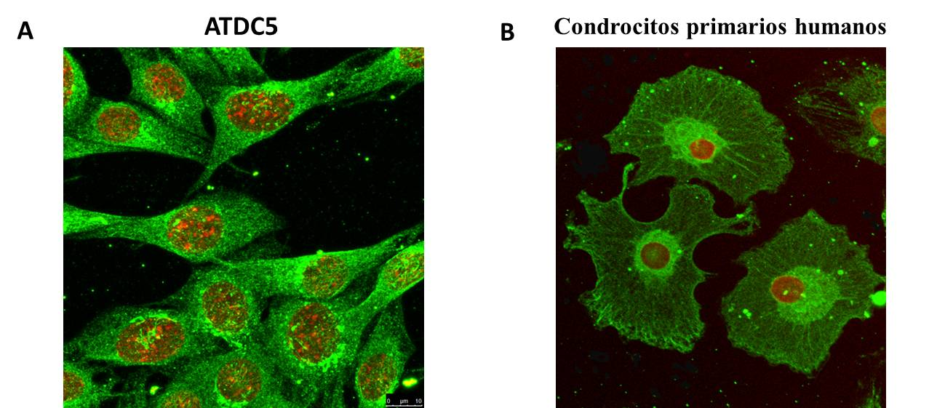
ATDC5 chondrocytes Human OA primary chondrocytes
The NEIRID Lab ©

Slide 10
WHAT ABOUT OLEOCANTHAL IN CARTILAGE?
Cartilage
MATRIX
CHONDROCYTES
The NEIRID Lab ©

Slide 11
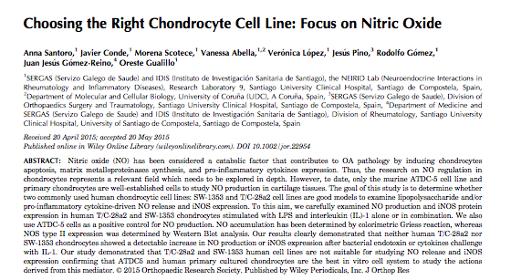
ATDC5 CHONDROCYTES AND HUMAN PRIMARY CHONDOCYTES ARE THE
BEST IN VITRO SYSTEM TO STUDY INFLAMMATORY MEDIATORS
The NEIRID Lab © J Orthop Res. 2015 Dec;33(12):1784-8.

Slide 12
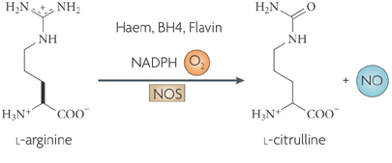
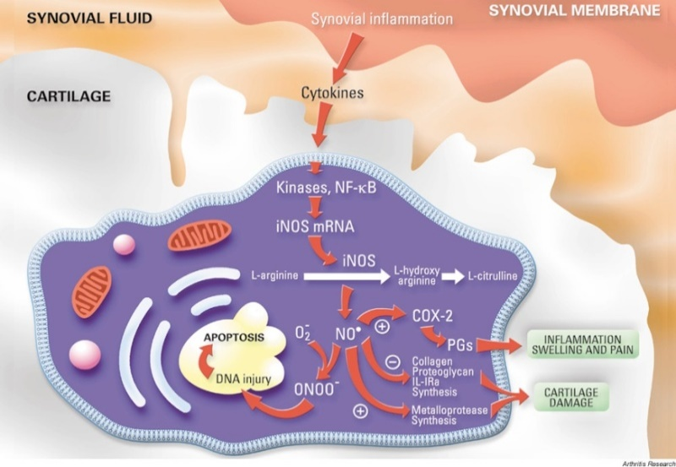
Nitric Oxide

Slide 13
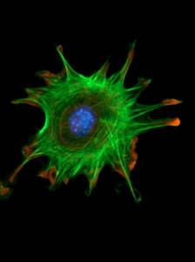
WHAT IS THE EFFECT OF NITRIC OXIDE
IN CHONDROCYTES?
CYTOKINES
ADIPOKINES
NITRIC OXIDE
MAP-K
PROTEASES
Erk-1/2 p38
CHONDROCYTE
p53
Caspases
Phenotype Apoptosis Matrix
Loss Degradation
Notes:
Nitric oxide was considerated one of the most important factor implicated in cartilage degeneration. In fact, NO upregulates the synthesis of matrix metalloproteinases contributing to degradation of the extracellular matrix, mediates apoptosis increasing caspases expression and induces chondrocyte phenotype loss via MAP-K.

Slide 14
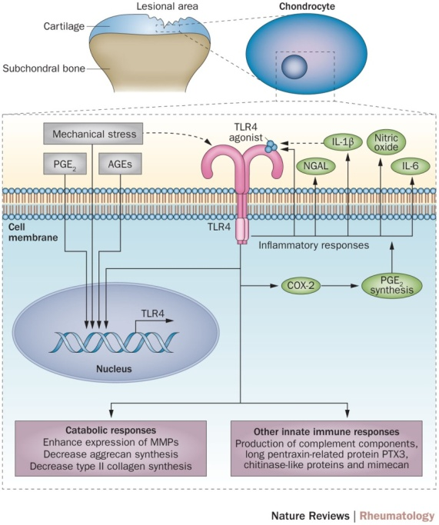
Toll Like Receptors
Nature Reviews Rheumatology 11, 159–170 (2015)
The NEIRID Lab ©

Slide 15
Schematic representation of the experimental method
RNA extraction:
RT-PCR
PROTEIN extraction:
Western Blot
Supernatants:
ELISA
Nitrite assay
Pre-treatment
with Oleocanthal
Treatment
with LPS
Seeding
Adhesion
Starvation
12 hours
24 hours
DAY 1
3-4 hours
Over night
DAY 2
DAY 3
DAY 4
ATDC5 cells
Human primary chondrocytes (OA)
J774 cells

Slide 16
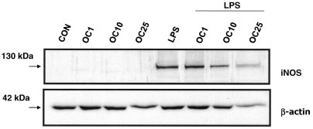
Oleocanthal suppresses NO production and i-NOS protein expression in the LPS-activated ATDC-5 cell line.
ATDC5 cells
24 hours 48 hours
The NEIRID Lab © Arthritis Rheum. 2010 Jun;62(6):1675-82

Slide 17
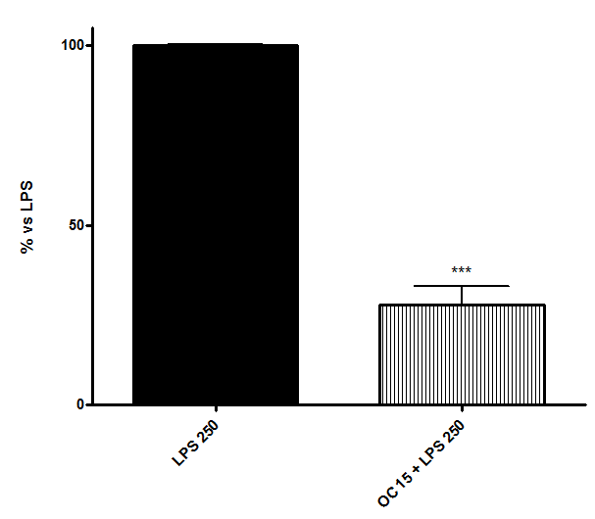
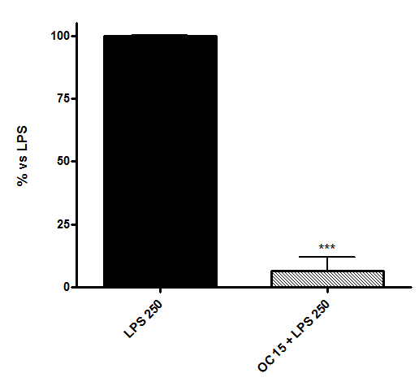
Oleocanthal inhibits MIP-1α and IL-6 mRNA expression in the LPS-activated ATDC-5 cell line
IL-6
MIP-1α
The NEIRID Lab © Life Sci 91(23-24):1229-35

Slide 18
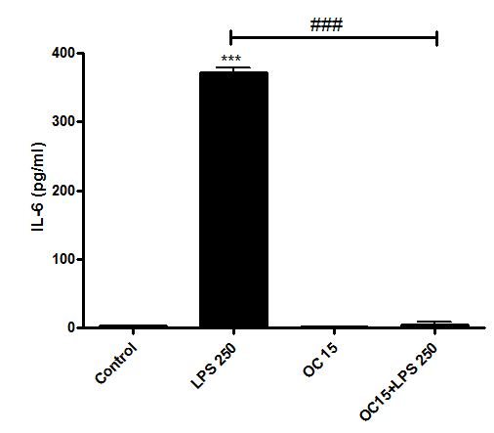
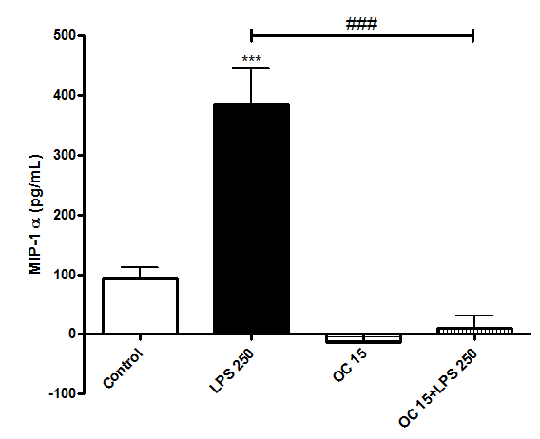
Oleocanthal inhibits MIP-1α and IL-6 protein secretion in the LPS-activated ATDC-5 cell line
The NEIRID Lab © Life Sci 91(23-24):1229-35

Slide 19
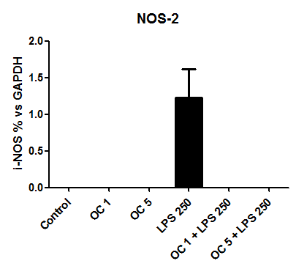
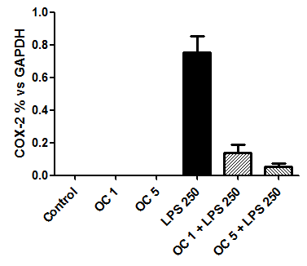
Oleocanthal inhibits i-NOS and COX-2 protein expression in the LPS-activated human primary chondrocytes from OA patients
LPS
LPS
Control
LPS 250
Control
OC 1µM
OC 5µM
LPS 250
OC 1µM
OC 5µM
OC 1µM
OC 5µM
OC 1µM
OC 5µM
130kDa
i-NOS
75kDa
COX-2
36kDa
GAPDH
36kDa
GAPDH
The NEIRID Lab ©

Slide 20
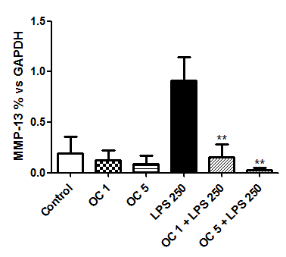
Oleocanthal inhibits MMP-13 protein expression in the LPS-activated human primary chondrocytes from OA patients
LPS
Control
OC 1µM
LPS 250
OC 5µM
OC 1µM
OC 5µM
48kDa
MMP-13
39kDa
GAPDH

Slide 21
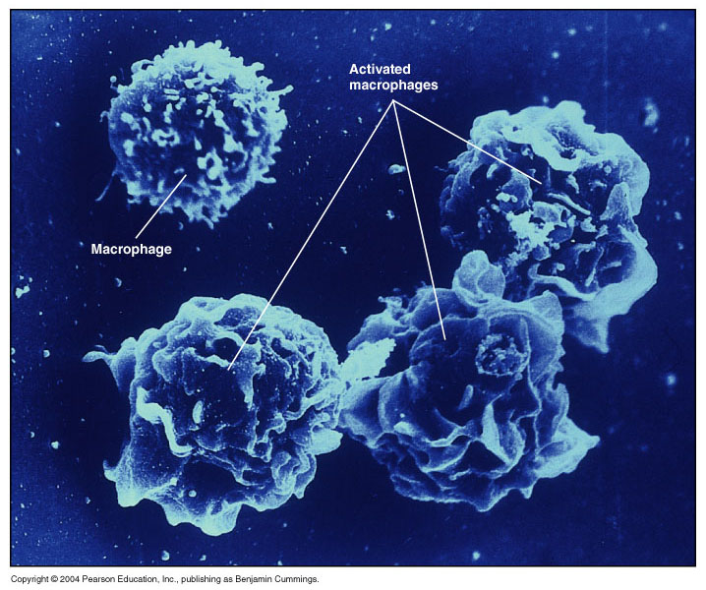
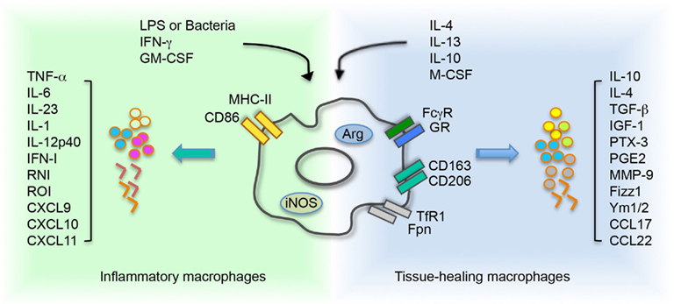
OLEOCANTHAL AND MODULATION OF INNATE IMMUNE RESPONSE

Slide 22
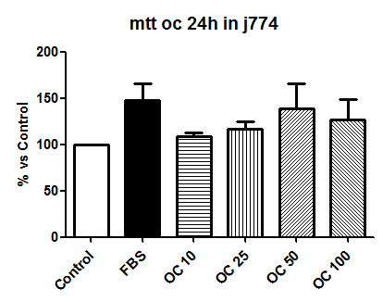
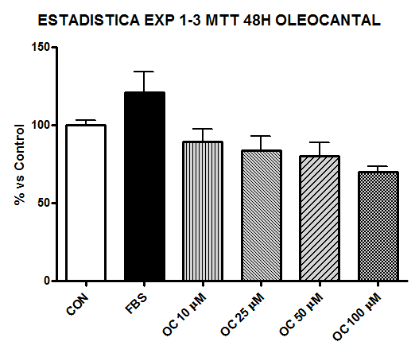
Cytotoxicity of oleocanthal in J774 murine macrophages
48h
24h
The NEIRID Lab © Life Sci 91(23-24):1229-35

Slide 23
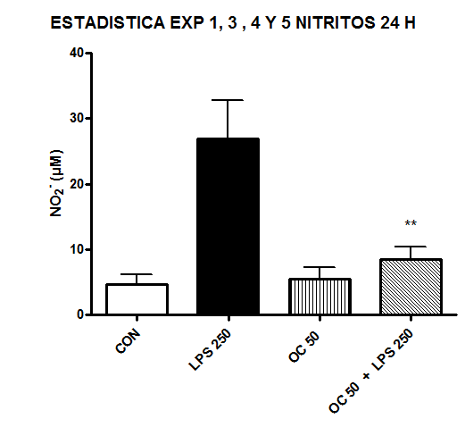
Effect of oleocanthal on NO synthesis in J774 murine macrophages
LPS 250
OC 50 + LPS
Control
OC 50
i-NOS
Β-Actin
The NEIRID Lab © Life Sci 91(23-24):1229-35

Slide 24
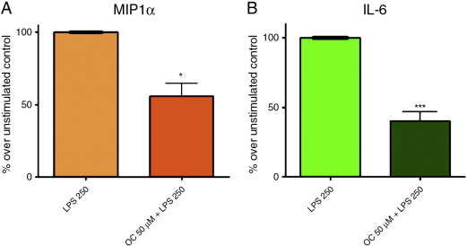
Oleocanthal inhibits IL-6 and MIP-1α mRNA expression in J774 murine macrophages
The NEIRID Lab © Life Sci 91(23-24):1229-35

Slide 25
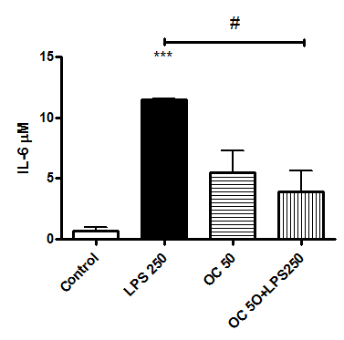
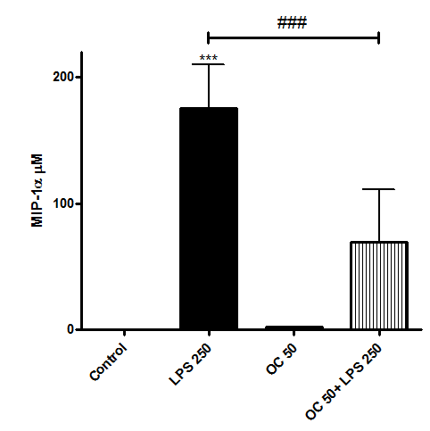
Oleocanthal inhibits IL-6 and MIP-1α protein secretion in J774 murine macrophages
J774 cells
The NEIRID Lab © Life Sci 91(23-24):1229-35

Slide 26
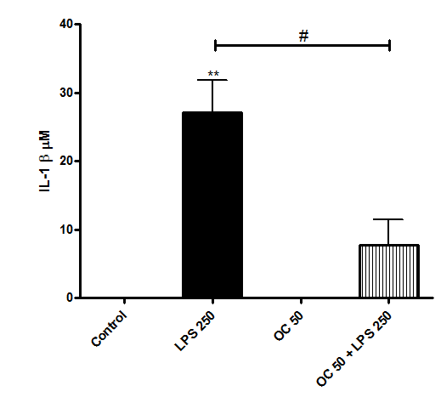
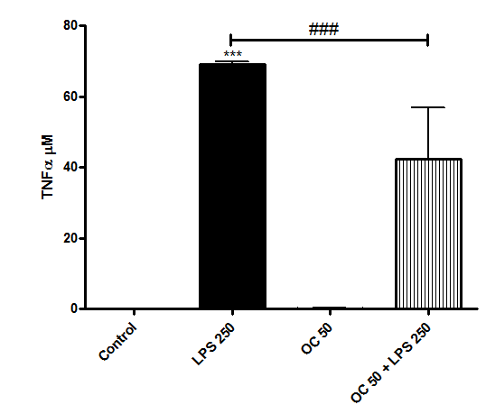
Effect of oleocanthal on other cytokines in J774 macrophages
The NEIRID Lab © Life Sci 91(23-24):1229-35

Slide 27
Schematic representation of the general anti-inflammatory activities of oleocanthal. (a) molecular pharmacological targets and (b) cellular targets.
The NEIRID Lab ©: Drug Discovery Today, Volume 20, Issue 4, 2015, 406–410

Slide 28
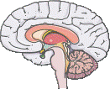
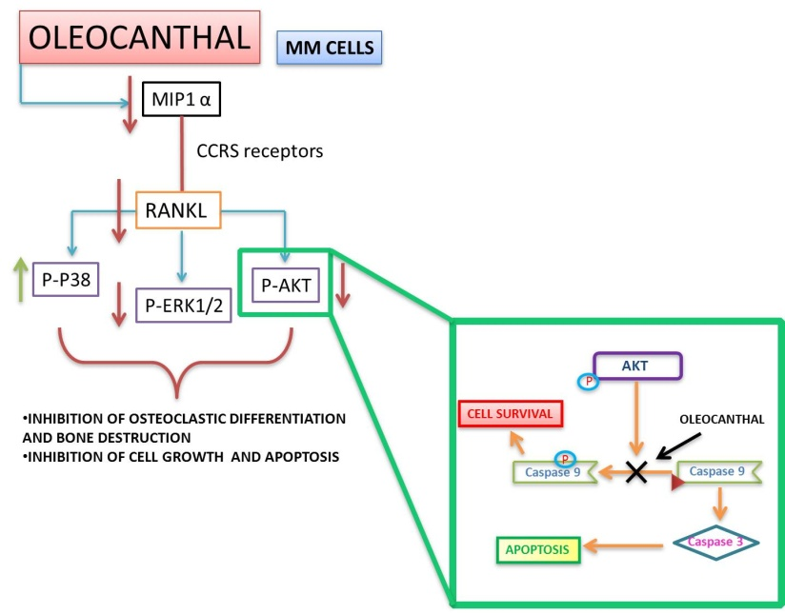
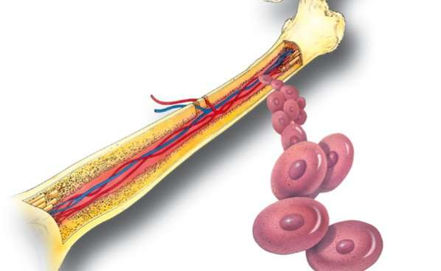
Summary of the pharmacological effects of oleocanthal (OC) in cancer cells and neurodegenerative diseases, including a detailed mechanism of OC activity in multiple myeloma (MM) cells.
CNS
BREAST CANCER CELLS
OLEOCANTHAL
COLON CANCER CELLS
BONE MARROW
The NEIRID Lab ©: Drug Discovery Today, Volume 20, Issue 4, 2015, 406–410

Slide 29
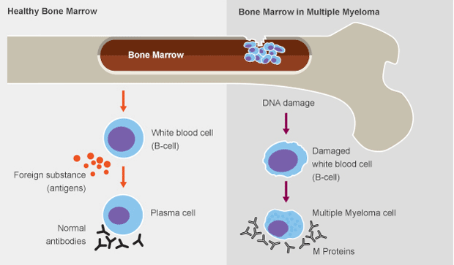
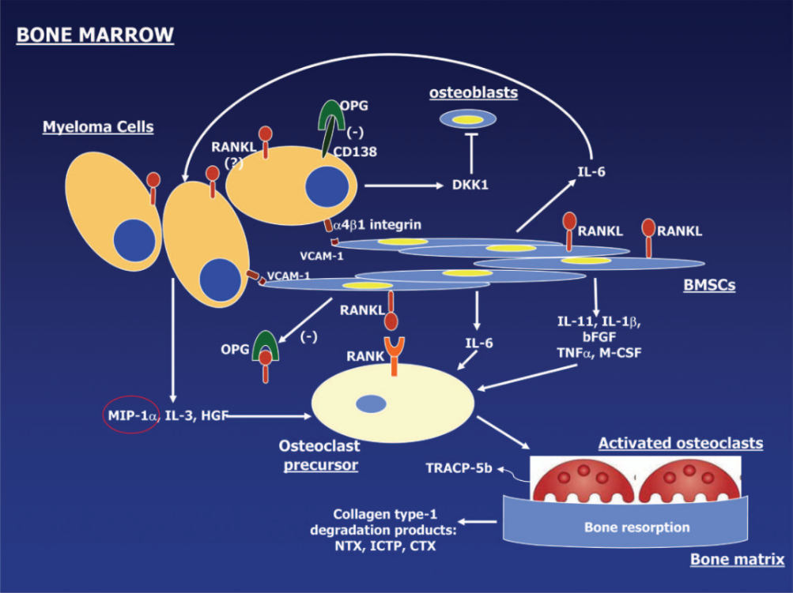
Oleocanthal and multiple myeloma
Multiple Myeloma represents 1% of total neoplasias and 10% of Hematological Cancers.
Extimation of about 40/50.000 new cases/year in Europe.

Slide 30
Schematic representation of the experimental method
RNA extraction:
RT-PCR
PROTEIN extraction:
Western Blot
Surnatants:
ELISA
LDH
MTT assay
CFSE assay
CELL CYCLE analysis
APOPTOSIS assay
Treatment
with Oleocanthal
Seeding
Starvation
3/6/12/24/48 hours
DAY 1
Over night
DAY 2
DAY 3
ARH-77 cells

Slide 31
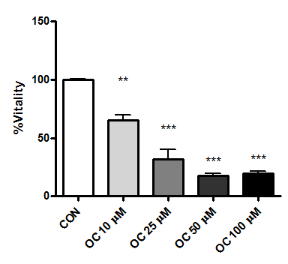
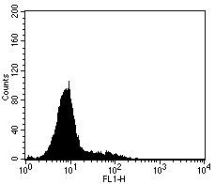
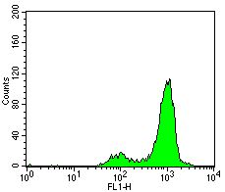
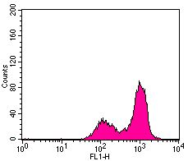
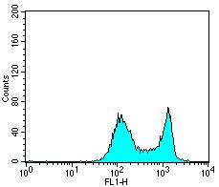
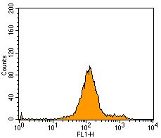
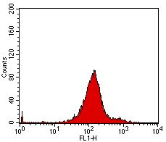
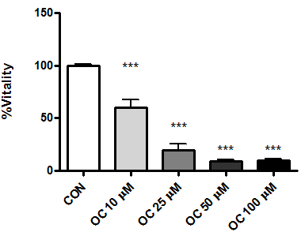
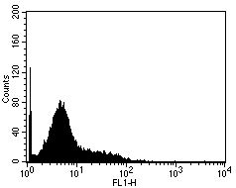
Oleocanthal decreases vitality and proliferation of myeloma cells (ARH-77)
A.
C.
24h
Number of cell counted
CFSE
D.
B.
48h
Number of cell counted
CFSE
The NEIRID Lab ©: Curr Med Chem. 2013;20(19):2467-75

Slide 32
Oleocanthal inhibits MIP1- mRNA expression and protein secretion in ARH-77 cells.
Effect of oleocanthal on LDH levels.
A
B
C
D
Scotece M. Curr Med Chem. 2013;20(19):2467-75

Slide 33
Induction of apoptosis in human myeloma cells by oleocanthal
The NEIRID Lab ©: Curr Med Chem. 2013;20(19):2467-75

Slide 34
Induction of apoptosis signaling molecules by oleocanthal.
Oleocanthal inhibits AKT and Map Kinase signaling pathways.
The NEIRID Lab ©: Curr Med Chem. 2013;20(19):2467-75

Slide 35
Schematic representation of the mechanism of action of Oleocanthal in MM cells
Scotece M. Curr Med Chem. 2013;20(19):2467-75

Slide 36
May we have, one of these days, an OLEOCANTHAL based therapy for arthritis….??

Slide 37
ORESTE GUALILLO: PharmD, PhD NEIRID Laboratory Head
Rodolfo Gómez: PharmD, PhD. Musculo-Skeletal Pathology Unit
Morena Scotece: MS, PharmD, PhD
Javier Conde: PhD
Vanessa Abella: PhD
Tamara Pérez: BSN, MS
Veronica López: AAS
Jesús Pino: MD PhD
SANTIAGO DE COMPOSTELA
SPAIN

Slide 38
Hope to see you soon in
Santiago de Compostela

Slide 39
Thank you for your attention
I’m confident this seminar has been stimulating for you “like a table full of things to help you stay awake listening my “sleepy” speech”

Slide 40
The NEIRID Lab ©

