Slide 1

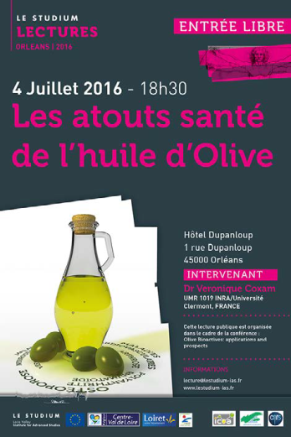

Olive Bioactives: applications and prospects
Orleans-France
JULY 4, 2016 - JULY 6, 2016
Neuroprotective effect of extra-virgin olive oil and its bioactive component oleocanthal in Alzheimer's disease
Amal Kaddoumi
University of Louisiana at Monroe
School of Pharmacy

Slide 2
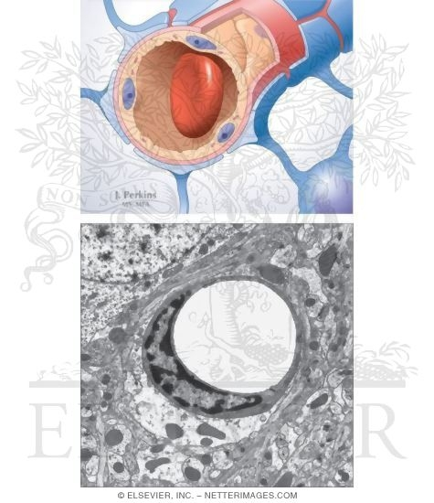
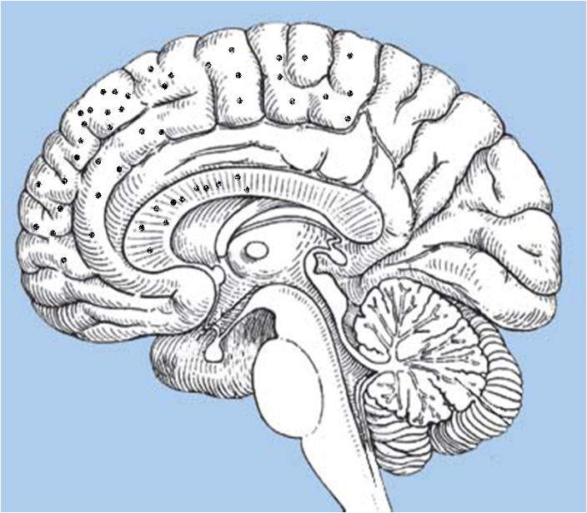
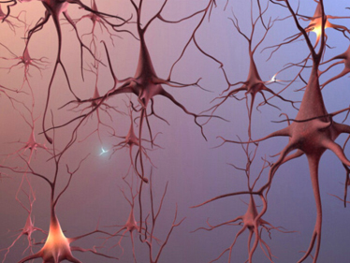
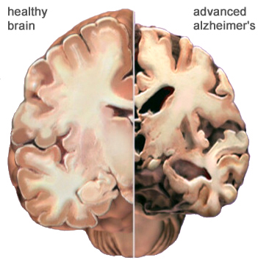
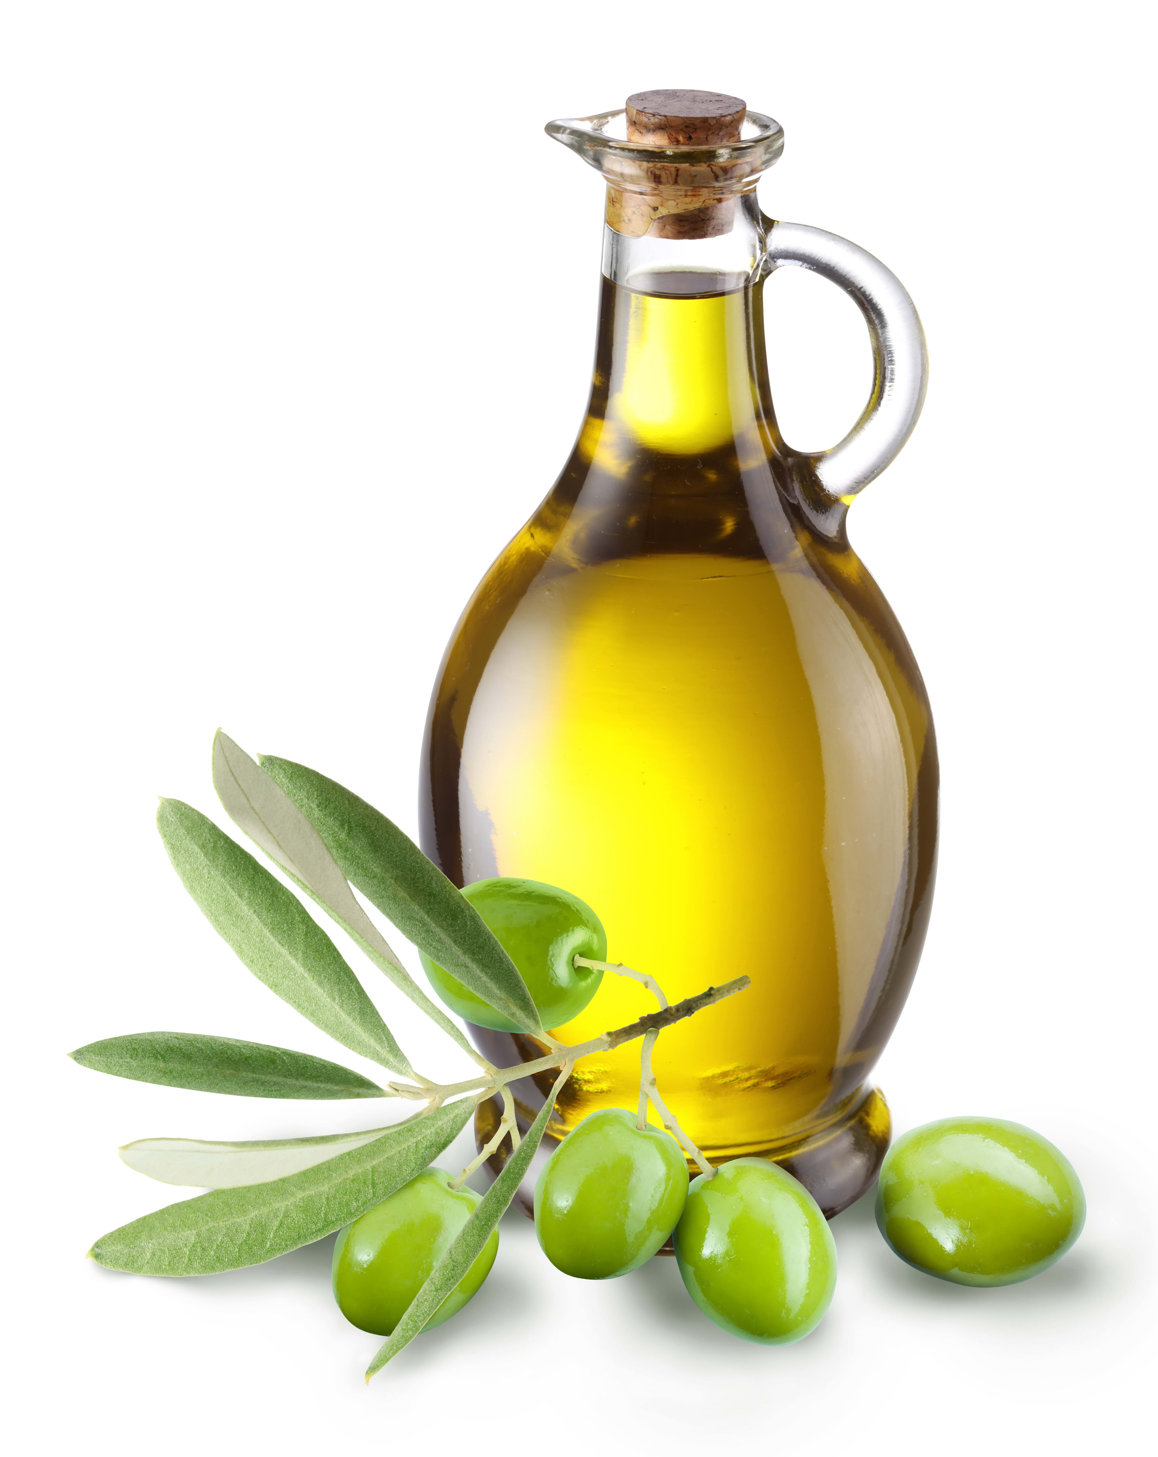
Alzheimer’s disease (AD)
Alzheimer’s disease (AD) impairs cognition, memory, and language and causes dementia; known for its hallmark features such as increased levels of tau hyperphosphorylation and amyloid-beta (Aβ) deposition, together with astrogliosis, neuronal dystrophy, neuronal loss, and vascular alterations.
Currently there are no available drugs that can cure AD, and available FDA drugs (Cholinesterase inhibitors and NMDA receptor antagonist) only provide symptomatic relief and memory improvement to AD patients.
Disturbances Accumulation Neuronal Alzheimer’s
in BBB of Aβ death Disease

Slide 3
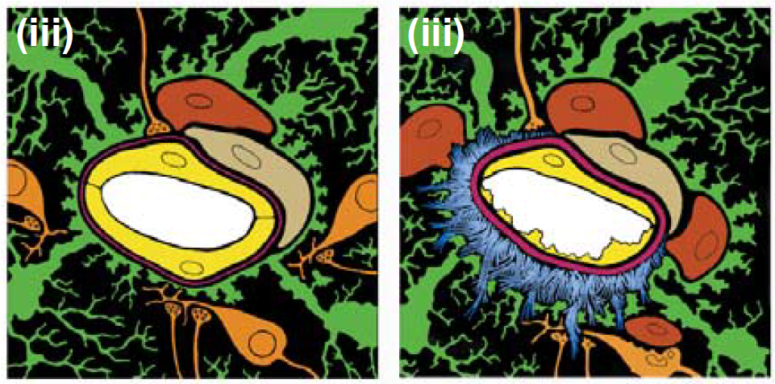
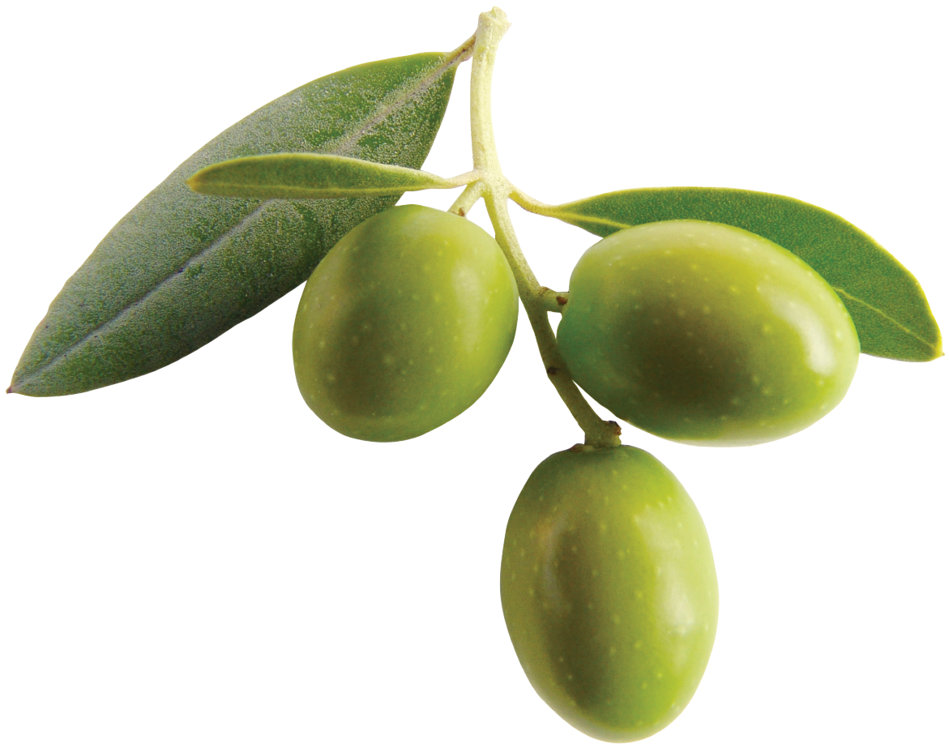
Blood-brain barrier (BBB) in AD
Several pathological alterations in the BBB function have been observed in AD patients.
Disrupted capillary integrity, loss of controlled molecular transport, and uncontrolled solute exchange are among these pathological alterations.
Accelerated disruption of BBB with increasing Aβ concentration in the brain of AD patients suggests possible toxic effect of Aβ against the BBB endothelium.
CNTRL
AD
Zlokovic B. Trends in Neurosci. 2005, 28:202

Slide 4
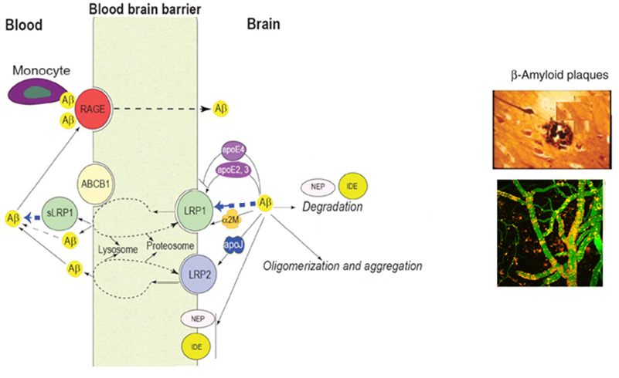
Effect of reduced clearance of Aβ in AD and CAA
(BBB)
Down-regulation in Aβ clearance
P-gp
Vascular Aβ deposit → CAA
CAA = Cerebral Amyloid Angiopathy
Modified from Sagare A P et al. J Alzheimers Dis. 2012

Slide 5
Aβ clearance pathways
    Using a modified brain efflux method (BEI%) we estimated about 60% of intracerebrally injected Aβ is cleared across the mouse brain BBB.
Qosa H., et al. Neuropharmacology 2014, 79:668

Slide 6
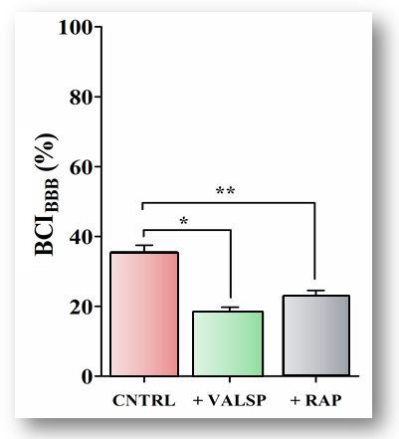
Aβ clearance across the BBB
    P-glycprotein (P-gp), an efflux transporter at the luminal side of the endothelial cells of the BBB.
    Low-Density Lipoprotein Receptor Related Protein-1 (LRP1): a multifunctional receptor that is located at the abluminal side of the brain endothelial cells.
Qosa H., et al. Neuropharmacology 2014, 79:668

Slide 7
Therapeutic approach against AD
Considering the dysfunctional BBB in the brains of AD patients, we proposed that pharmaceuticals and/or nutraceuticals that target the BBB could provide a protection effect and/or slow progression of AD.
Dysfunctional BBB due to aging or AD is associated with down-regulation of Aβ major transport proteins, LRP1 and P-gp.
Decrease cerebral Aβ deposition by enhancing its cerebral clearance across the BBB could be a potential therapeutic approach to prevent and/or slow progression of AD.

Slide 8
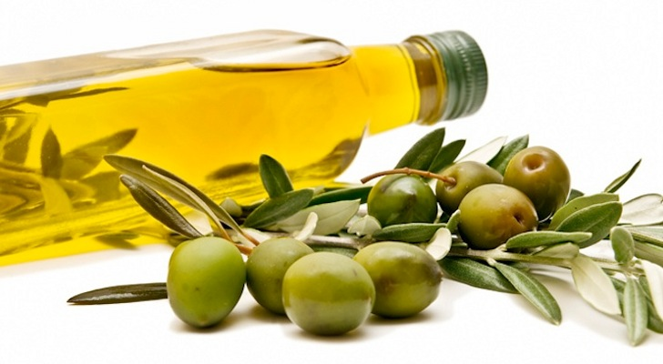
Extra-Virgin Olive Oil (EVOO)
Several epidemiological and clinical studies suggested adherence to Mediterranean diet improves cognitive function, reduces risk of developing MCI, and reduces risk of MCI conversion to AD.
Daily consumption of EVOO is one of the characteristic elements of a Mediterranean diet.
Several studies showed the beneficial effect of EVOO consumption on the cognitive function in humans (PREDIMED-NAVARRA) and rodents.
EVOO composition is primarily glycerol fraction (~95%, rich in monounsaturated fatty acids), and non-glycerol fraction (~5%, phenolic compounds).

Slide 9
Daily Chef Extra-Virgin Olive Oil from Italy (Lot # L022 RE-56), which contains 71 mg/kg oleocanthal and 3.8 mg/kg oleuropein aglycone as determined by HPLC and high-resolution ESIMS experiment conducted using a JEOL JMS-T100 LP AccuTOF LC-Plus, equipped with an ESI source.

Slide 10
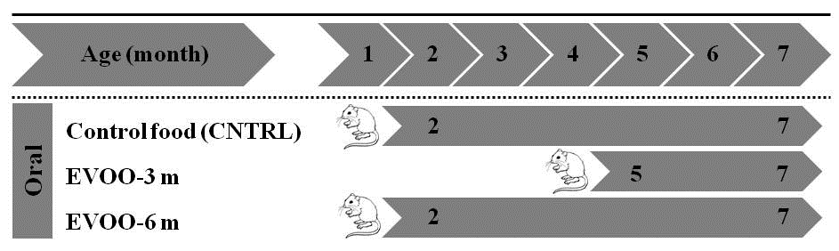
Study design
TgSwDI mice express human APP harboring double Swedish mutations and the Dutch and Iowa vasculotropic Aβ mutations
Qosa H., et al. J Nutr Biochem. 2015;26(12):1479-90.

Slide 11
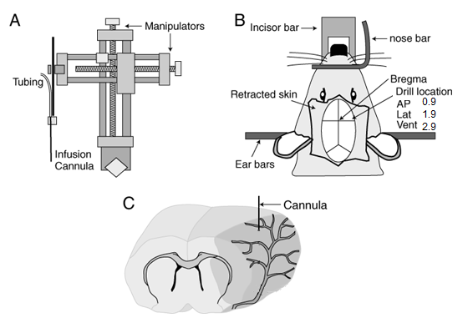
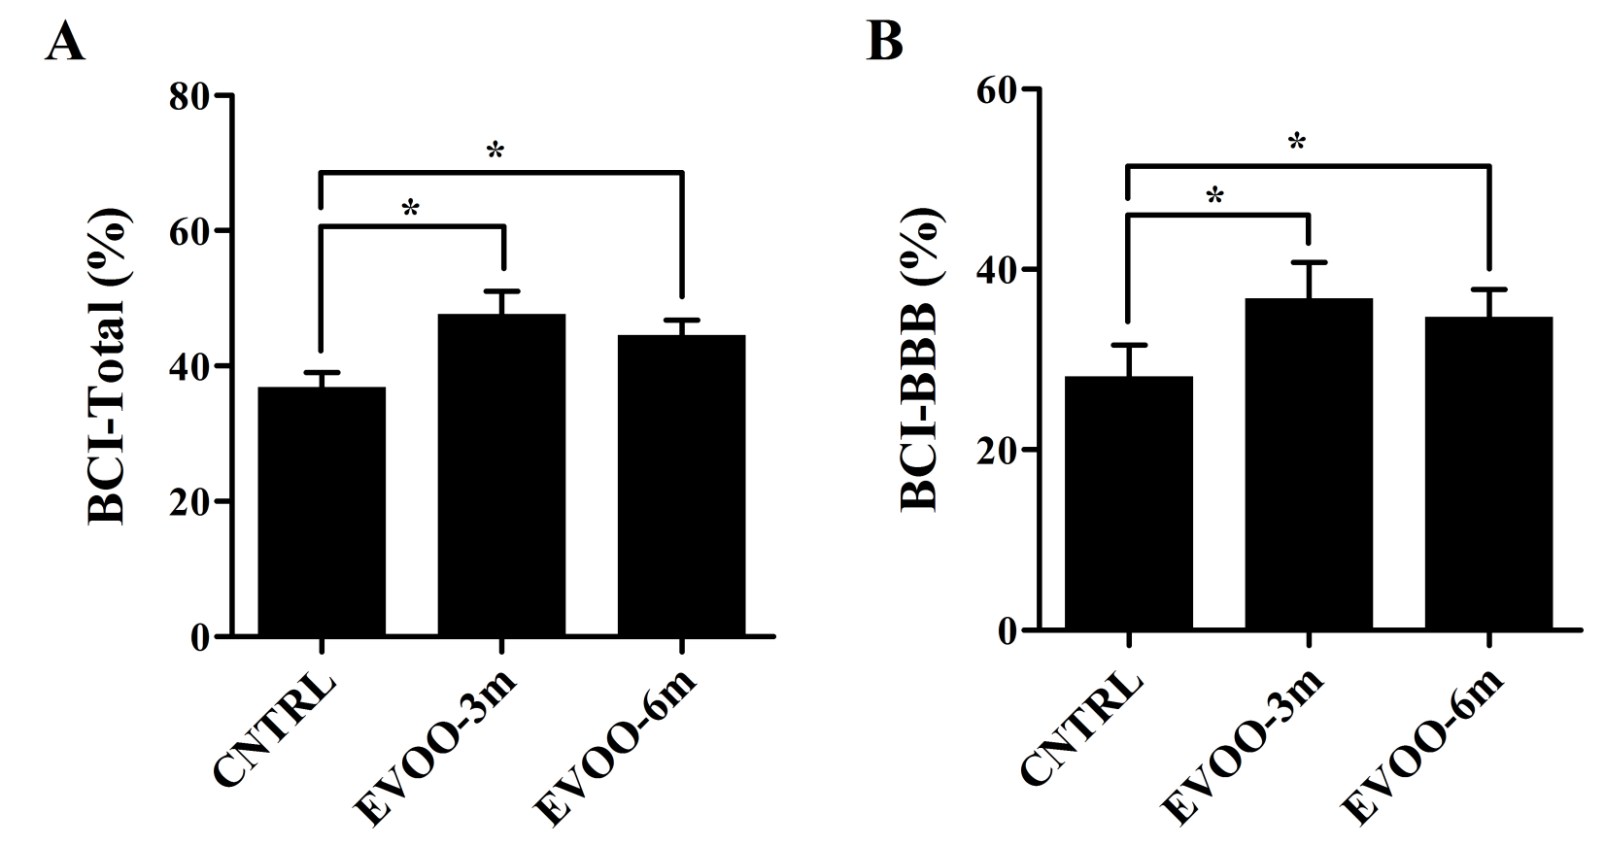
EVOO enhances the clearance of Aβ
Brain clearance index (BEI/BCI)
Qosa H., et al. J Nutr Biochem. 2015;26(12):1479-90.

Slide 12
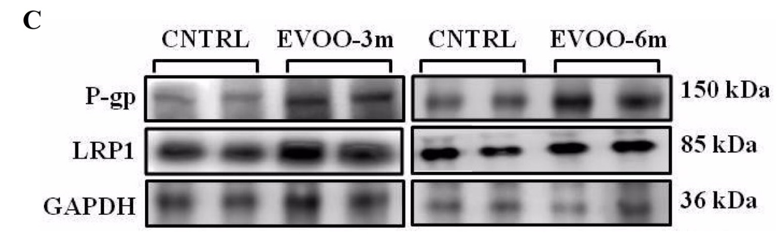
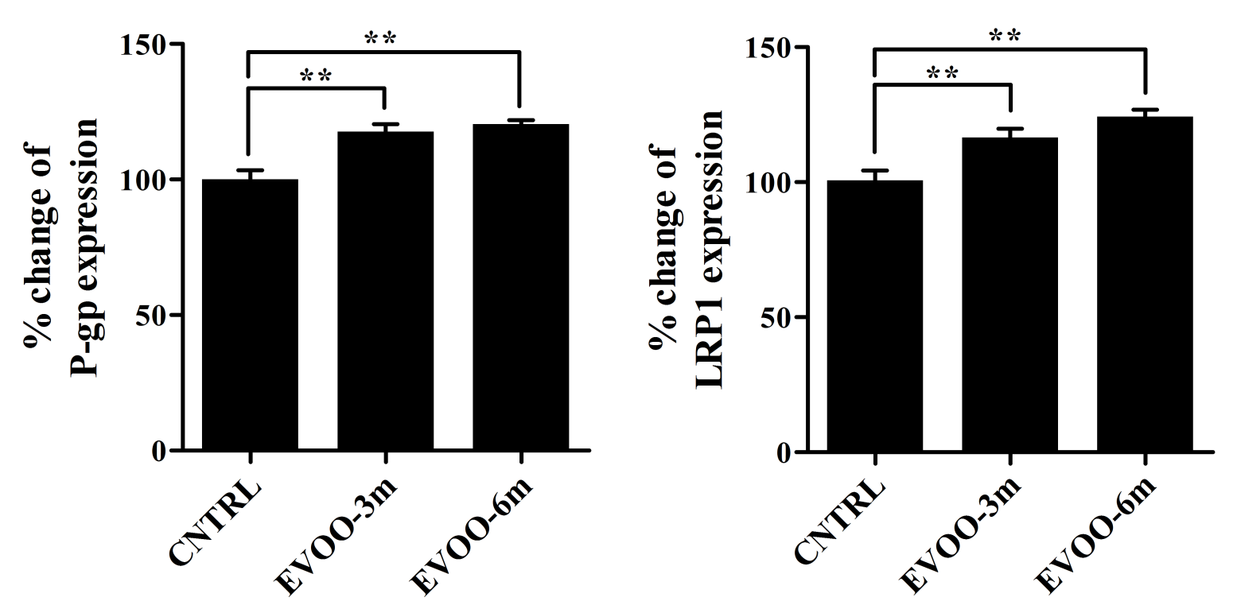
EVOO enhances the clearance of Aβ
Qosa H., et al. J Nutr Biochem. 2015;26(12):1479-90.

Slide 13
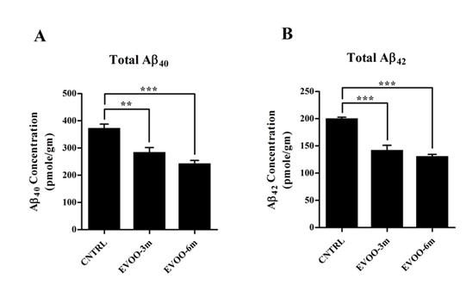
EVOO decreases total Aβ in mice brains
Qosa H., et al. J Nutr Biochem. 2015;26(12):1479-90.

Slide 14
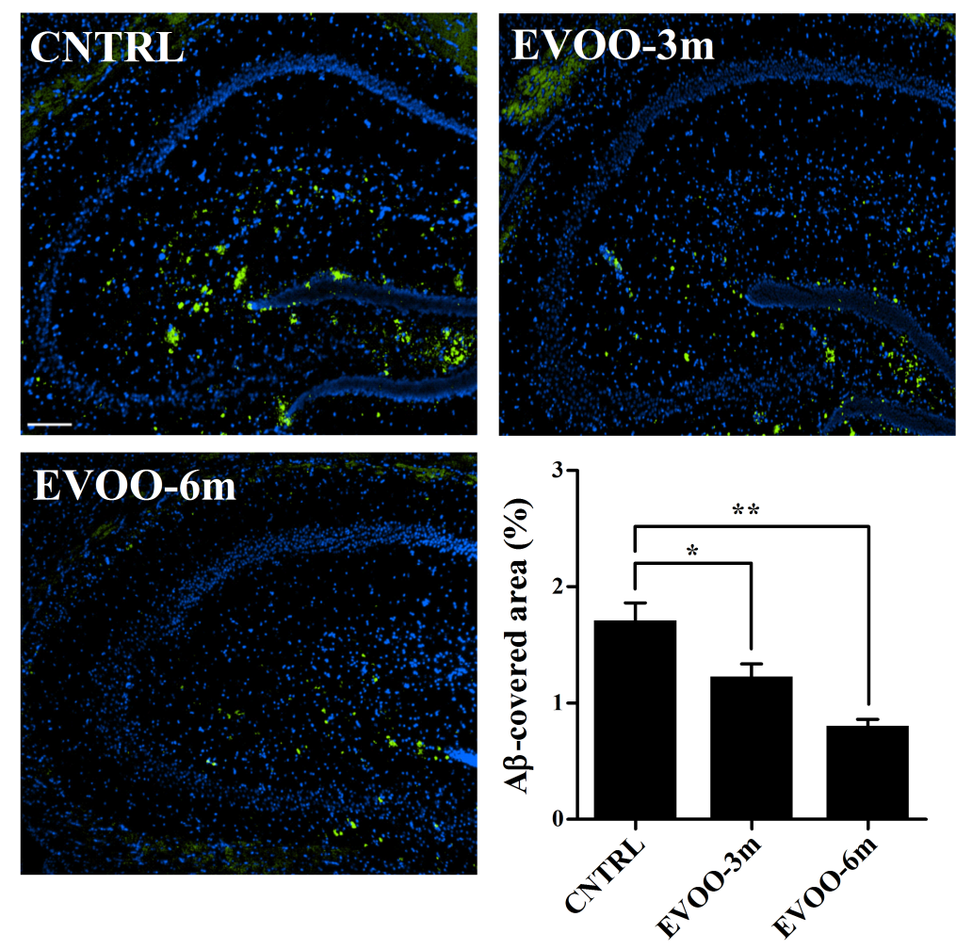
EVOO decreases total Aβ in mice brains
Qosa H., et al. J Nutr Biochem. 2015;26(12):1479-90.

Slide 15
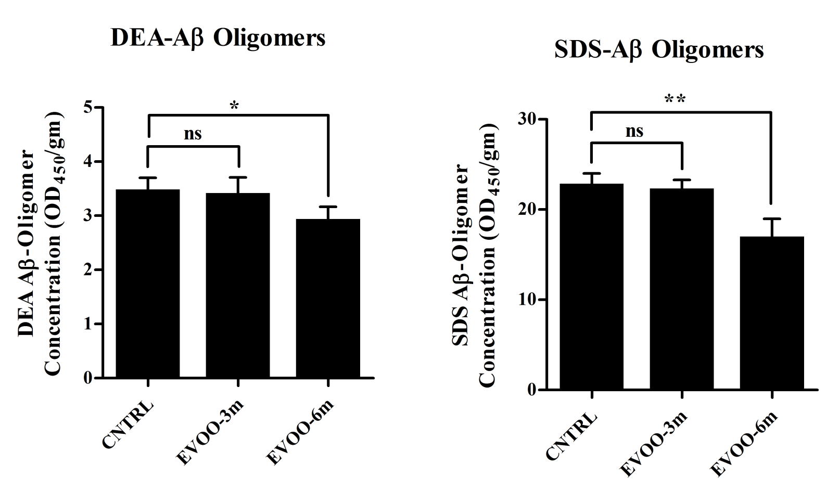
EVOO-6m decreases Aβ oligomers in mice brains
Qosa H., et al. J Nutr Biochem. 2015;26(12):1479-90.

Slide 16
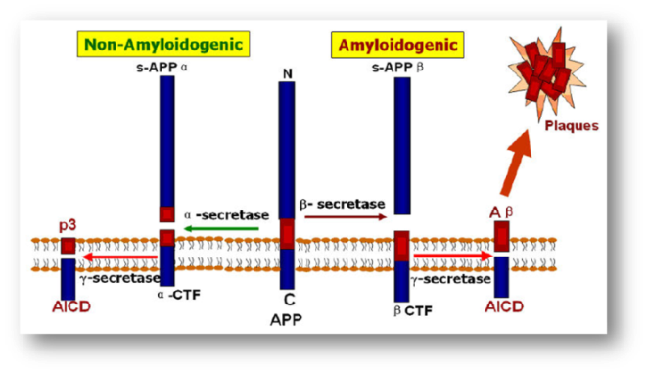
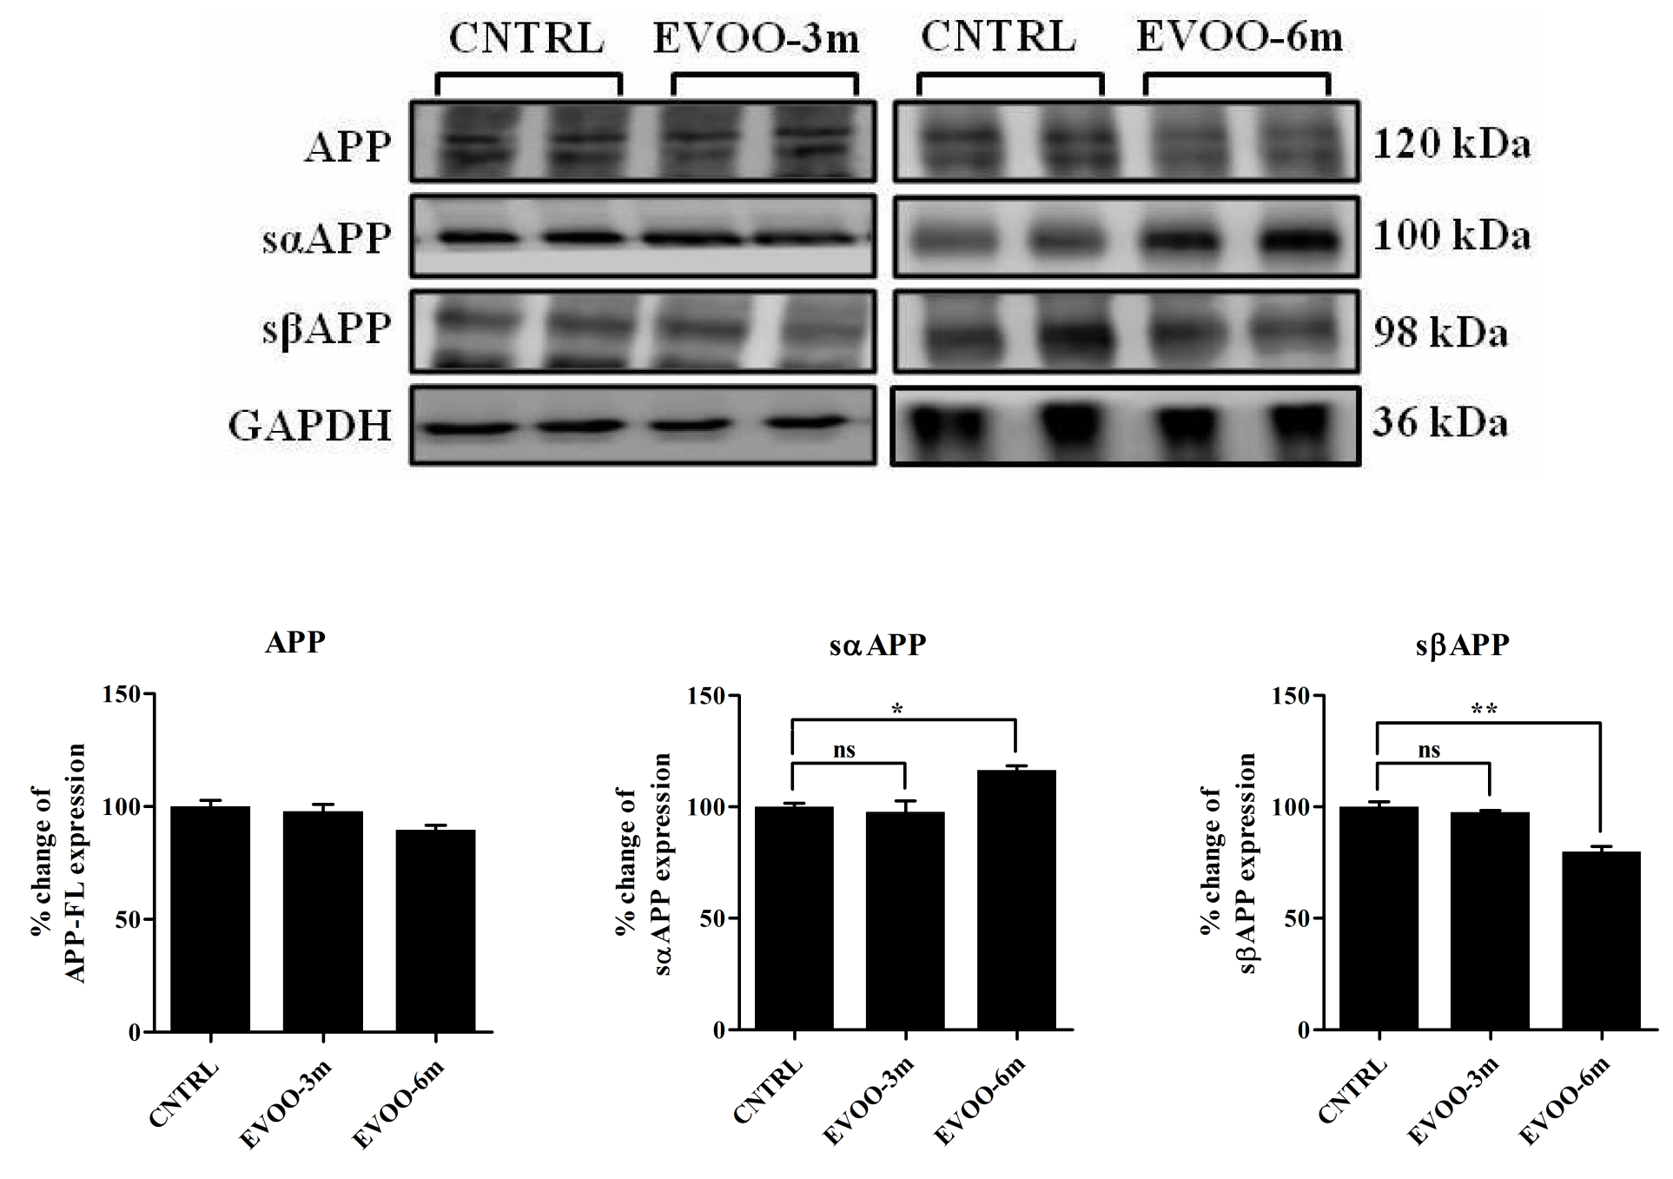
EVOO decreases Aβ production
Qosa H., et al. J Nutr Biochem. 2015;26(12):1479-90.

Slide 17
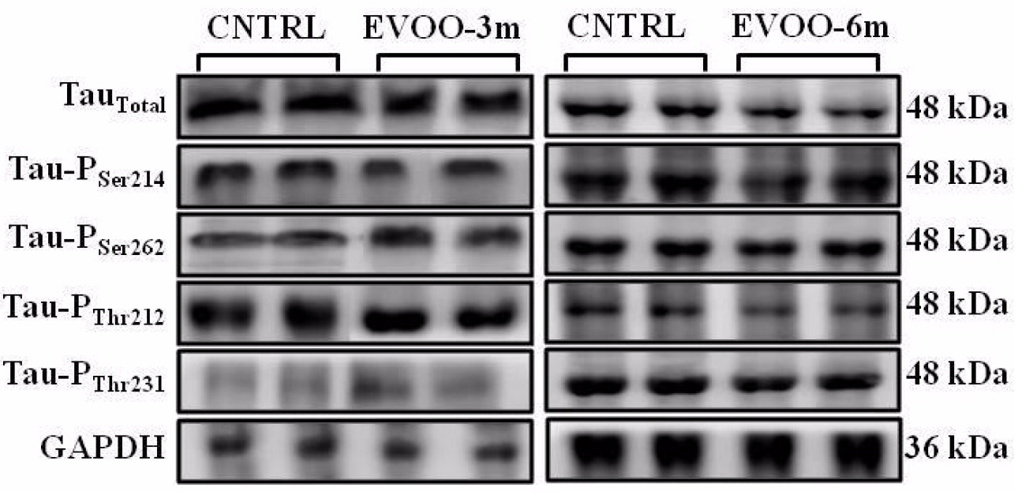
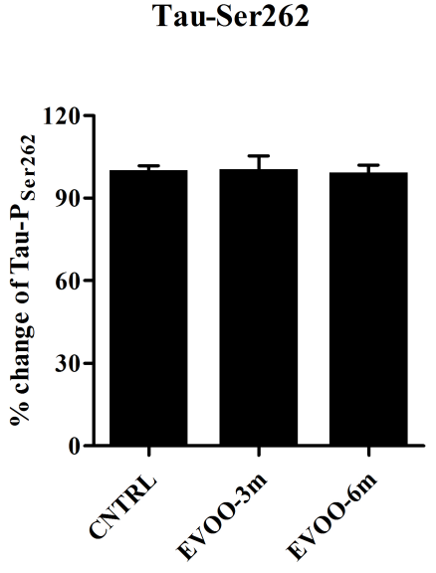
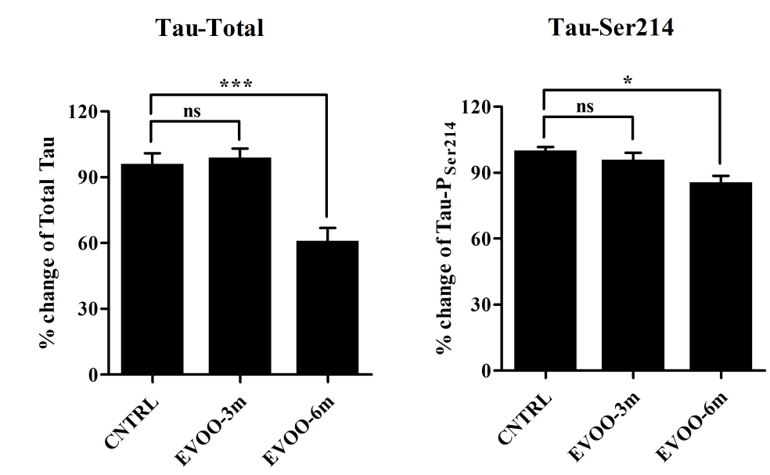
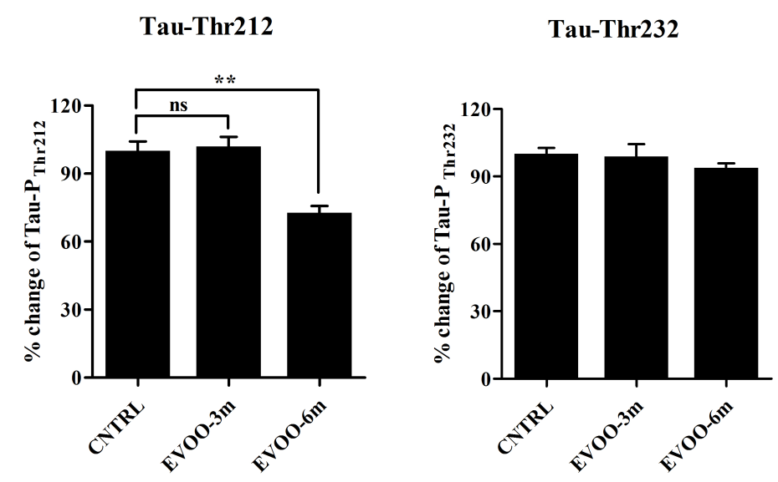
EVOO decreases total and phosphorylated tau in mice brains
Qosa H., et al. J Nutr Biochem. 2015;26(12):1479-90.

Slide 18
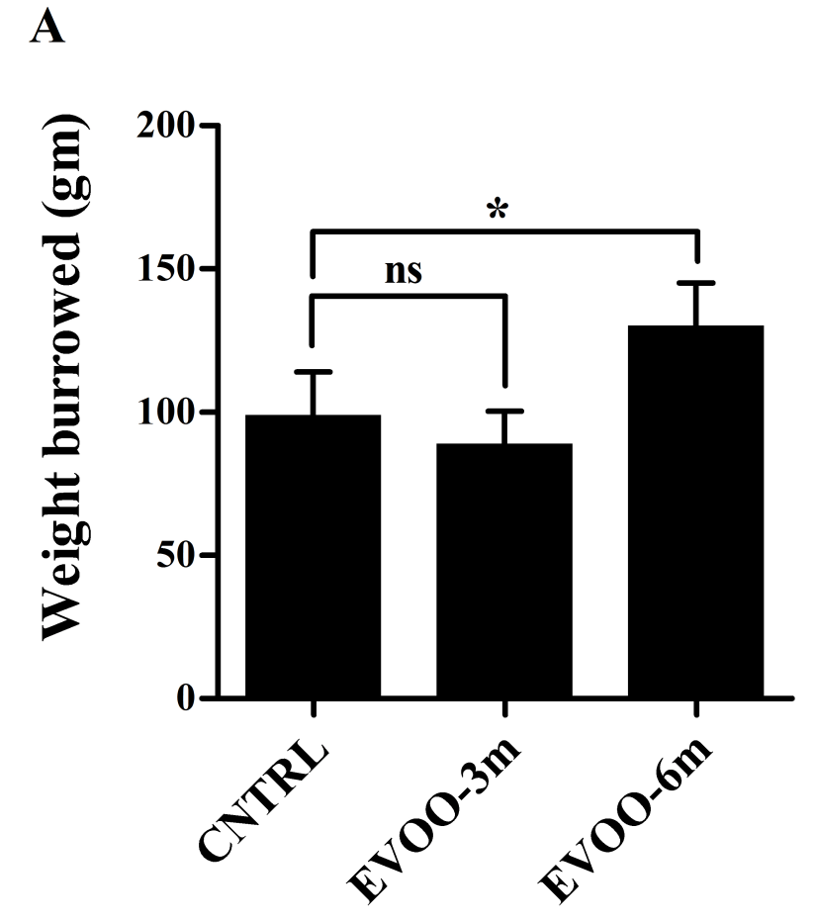
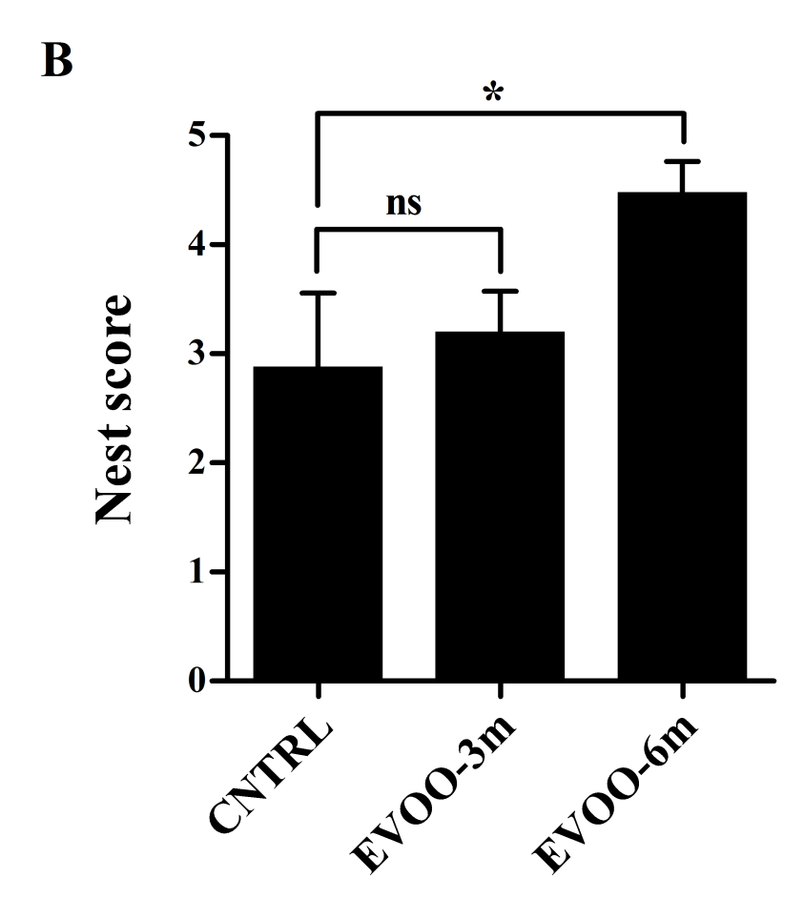
EVOO dietary intake for 6 months improves mice behavior
Burrowing
Nest construction
Qosa H., et al. J Nutr Biochem. 2015;26(12):1479-90.

Slide 19
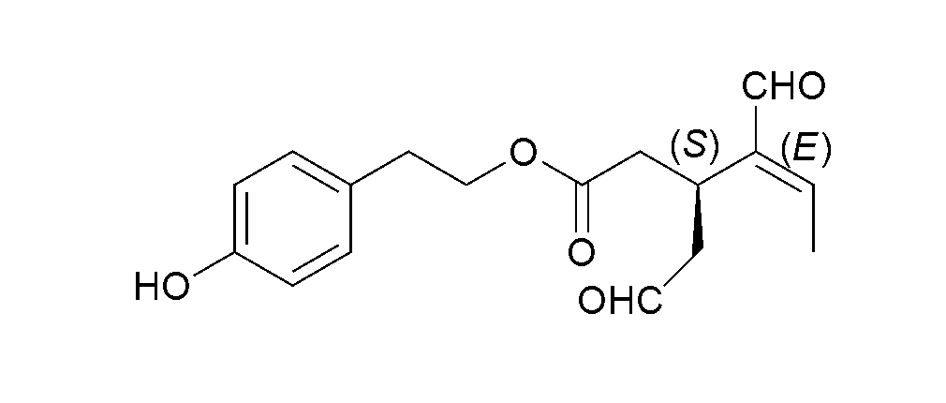
Oleocanthal
A phenolic secoiridoid component of EVOO linked to its beneficial effect against AD.
Available in vitro studies demonstrated oleocanthal may have potential neuroprotective properties and contribute to preventing cognitive decline.
Mechanisms proposed:
Inhibition of tau fibrillization (PMID: 19549281)
Altering the oligomerization state of Aβ (PMID: 19631677)
Aβ clearance across BBB????

Slide 20
Oleocanthal extraction from EVOO
Extra-virgin olive oil (EVOO; Member’s Mark, batch no. VF1-US102808, Italy) was used as a source for extracting oleocanthal.
Oleocanthal was first eluted from lipophilic Sephadex LH20 packed column (bead size 25-100 μm, Sigma Aldrich, MO) with n-hexane:CH2Cl2 (1:9) system.
Oleocanthal was purified from its rich fraction on C-18 reversed phase Bakerbond octadecyl packed column (bead size 40 μm; Mallinckrodt Baker) using isocratic CH3CN:H2O (40:60).
A purity of >90% was established for oleocanthal as assessed by TLC, 1H-NMR spectroscopy, and HPLC analysis.
Elnagar et al, Planta Med 77, 1013-1019.

Slide 21
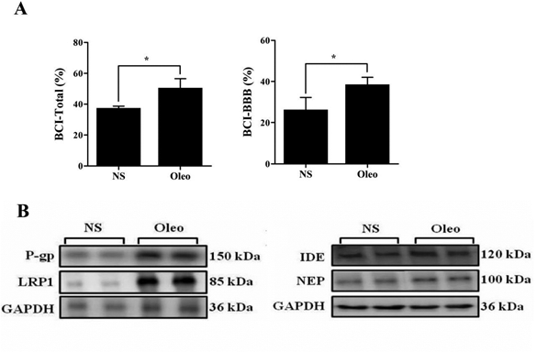
Brain clearance index and microvascular
expression of Aβ clearance proteins
4 weeks treatment at age of 4 months, 5 mg/kg/day
Qosa et al. ACS Chem. Neurosci. 2015, 6, 1849-1859.

Slide 22
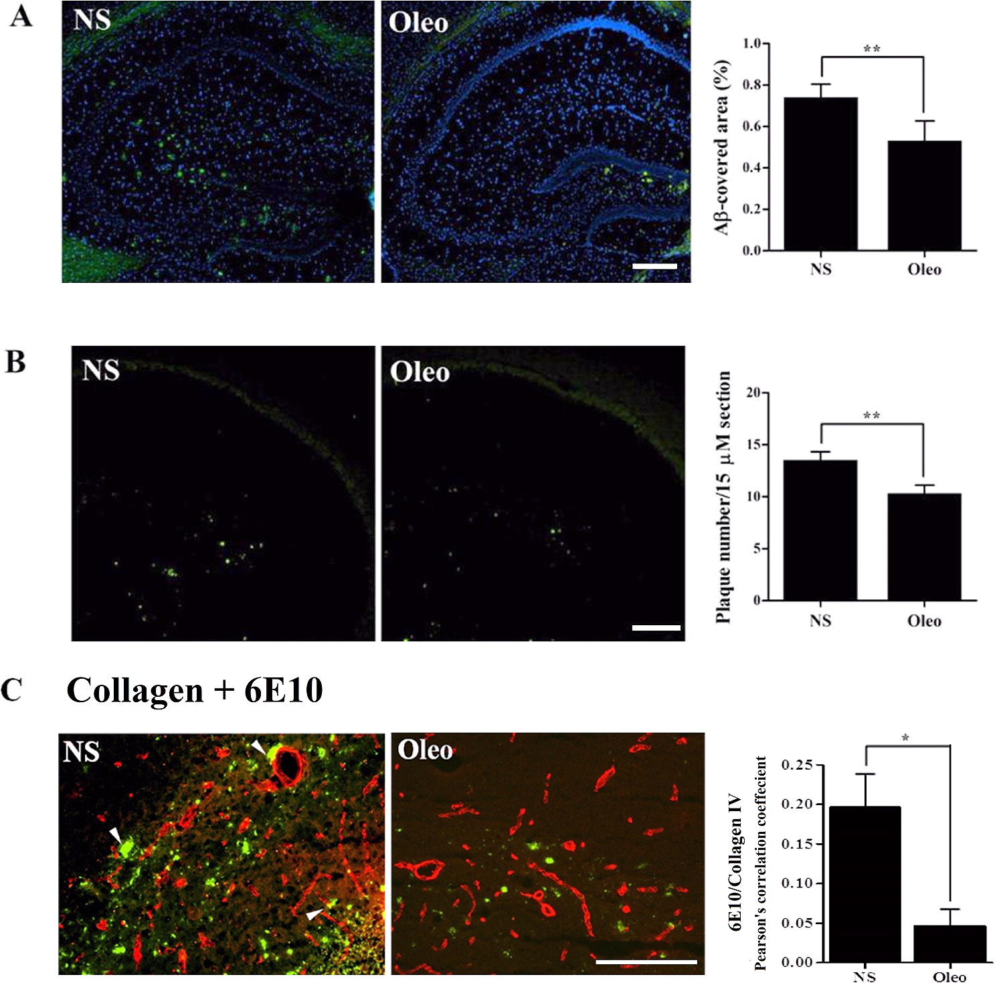
Immunostaining of total Aβ and Aβ plaques
4 weeks treatment starting at the age of 4 months reduces Aβ brain load
Qosa et al. ACS Chem. Neurosci. 2015, 6, 1849-1859.

Slide 23
Double immunostaining of capillaries and Aβ
Qosa et al. ACS Chem. Neurosci. 2015, 6, 1849-1859.

Slide 24
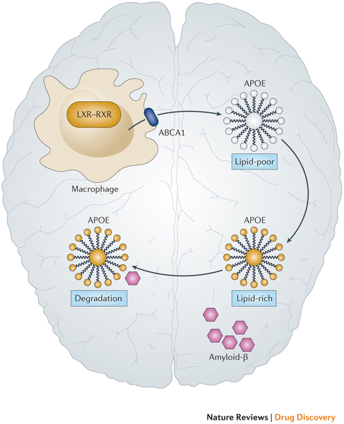
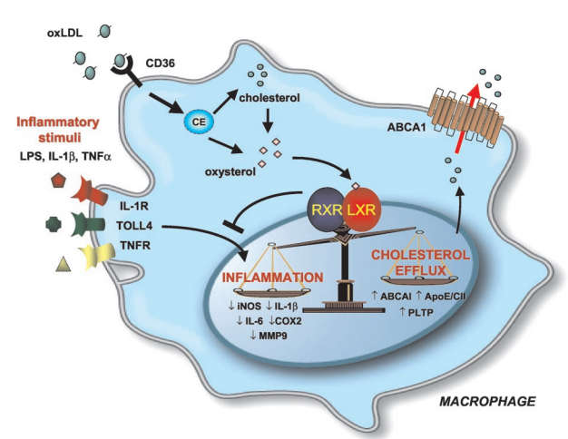
ApoE-dependent clearance pathway of Aβ
PMID: 12690094
PMID: 24833295

Slide 25
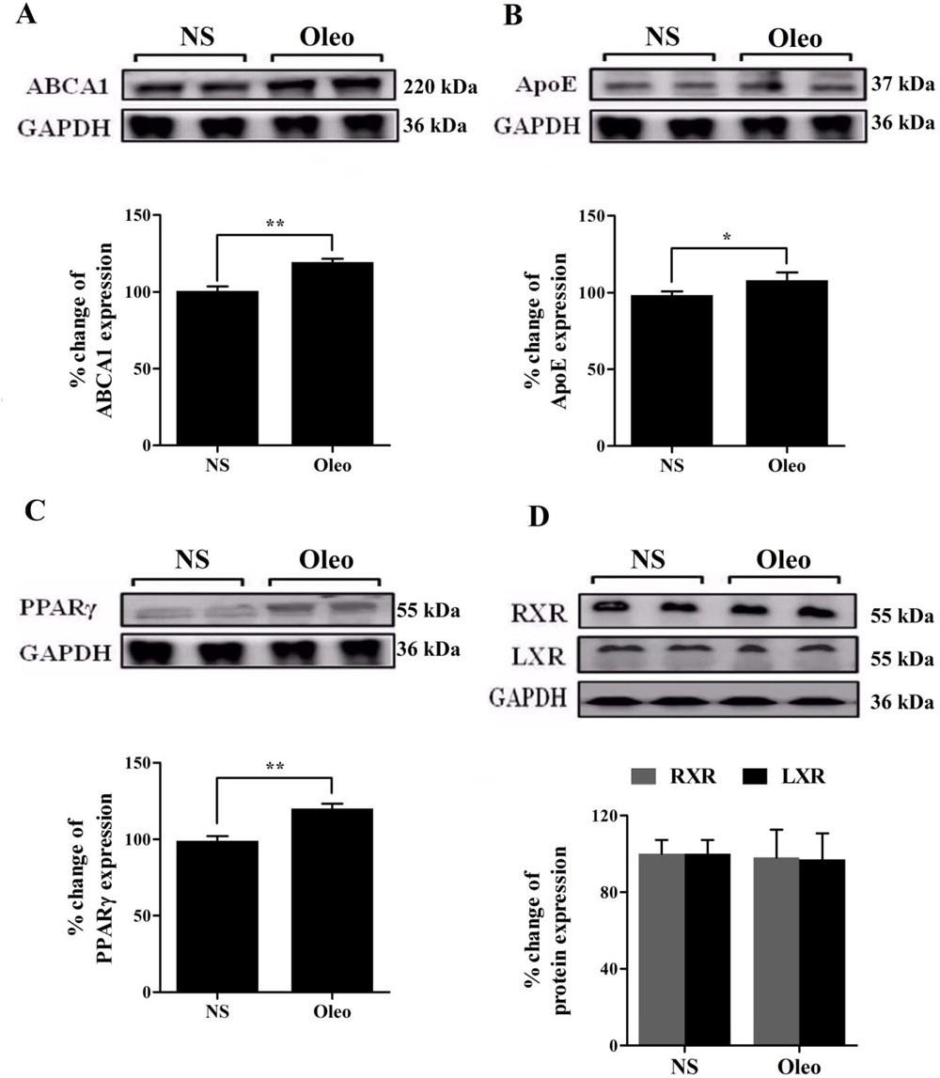
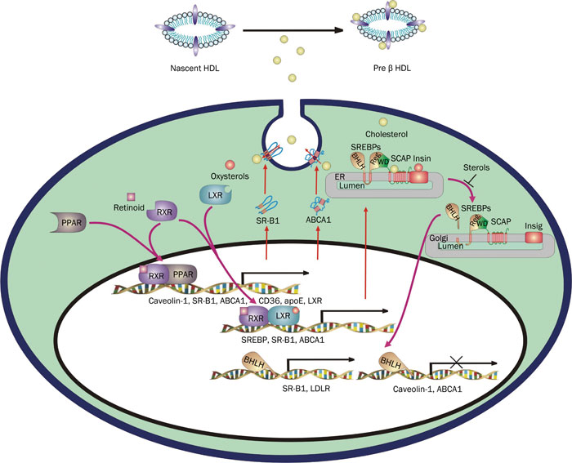
ApoE-dependent clearance pathway of Aβ
PMID: 20835267
Oleocanthal treatment enhanced ApoE-dependent clearance pathway of Aβ through PPARγ activation.
Qosa et al. ACS Chem. Neurosci. 2015, 6, 1849-1859.

Slide 26
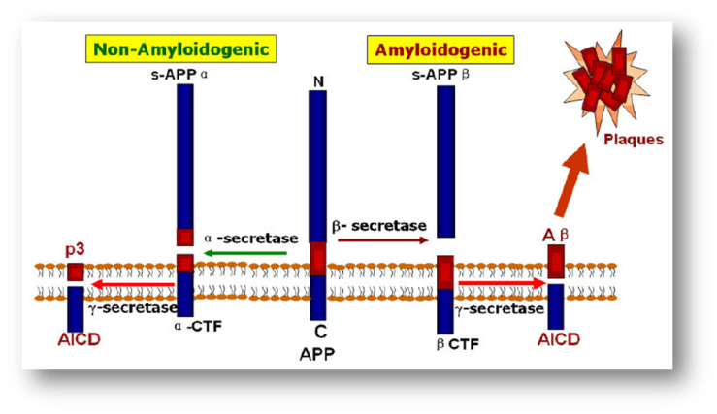
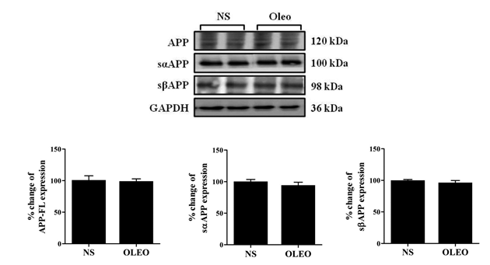
Brain expression of Aβ production markers
Treatment for 4 weeks starting at the age of 4 months did not modulate the processing of APP as demonstrated by comparable levels of full length APP, sAPPα, and sAPPβ between oleocanthal and normal saline treatment groups.
Qosa et al. ACS Chem. Neurosci. 2015, 6, 1849-1859.

Slide 27
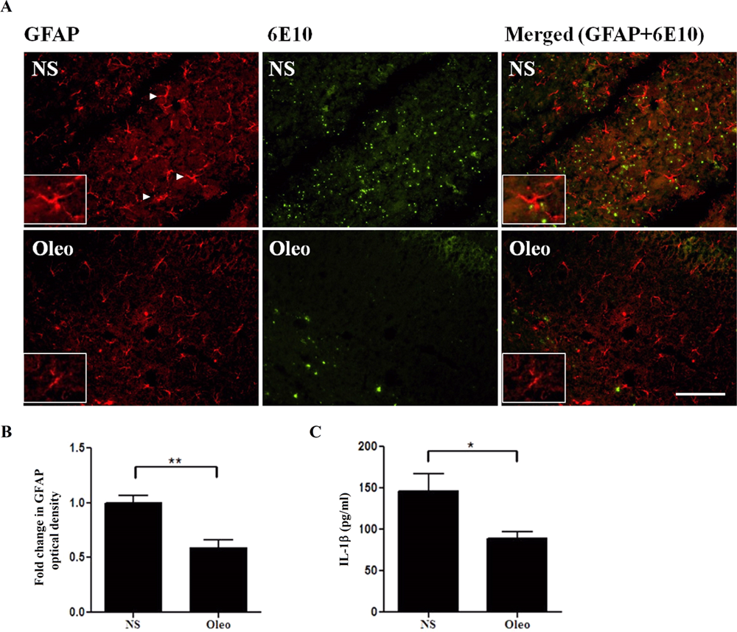
Double immunostaining of astrocytes activation (GFAP) and Aβ
Qosa et al. ACS Chem. Neurosci. 2015, 6, 1849-1859.

Slide 28
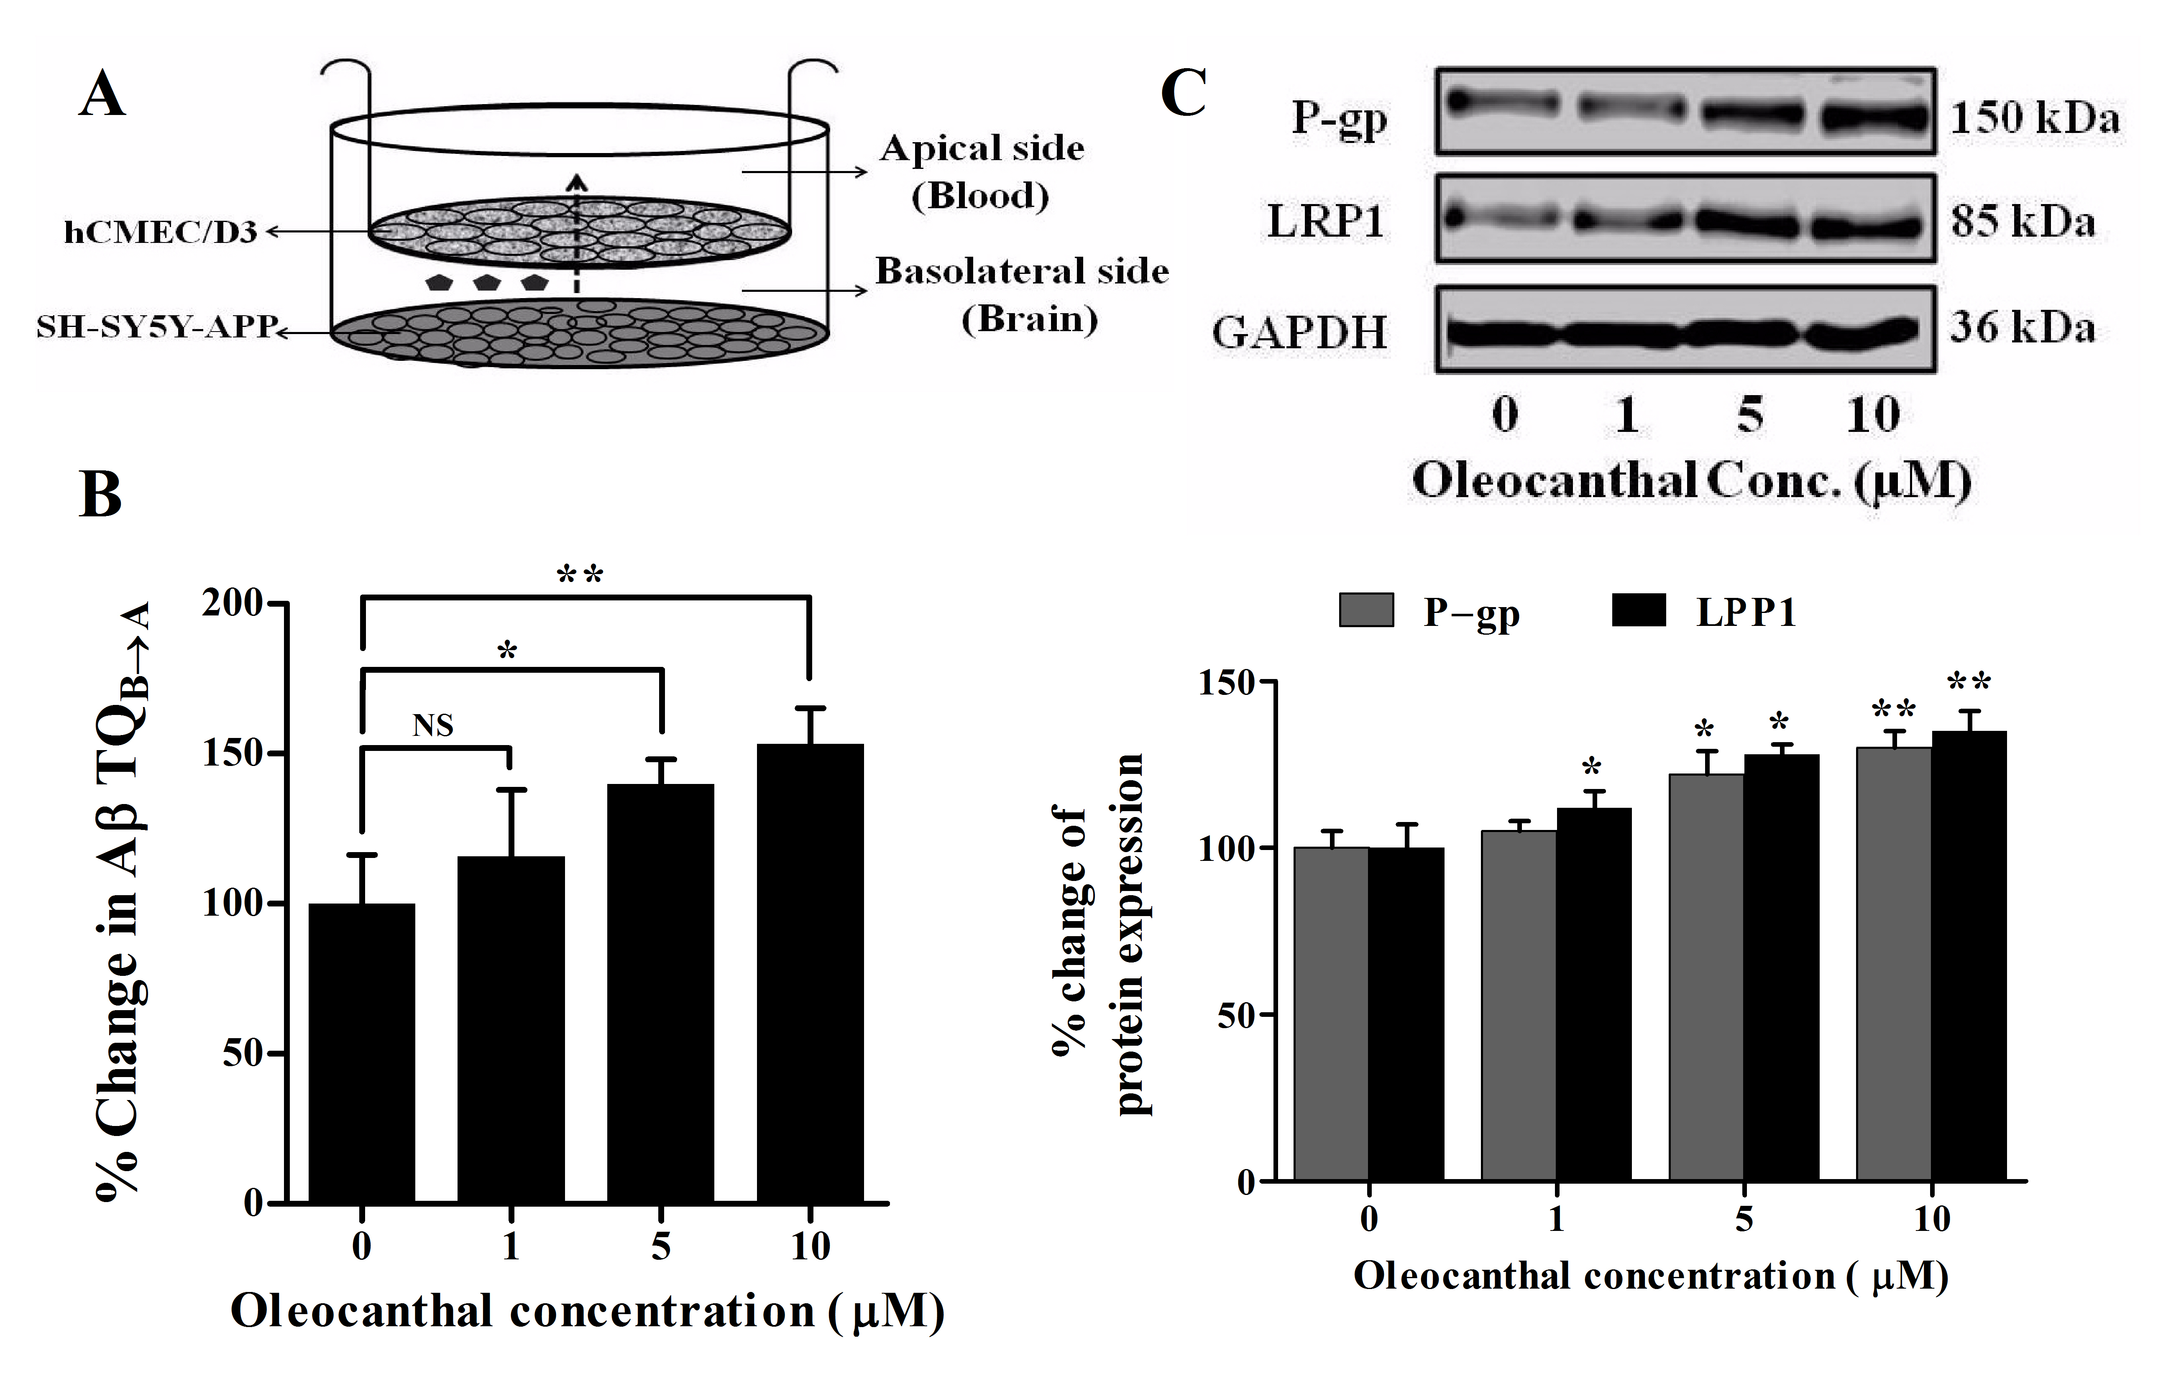
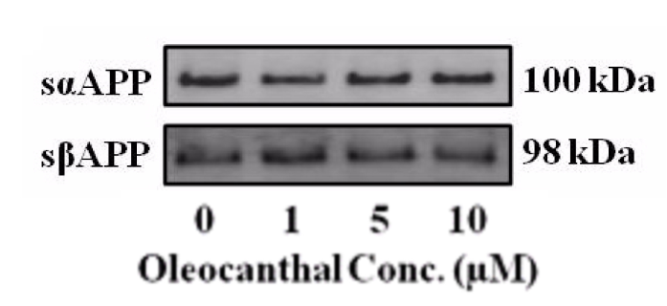
Translational potential: oleocanthal enhances Aβ clearance in an in vitro human neurovascular unit model
Qosa et al. ACS Chem. Neurosci. 2015, 6, 1849-1859.

Slide 29
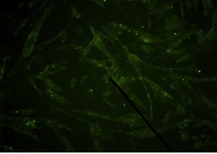
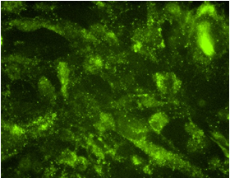
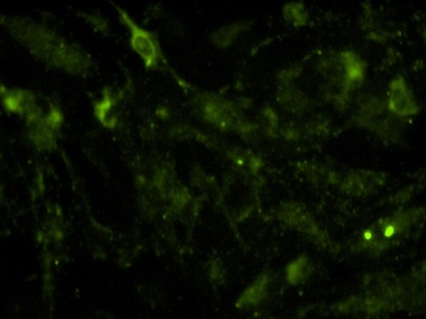
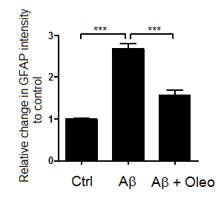
Effect of oleocanthal on Aβ oligomers induced astrocytes activation
Oleo treated →Aβ oligomer
Control
Aβ oligomer

Slide 30
Conclusions
Results from these studies support the premise that enhanced cerebral Aβ clearance by up-regulating its transport proteins at the BBB and its degrading enzymes is a promising therapeutic strategy to decrease Aβ load in the brain of AD patients and thus delay or slow progression of AD.
Oleocanthal is a novel natural molecule possesses several beneficial effects via targeting the BBB and other multiple pathological aspects of AD, and holds a promise for development as a potentially effective AD drug.

Slide 31



Acknowledgement
Graduate students
Hisham Qosa
Loqman Mohamed
Saeed Alqahtani
Yazan Batarseh
Andrew Duong
Sweilem AL Rihani
Khalid Hamad
Youssef Mousa
Collaborators
Dr. Khalid El Sayed, ULM
Dr. Jeffrey Keller , LSU/PBRC
Dr. Harry LeVine, U of K
Dr. Wendy Qiu, Boston University
School of Medicine
Dr. Sandip Bharate, Indian Institute
of Integrative Medicine
IDeA, NIGMS
P20GM103424
NINDS
R15NS091934
LEQSF(2013-16)-RD-A-16

Slide 32
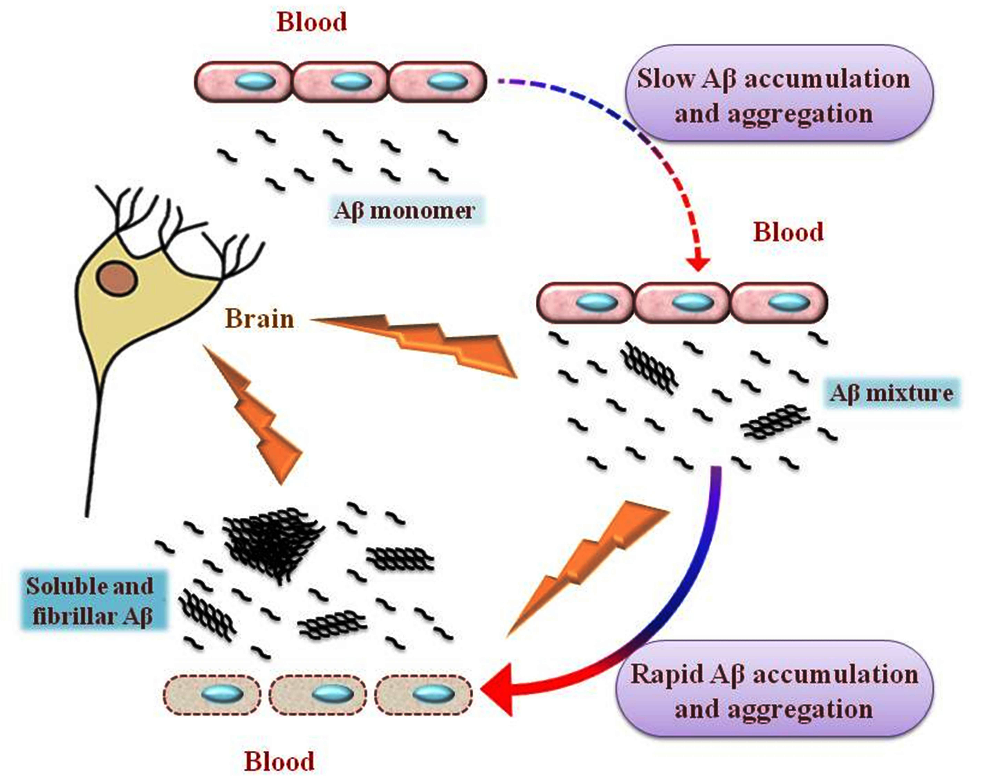
Disruptive effect of Aβ on the BBB
Qosa H., et al. Biochim Biophys Acta. 2014, 1842:1802

