Slide 1

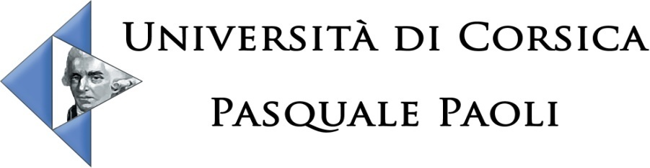

UMR CNRS 6134
Using Lipoxygenase pathway enzymes for the biotechnological production of compounds with aromatic properties
Pr Liliane Berti

Slide 2
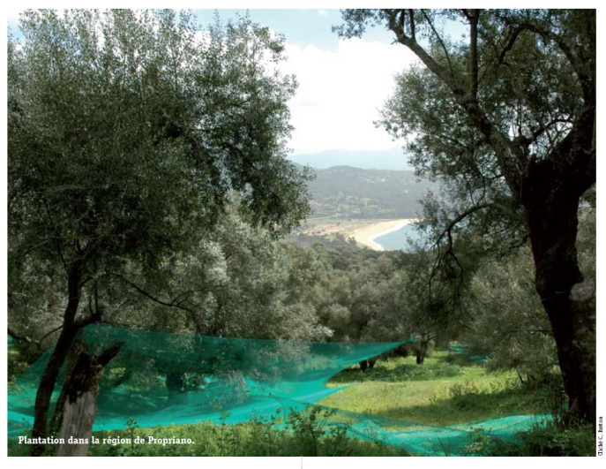
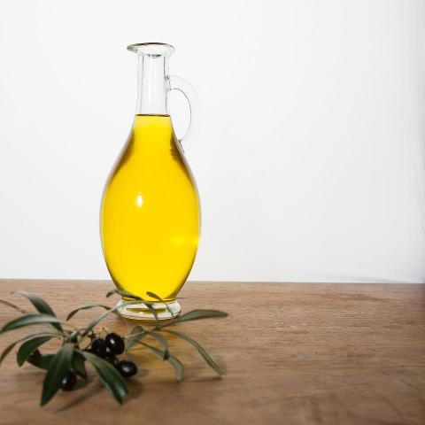
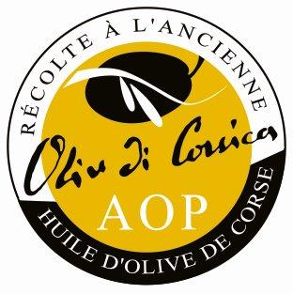
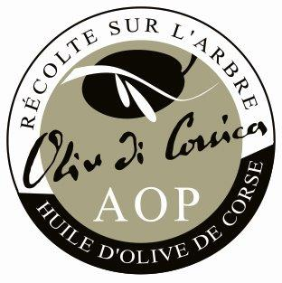
Olive oils labelled PDO
Olive oil is a genuine fruit juice obtained by simple pressure of olive paste
Olive tree is one of the most important crops in mediterranean countries
In France, the olive orchard is composed of 150 varieties cultivated in four regions including Corsica, which represents 10% of french production.
The Protected Designation of Origin (PDO) was obtained by the Corsican producers in 2004. This PDO refers to oils produced from olive cultivars grown in various areas

Slide 3
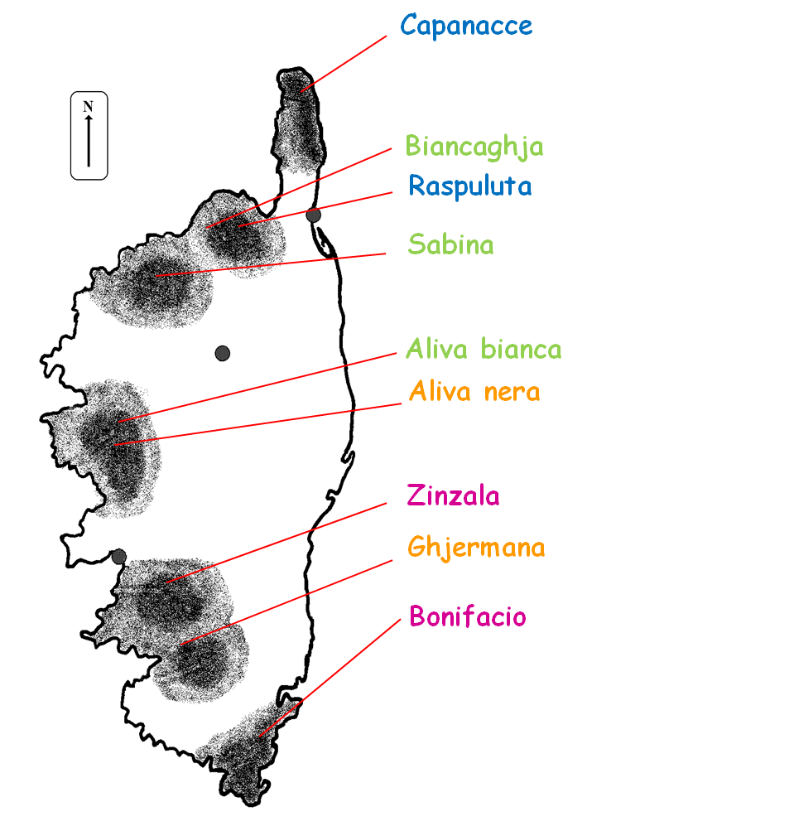
They belong to 4 varieties
(identification performed using molecular markers)
Aliva nera
Capanacce
Sabina
Zinzala
Nine main Corsican olive cultivars
Endemic varieties
Fatty acid and TAG compositions strongly depend on olive variety
Geographical location
of the corsican olive cultivars

Slide 4
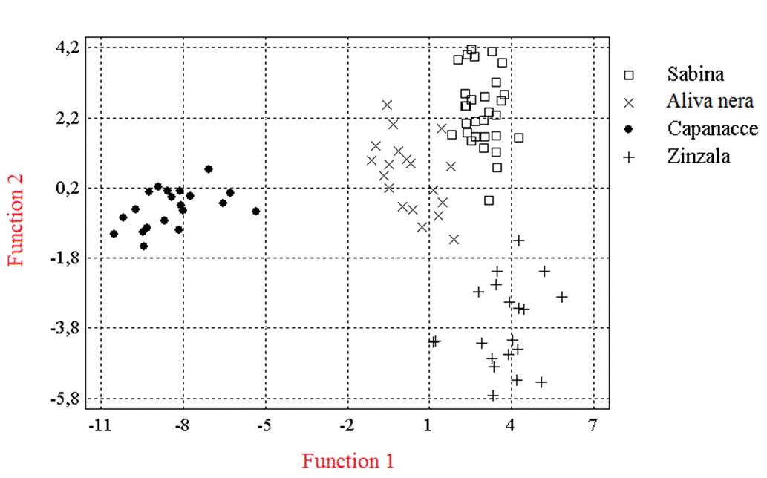
Chemometric method on the basis of variety
100% of oils samples were correctly classified in their variety’s group
The discriminating variables:
OOO (triolein) ; OOL (dioleo-linolein) ; PoOO (dioloo-palmitolein) ; OLL (dilinoleo-olein) et 18:0 (stearic acid)
Only five compounds allow to differentiate the four oils varieties
Oliv-Track, QLK1-CT-2002-02386

Slide 5
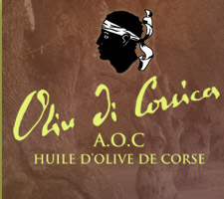
We have clearly established the relationships between some characteristics of the oil and the area of production for three varieties (Sabina, Zinzala and Capanacce) which are originated from Corsica
Our results showed a weak influence of environment
Bronzini de Caraffa et al. Eur. J. Lipid Sci. Tech., 2008, 110, 40 - 47

Slide 6
Research field of the laboratory
Laboratoire de Biochimie et Biologie Moléculaire du Végétal - Université de Corse
Characterization of the olive oil flavor
Identification of a metabolic cascade:
the lipoxygenase pathway
Lipoxygenases (LOX, EC 1.13.11.12):
first enzymes acting in the LOX pathway
Olive LOX 1: cloned and characterized in the laboratory
Notes:
6

Slide 7
Project BioSynthesis of Fragrances (BioSF)
7th Framework Program: EuroTransBio
Partners:
University of Marseille (France)
University of Firenze (Italy)
2 SME: Corsica Essences (Corsica) and BiCT (Milano, Italy)
Aim: Use of enzymes from the LOX pathway to produce in vitro flavoring compounds for application in industrial processes
Understanding of the catalytic mechanism of the first enzymes of the LOX pathway: olive lipoxygenase (LOX) and hydroperoxide lyase (HPL)

Slide 8

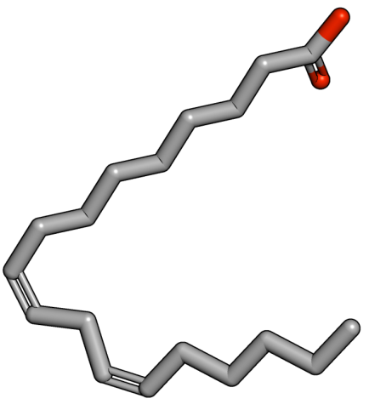
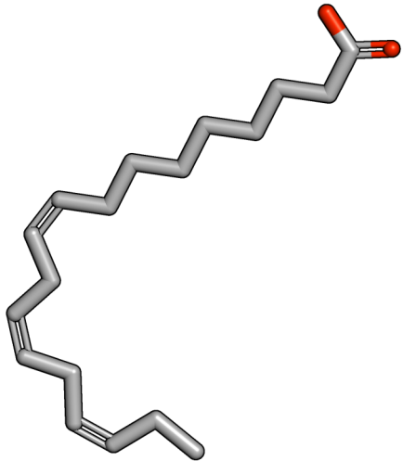
LOX pathway in plants
Linoleic acid 18:2
Poly-Unsaturated Fatty Acid (PUFA)
α-linolenic acid 18:3
Roles:
Physiological processes
(growth, senescence, …)
Answer to an environmental stress
(mechanical, biological)
LOX
PUFA hydroperoxide
reductase
PUFA-hydroxyl
POX
PUFA epoxy-hydroxyl
LOX
Conserved structure:
(1Z,4Z)-pentadienic system.
PUFA-keto
EAS
PUFA epoxy-hydroxyl
DES
PUFA divinyl ether
AOS
Octadecanoid pathway
HPL
Aldehydes, alcohols

Slide 9
LOX-HPL coupling in the flavor production
Linoleic acid
18:2
LOX
α-linolenic acid
18:3
9-hydroperoxides
13-hydroperoxides
9-hydroperoxides
13-hydroperoxides
HPL
For the production of these compounds: central role of a lipoxygenase
3Z-nonenal
(9 carbons)
hexanal
(6 carbons)
3,6 Z,Z-nonadienal
(9 carbons)
3Z-hexenal
(6 carbons)
Role in defense
(environmental stress)
Further conversion in corresponding alcohols
Flavoring properties:
green note
Notes:
9

Slide 10
Bioproduction of “green note”: an example
rLOX
rHPL
Lipases
Flour
O₂
Crushed leaves
Vegetable oil
Free fatty acids
Fatty acids hydroperoxides
« green note » compounds
Linseed oil
830 kg
Soybean flour
150 kg
Sugar beet leaves
6.4 T
Aldehydes
22.5 kg
Gigot, 2011
Notes:
10

Slide 11
Reactional mechanism
Hydrogen abstraction and electronic delocalization
Reactional mechanism is well known from a chemical point of view.
The regiospecificity and stereospecificity determinants are not well identified.
There are some LOXs with dual specificity, which means they produce both 9 and 13-hydroperoxides
n+2
n-2
O₂
O₂
2. Rearrangement of the radical
➔ regiospecificity
3. Antarafacial insertion of the oxygen
➔ stereospecificity
4. Protonation
13-hydroperoxide
13-LOX
9-LOX
9-hydroperoxide
Notes:
.
11

Slide 12
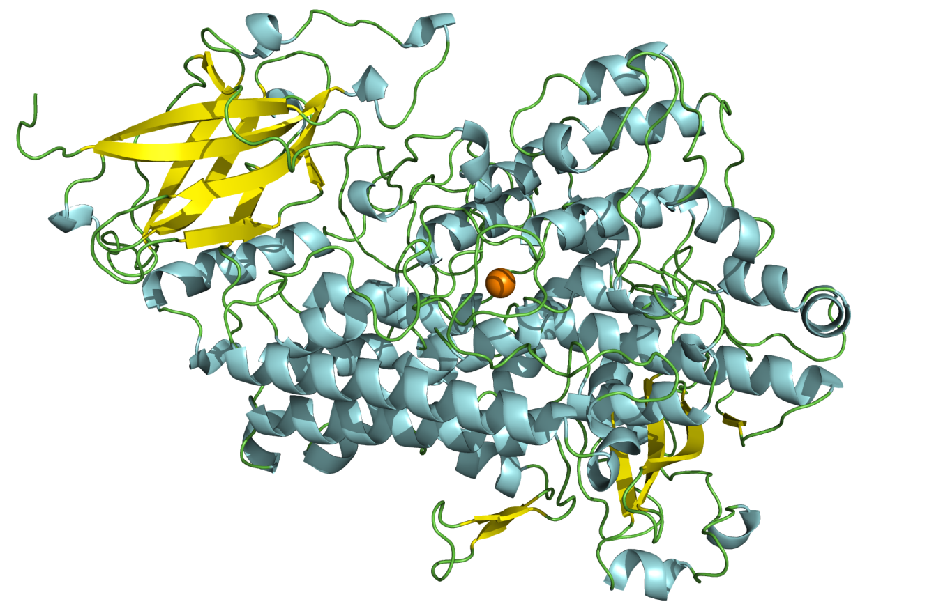
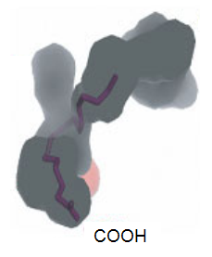
As LOX enzymes likely influence the organoleptic features of olive oil and in order to better understand the implication of individual LOX isoforms, we looked for new LOX enzymes.
Structure of the crystallized soybean LOX1
C-terminal domain
catalytic iron atom
α helices
N-terminal domain
- β barrel
Two cavities
described:
Fe
Fe
Notes:
12

Slide 13
LOX cDNA ISOLATION
We isolated a full length cDNA by RT-PCR and RACE PCR (2852 pb) encoding an olive LOX.
Molecular mass of 98.4 kDa
ORF of 2592 bp
Presumptive translation product of 864 aa
pI of 5.95
No consensus targeting nor retention signal for any organelles
confined to the cytosol.
Deduced amino acid sequence displayed 77.3% of identity with hazelnut LOX and 76.3% with tobacco LOX1.
Encoded by an unique copy of gene.

Slide 14
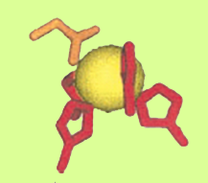
Several highly conserved regions were identified
Substrate binding domain:
A₃₆₄WRTDEEFARMLAG₃₇₈ + T₅₈₂V₅₈₃
TV motif predominant in 9-LOXs and present in few 13-LOXs
Ligands of iron atom:
I₈₆₄
N₇₂₀
H₅₃₀
H₅₂₅
H₇₁₆
Oxygen binding domain:
A₇₁₂SALHAAVNFGQY₇₂₄
C-terminus domain: G₈₅₇IPNSVSI₈₆₄

Slide 15




Biochemical Characterization of recombinant olive LOX
Induction by IPTG (1mM) and low temperature (15°C).
Soluble fraction
Westernblot
kDa
Sephadex
Nickel
Expression in E. coli in supernatant.
116
LOX
Purification by a two-step procedure:
66
Nickel chelated column
45
35
Sephadex 200 gel filtration.
25
18
Unique band at 98 kDa in SDS-PAGE and immunoblot.
14
4.18 mg of recombinant protein from 5 liters of culture medium.

Slide 16
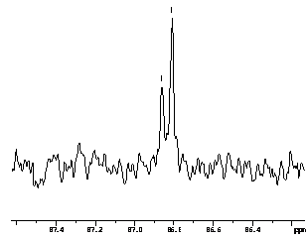
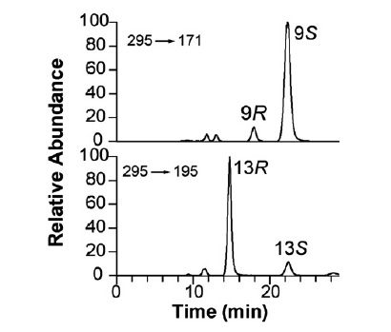
Characterization of the recombinant olive LOX
Regio- and stereo-specificity of recombinant olive LOX
80 Units of r olive LOX were incubated with 5,36 mM linoleic acid, 30 min at 4°C.
Products analysis by
13C-NMR.
by chiral-phase HPLC-MS/MS
9/13-LOX
9S 13R LOX
carbon 9 of 9-hydroperoxy octadecadienoic acid
carbon 13 of 13-hydroperoxy octadecadienoic
acid
9-HPODE
13-HPODE
Palmieri-Thiers, 2009, Biochim. Biophys Acta, 1971, 339-346

Slide 17
LOX EXPRESSION AND ENZYMATIC ACTIVITY DURING OLIVE FRUIT DEVELOPMENT
Turning stage
Green stages
Black stages
LOX activity detected in all stages with maximal activity at black stage.
9/13-LOX expressed in black olives.
a 13-LOX was purified from black olives.
Green stages
Black stages
Turning stage
At least two isoforms in black olives

Slide 18
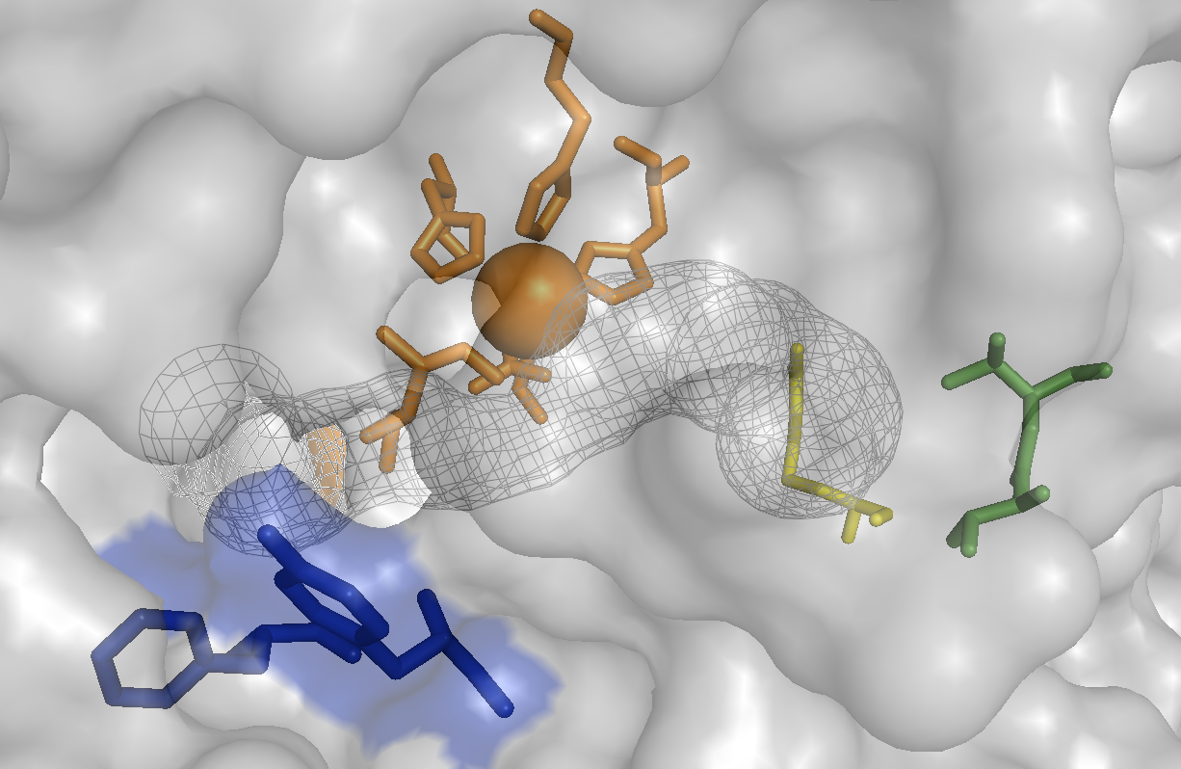
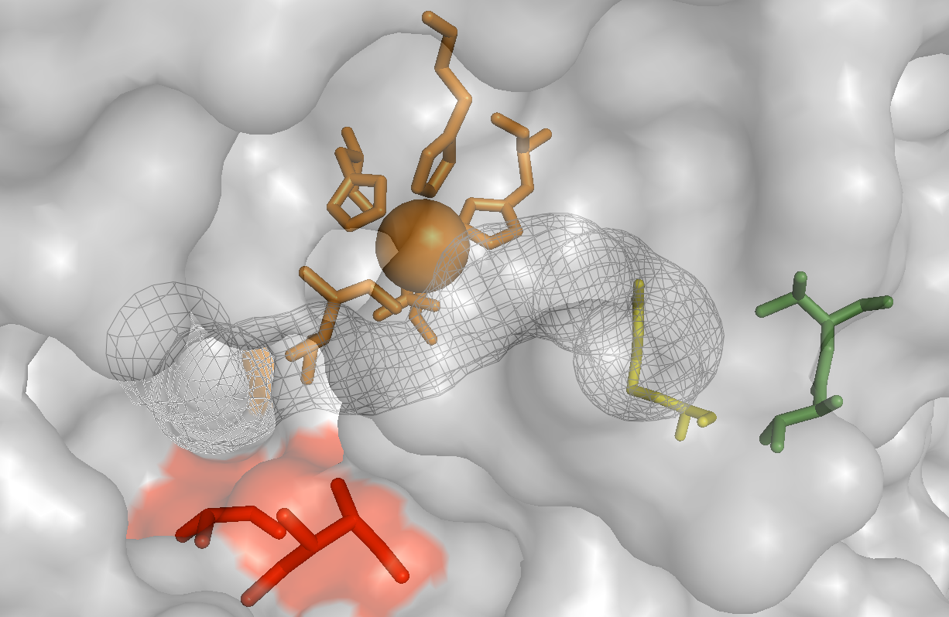
Structural modeling and site-directed mutagenesis
Presence of two particularly bulky residues located at the site entrance (blue): mutant enzymes were constructed by replacement of bulky amino acid residues with the less space-ﬁlling residues (red)
His530
His530
His716
His716
His525
His525
Ile864
Fe
Arg733
Val583
Ile864
Fe
Arg733
Val583
Asn720
Asn720
Phe277
Thr582
Ala277
Thr582
Tyr280
Ile280
The removal of steric bulk at the entrance of the catalytic site induces an increase of substrate afﬁnity and of catalytic efﬁciency
Palmieri-Thiers, 2011, Arch. Biochem. Biophys. 509, 82-89
EuroTrans-Bio 2009-94, ‘‘Biocatalyzed synthesis of fragrances’’
Notes:
18

Slide 19

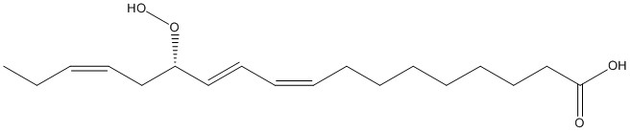
Bioproduction of green note
LOX
Linolenic hydroperoxide
Substrates are cleaved by hydroperoxide lyase (HPL) to generate short-chain aldehydes (C6 or C9) and oxoacids (C12 or C9)
3Z-hexenal
Oxo-acid

Slide 20
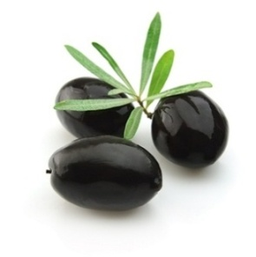
HPL cDNA ISOLATION
We isolated a full length cDNA (1641 pb) encoding an olive 13HPL.
Leccino variety
Molecular mass of 50 kDa
Presumptive translation product of 487 aa
pI of 6.9
99.8 % identity with the olive HPL sequence of the Picual variety

Slide 21
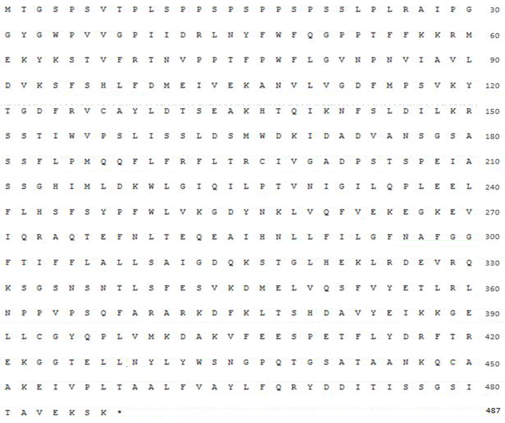
HPLs: heminic enzymes classified in the cytochrome P450 family
N-terminal transit peptide
targeting and insertion to the chloroplast envelope
Contains the four conserved domains of CYP74
Domain A
Contains the sequence of the helix I
N₂₆₉A₂₉₇F₂₉₈G₂₉₉G₃₀₀F₃₀₁T₃₀₂
Domain B
Domain C
Contains the cysteine residue (C449)
Domain D
Notes:
Enzyme plus courte à l’extrémité Nter et un aa modifié dans la séquence

Slide 22

Biochemical Characterization of recombinant olive HPL
Incubation 48 h at 15 C after addition of
IPTG (0,5 mM) and δ-aminolevulinic acid (2.5mM)
Expression in E. coli in supernatant.
Cobalt
Purification by affinity chromatography using Cobalt chelated column
Western Blot
kDa
116
Unique band at 50 kDa in SDS-PAGE and immunoblot.
66
45
HPL
35
25
We have deleted the sequence encoding the transit peptide HPLdel
18
14

Slide 23
rHPLs Characterization
Determination of optimum pH
Determination of optimum temperature
7.5
25°C
HPLwt
HPLwt
HPLwt and HPLdel displayed an optimum pH at 7.5 and an optimum temperature
at 25 °C

Slide 24
rHPLs Characterization
Kinetic parameters of purified recombinant olive HPLwt and HPLdel
HPL | Substrates |  | Km (µM) | Vm (nmol.s⁻¹) |  | kcat (s⁻¹) | kcat/Km (s⁻¹.µM⁻¹)
HPLwt | 13-HPOD | 43.10 ± 4.46 |  |  | 0.48 ± 0.06 | 26.38 ± 3.01 | 0.62
 | 13-HPOT | 152.75 ± 10.36 |  |  | 10.35 ± 0.68 | 564.95 ± 36.89 | 3.71
HPLdel | 13-HPOD | 43.22 ± 7.87 |  |  | 0.34 ± 0.01 | 17.89 ± 0.53 | 0.43
 | 13-HPOT | 173.85 ± 27.70 |  |  | 7.65 ± 0.07 | 402.62 ± 3.66 | 2.36
13-HPOD: 13-hydroperoxide of linoleic acid 13-HPOT: 13-hydroperoxide of linolenic acid
catalytic efficiency (kcat/Km) of both HPLs significantly higher for 13-HPOT than for 13-HPOD
HPLwt seems to act more effectively on 13-HPOT and 13-HPOD than
HPLdel

Slide 25





C6 Aldehydes Production
Biosynthesis of green note compounds
13S-HPOD
13S-HPOT
13-HPL
Optimization of the reaction
Different substrate concentrations (13-HPOD and 13-HPOT) : 2; 4; 6 mM
Different enzyme concentrations (HPLwt et HPLdel) : 0.25; 0.5; 1 U.mL⁻¹
Different time of reaction : 1; 5; 10; 15; 20 min
Hexanal
3Z-hexenal
Extraction by dichloromethane.
Volatile green notes were quantified by GC-FID and identified by GC-MS.

Slide 26
Biosynthesis of C6 aldehydes
Hexanal production at 25 °C
 | Amount (U.mL⁻¹) | 13-HPOD (mM) | Hexanal (mM) | Optimum reaction time (min)
HPLwt | 1 | 6 | 5.61± 0.48 93.5 % | 10
HPLdel | 1 | 6 | 3.93 ± 0.15 65.5 % | 20
The amounts of 3Z-hexenal were lower than the amounts of hexanal
But both HPLs act more effectively on the 13-HPOT than on the 13-HPOD
3Z-hexenal production at 25 °C
 | Amount (U.mL⁻¹) | 13-HPOT (mM) | 3Z-hexenal (mM) | Optimum reaction time (min)
HPLwt | 0.5 | 6 | 2.26 ± 0.02 38 % | 5
HPLdel | 0.5 | 4 | 1.12 ± 0.02 28 % | 20
high volatility of 3Z-hexenal to 25°C ?
Jacopini et al. 2016, Appl Biochem Biotechnol,179:671–683

Slide 27
Biosynthesis of C6 aldehydes
 | Temperatures | Amount (U.mL⁻¹) | 13-HPOT (mM) | 3Z-hexenal (mM) | Optimum reaction time (min)
HPLwt | 25°C | 0.5 | 6 | 2.26 ± 0.02 38 % | 5
 | 15°C | 0.5 | 6 | 2.86 ± 0.13 48% | 15
 | 10°C | 0.5 | 6 | 4.39 ± 0.38 73 % | 15
Maximal molar conversion rate of
73 % at 10°C
 | Temperatures | Amount (U.mL⁻¹) | 13-HPOT (mM) | 3Z-hexenal (mM) | Optimum reaction time (min)
HPLdel | 25°C | 0.5 | 4 | 1.12 ± 0.02 28 % | 20
 | 15°C | 0.5 | 4 | 1.74 ± 0.18 43 % | 20
 | 10°C | 0.5 | 4 | 1.80 ± 0.05 45 % | 15
Maximal molar conversion rate of
45 % at 10 °C
HPLwt appears to be a promising
efficient biocatalyst

Slide 28
Using recombinant HPL olive in a complete biocatalysis process
Candida rugosa
Soybean LOX
Olive
HPL
Commercial Lipase
Commercial LOX
recombinant HPL
Oils
C18: 2
C18: 3
Hydroperoxides
Aldehydes

Slide 29
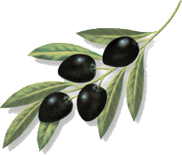
Thank you for your attention
UMR 6134 SPE
University of Corsica
Project “Natural Ressources”
University Of Sweden
E Oliw
J Maury V Brunini
C Gambotti M Mariani
JC Alberti F Tomi
A Muselli J Costa
S Vincenti S Jacopini
Corsica Essences
P Paquet

