Slide 1








University of Excellence
Estrogen-like properties of polyphenols from olive oil

Slide 2
Nuclear Receptors/ Natural Compounds
Estrogen receptors:
- Interaction of signaling pathways
- Screening tools for novel compounds
Androgen receptors:
- Anabolic steroids – detection and biomedical side effects
- Prostate cancer microenvironment
Developmental programming & breast cancer (prevention):
- Fetal, neonatal, pubertal exposure
- Epigenetic mechanisms
Menopausal applications of dietary supplements:
- Efficacy: bone health
- Safety: breast cancer and endometrial hyperplasia

Slide 3
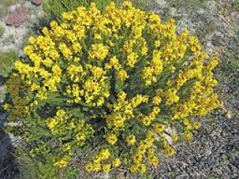
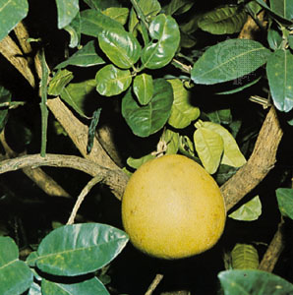





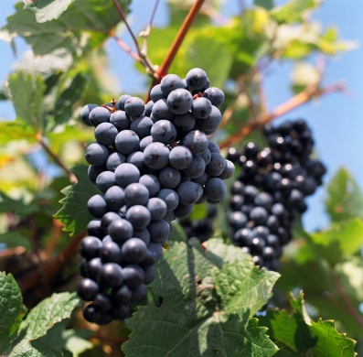
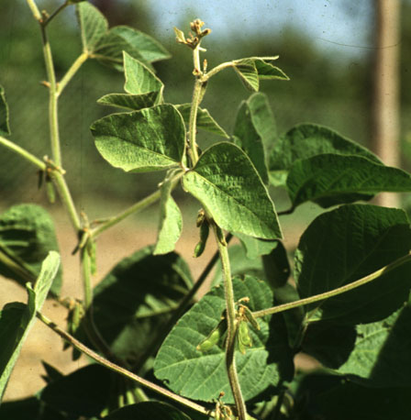


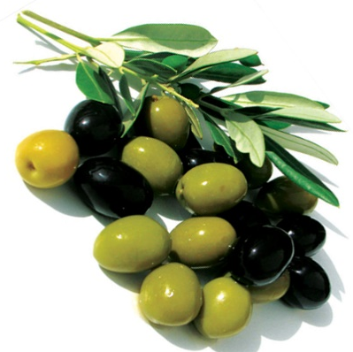
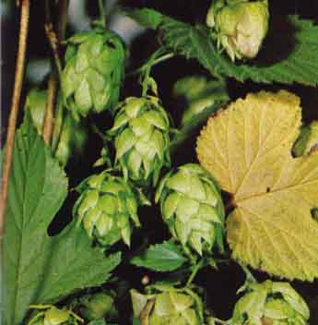

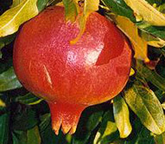
Leandros Skaltsounis
Maria Halabalaki
Sefirin Djiogue
Honey Bush (Cyclopia genistoides
Grapefruit (Citrus grandis)
Red Clover (Trifolium pratense)
Siberian Rhubarb (Rheum rhaponticum)
Alfalfa (Medicago sativa)
Problem: Efficacy (vasomotor symptoms, osteoporosis) and safety (endometrial and breast cancer) often not well investigated
Fennel (Foeniculum vulgare )
Monotes (Monotes engleri)
Red Wine (Vitis vinifera)
Soybean (Glycine max)
Black Cohosh (Actaea racemosa)
Coral Tree (Erithrina spec. )
Olive (Olea europaea)
Hops (Humulus lupulus)
Flax (Linum sitatissimum)
Pomegranate (Punica granatum)
Notes:
Heterologous group of plant-derived estrogens with the capacity to interfere estrogen dependent signal transduction cascades by binding to the estrogen receptors (ER)
> 20 substances
> 300 different plants
> 16 families
(Ren et al.2001)

Slide 4
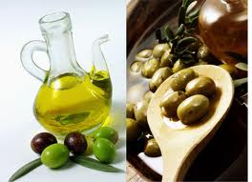
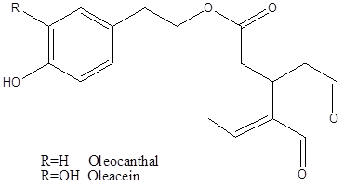
Bone protection as a selected biological activity of polyphenols from olive oil
Bone protective in the model of the inflammation-induced bone loss
  Oleuropein: Puel et al., 2006
  Hydroxy-/tyrosol: Puel et al., 2008
  Olive oil: Saleh et al., 2011
Bone protection in models of hormone deficiency related bone loss?
  Hormonal activities?
Oleacein: 3,4‐DHPEA‐EDA (Oleacein) Synonyms: 3,4‐DHPEA‐Elenolic acid Di‐Aldehyde; Oleuropein‐aglycone dialdehyde (Decarboxymethyl oleuropein‐aglycone major form)
Oleocanthal: 3,4‐HPEA‐EDA

Slide 5
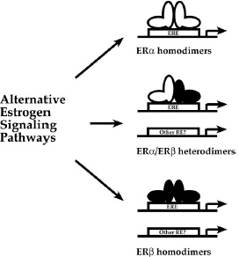
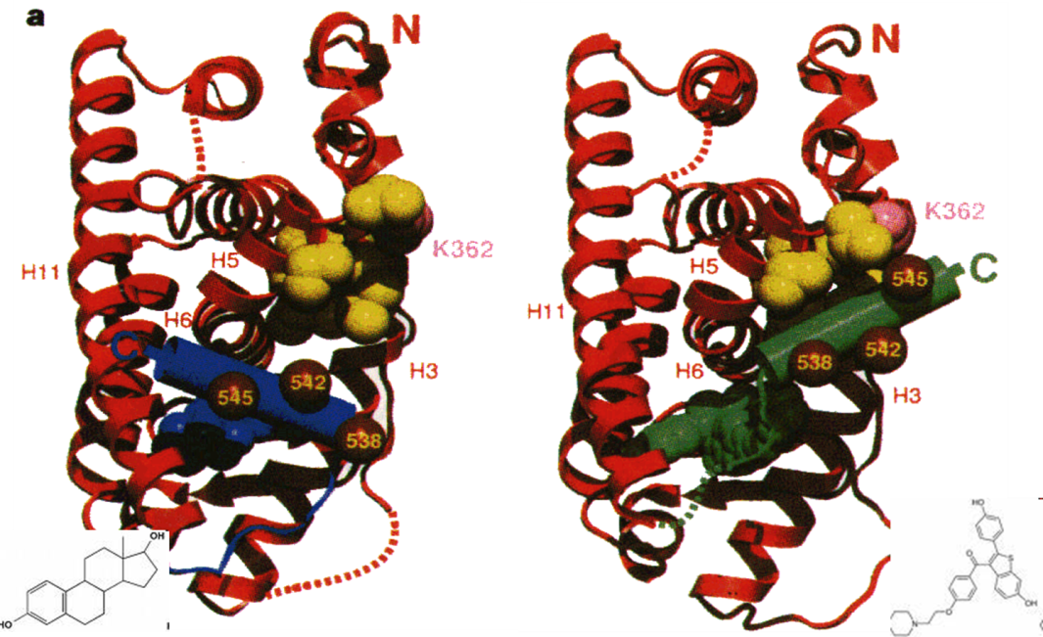
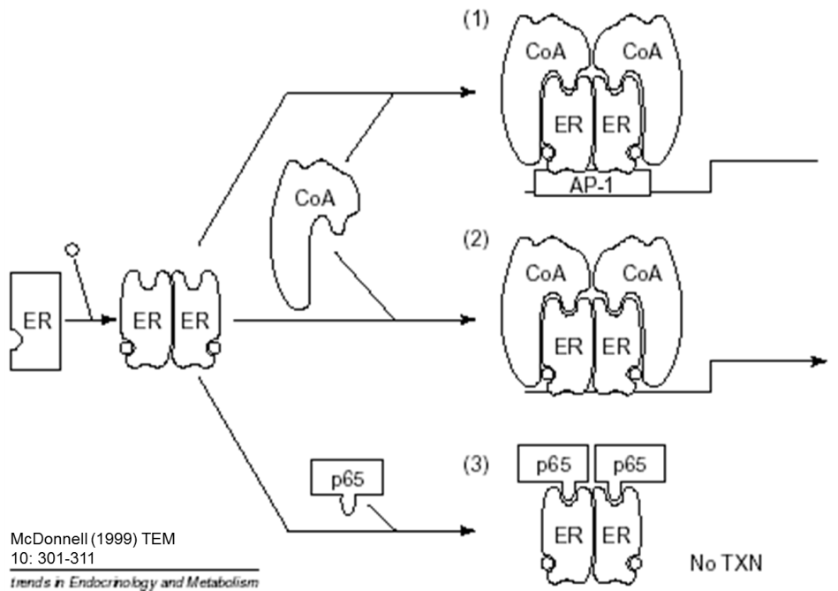
Pettersson K. and Gustafsson J.-A. (2001) Ann. Rev. Physiol. 63: 165-192.

Slide 6
Screening approaches for estrogenic activities
Approach | Extract | Single compound
Ligand binding assay | Yes (matrix effects !!!) | Yes
In silico screening/ docking | No | Yes
High troughput screening | No | Yes
High capacity | Yes | Yes
Reporter gene assays | Yes | Yes
Gene expression (qPCR) | Yes | Yes

Slide 7
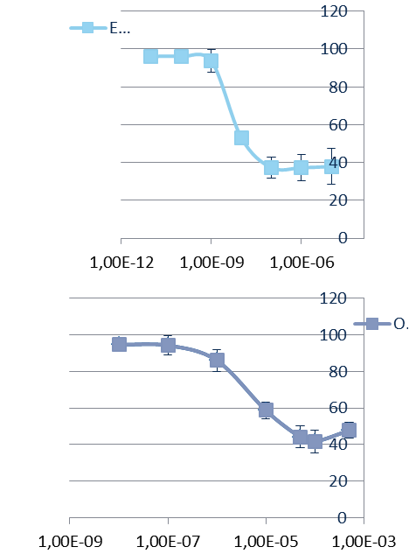
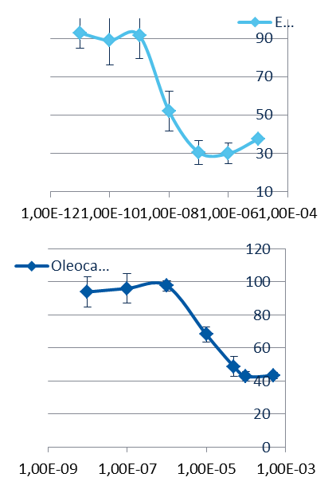
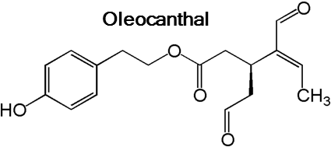
Relative binding affinity of oleocanthal
 | ERα |  | ERβ
 | IC₅₀ | RBA [%] | IC₅₀ | RBA [%]
17β-estradiol | 6.99 nM | 100 | 7.85 nM | 100
Oleocanthal | 6.87 µM | 0.102 | 47.17 µM | 0.0166
Impact of a functionalized olive oil extract on the uterus and the bone in a model of postmenopausal osteoporosis Keiler AM, Zierau O, Bernhardt R, Scharnweber D, Lemonakis N, Termetzi A, Skaltsounis L, Vollmer G, Halabalaki M. 2014 Eur J Nutr. 53:1073-1081

Slide 8
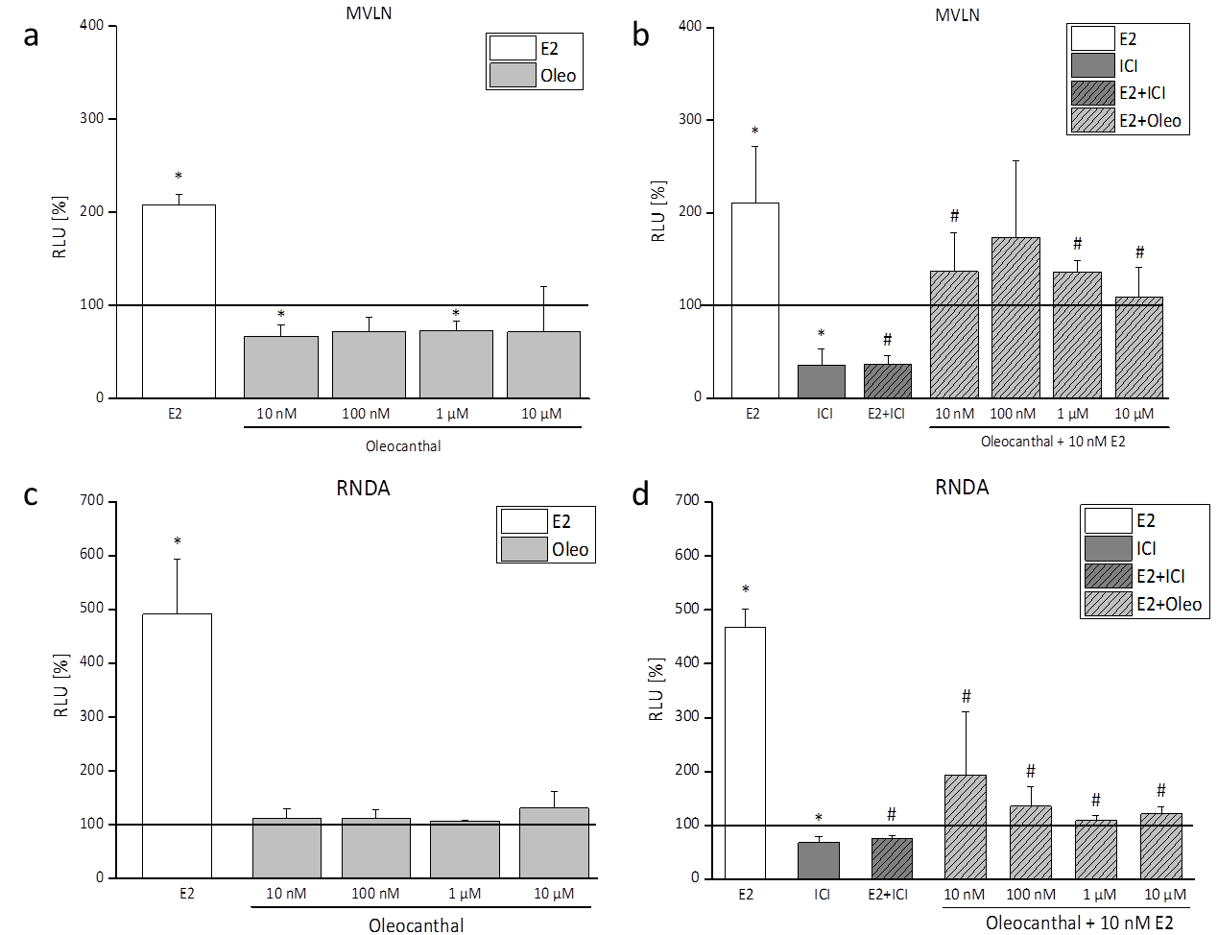
Reporter gene activity in ERα and ERβ dependent cell lines
Oleocanthal modulates estradiol-induced gene expression involving estrogen receptor-α. Keiler AM, Djiogue S, Ehrhardt T, Zierau O, Skaltsounis L, Halabalaki M, Vollmer G. 2015 Planta Med. 81: 1263-1269

Slide 9
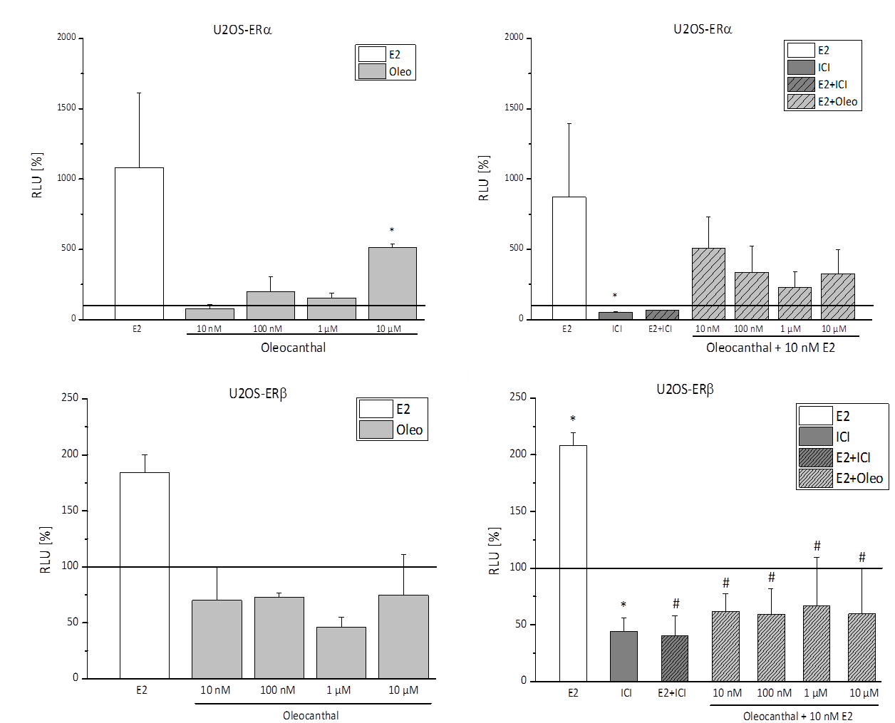
Reporter gene activity in ERα or ERβ dependent bone cell lines
Oleocanthal modulates estradiol-induced gene expression involving estrogen receptor-α. Keiler AM, Djiogue S, Ehrhardt T, Zierau O, Skaltsounis L, Halabalaki M, Vollmer G. 2015 Planta Med. 81: 1263-1269

Slide 10
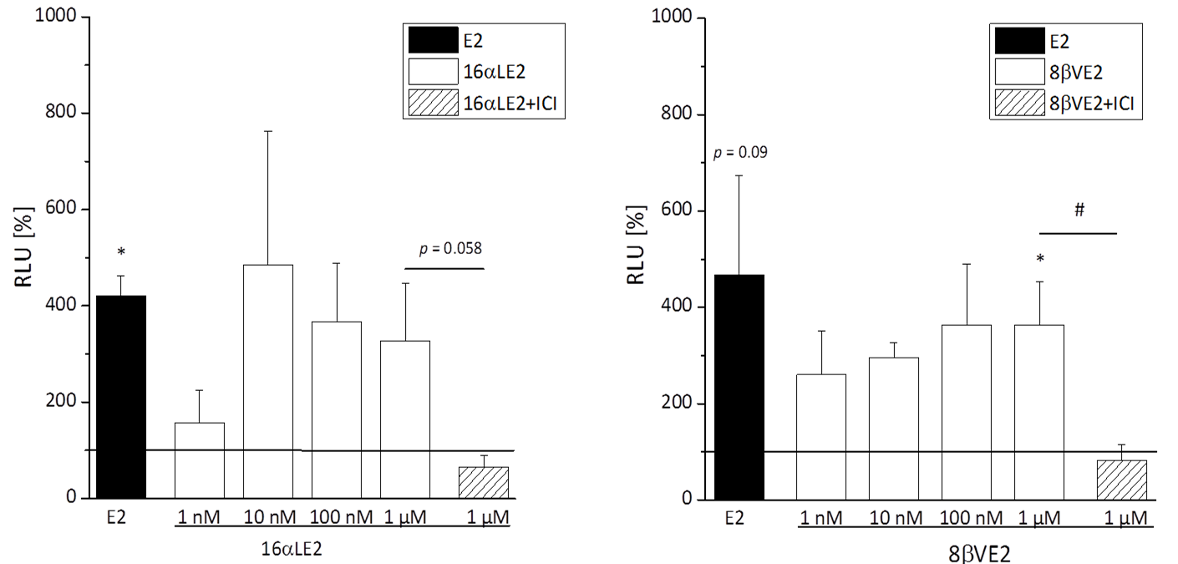
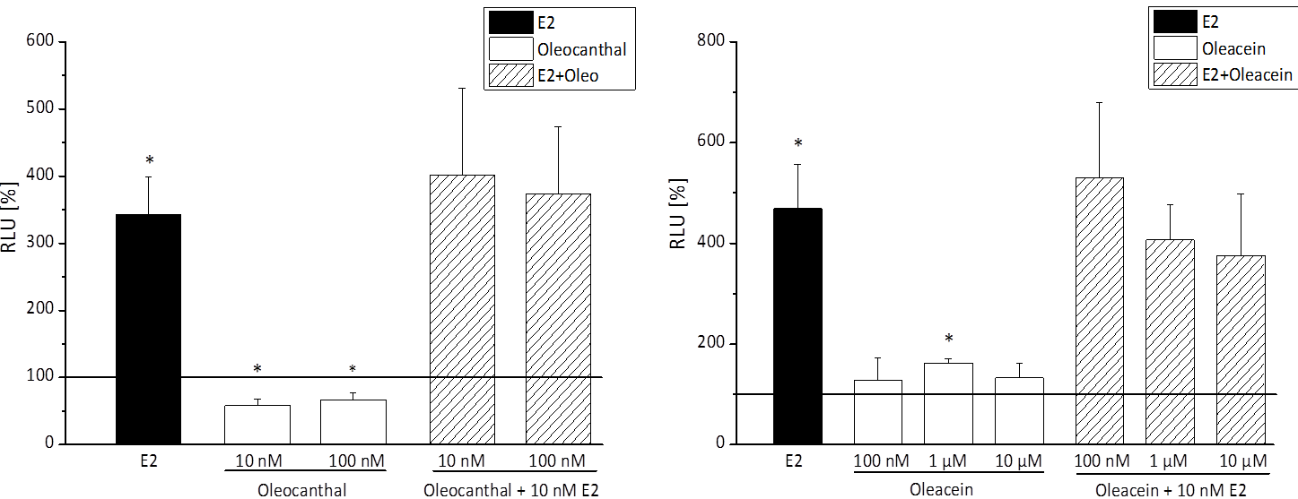
Reporter gene activity in bone cell lines expressing both ERs
Oleocanthal modulates estradiol-induced gene expression involving estrogen receptor-α. Keiler AM, Djiogue S, Ehrhardt T, Zierau O, Skaltsounis L, Halabalaki M, Vollmer G. 2015 Planta Med. 81: 1263-1269

Slide 11
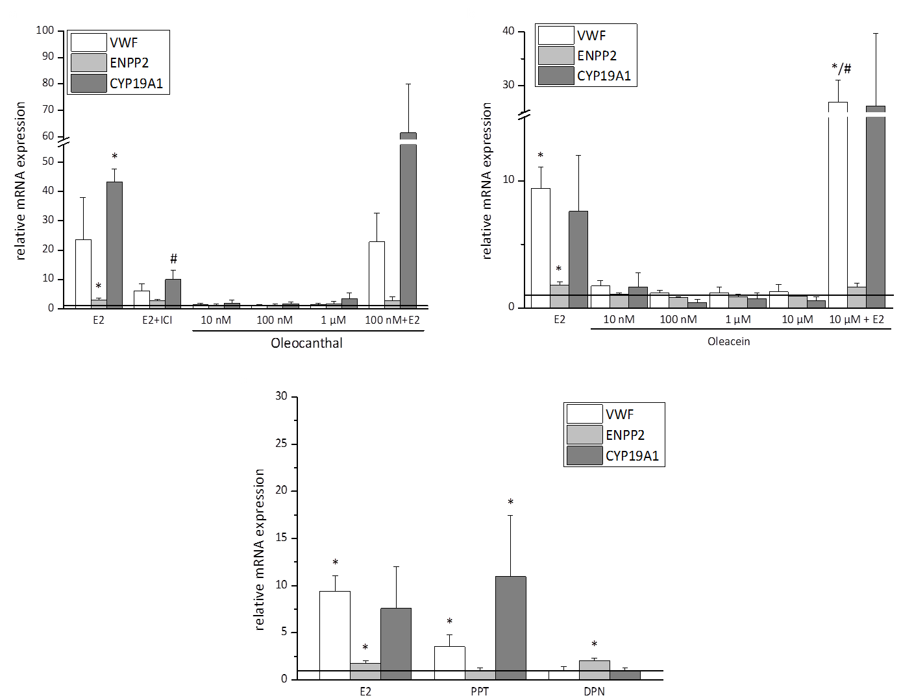
Regulation of gene expression in bone cell lines expressing both ERs
Oleocanthal modulates estradiol-induced gene expression involving estrogen receptor-α. Keiler AM, Djiogue S, Ehrhardt T, Zierau O, Skaltsounis L, Halabalaki M, Vollmer G. 2015 Planta Med. 81: 1263-1269

Slide 12
Summary of effects in vitro of oleocanthal
Estrogen-like activities of oleocanthal
  Distinct, but weak relative binding affinities to both ERs
  Weak, if any, agonistic activity in reporter gene assays
  Strong inhibition of E2-induced reporter gene activity
  Enhancement of ERα dependent activities of E2 in cellular systems expressing both ERs. In other words, weak mixed agonistic properties of E2 are shifted to a stronger, pure ERα agonistic response in the presence of oleocanthal.
  Are we dealing with a covalent binding to the ligand binding pocket?

Slide 13
Aim of the in vivo study
Investigation of potential bone sparing activities of olive oil total polyphenolic fraction on ovariectomy induced bone loss

Slide 14
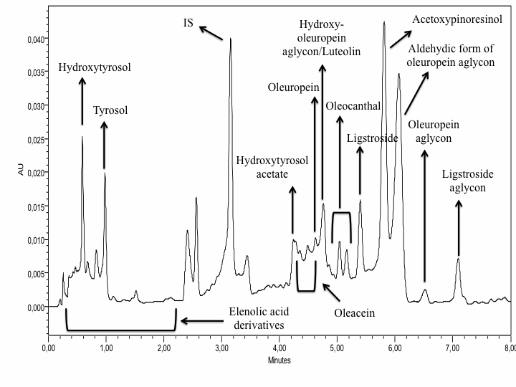
Impact of a functionalized olive oil extract on the uterus and the bone in a model of postmenopausal osteoporosis Keiler AM, Zierau O, Bernhardt R, Scharnweber D, Lemonakis N, Termetzi A, Skaltsounis L, Vollmer G, Halabalaki M. 2014 Eur J Nutr. 53:1073-1081

Slide 15
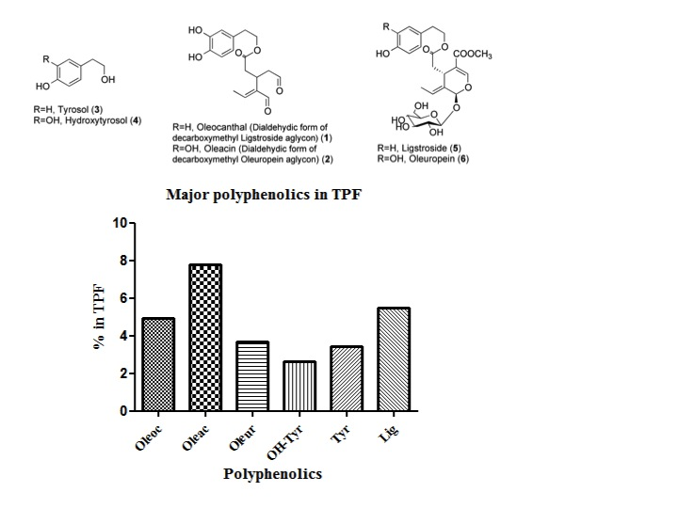
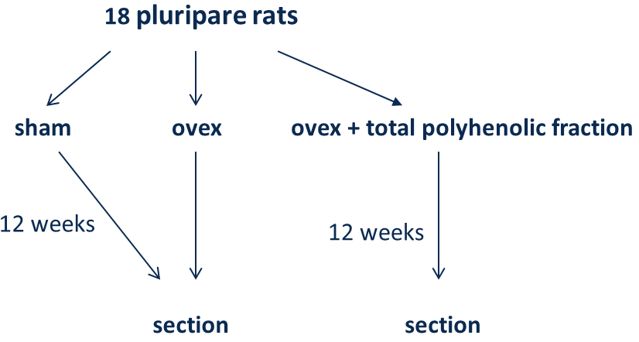
Rat feed
Total polyphenolic fraction | 800 ppm
Compounds of interest | 150 ppm
Impact of a functionalized olive oil extract on the uterus and the bone in a model of postmenopausal osteoporosis Keiler AM, Zierau O, Bernhardt R, Scharnweber D, Lemonakis N, Termetzi A, Skaltsounis L, Vollmer G, Halabalaki M. 2014 Eur J Nutr. 53:1073-1081

Slide 16
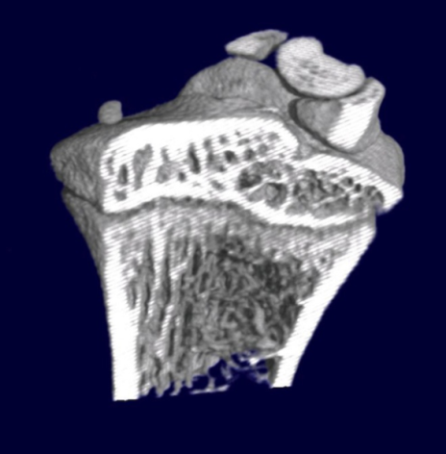
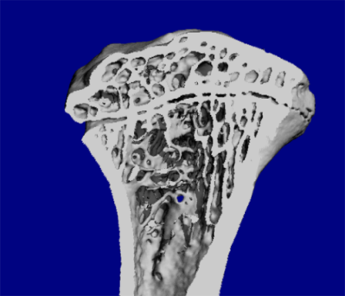
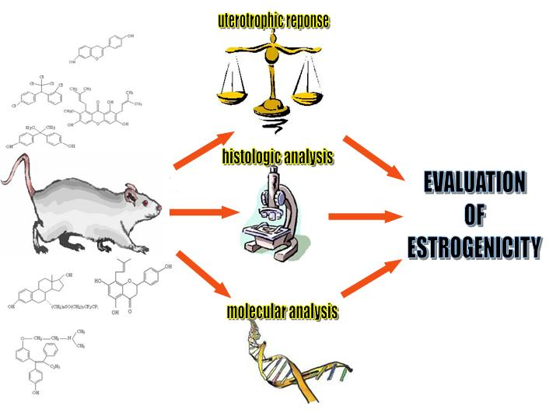
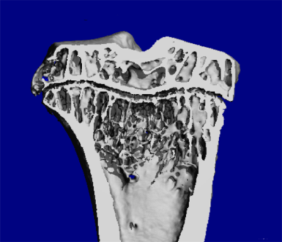
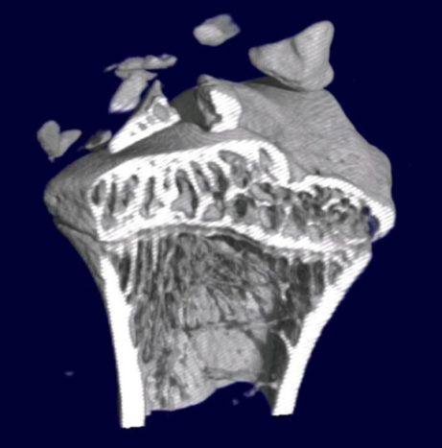
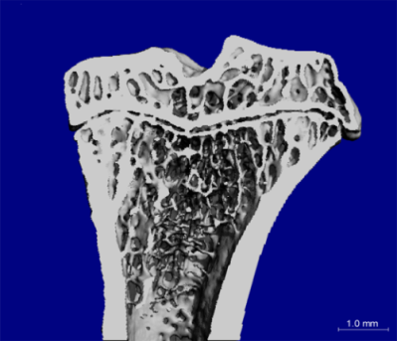
Ovariectomy induced bone loss as model for osteoporosis
Week 0
sham
ovx
Week 10
Abbreviation | Description | Unit
BV/TV | Bone volume/ total volume | %
Tb.N | Number of trabeculae | 1/mm
Tb.Th | Thickness of trabeculae | mm
Tb.Sp | Distance between trabeculae | mm
Conn.D | Connectivity | 1/mm³
T-BMD | Trabecular bone density | mg/cm³
ovx+E2
Keiler et al. 2012, Lab Animal 46: 237-244

Slide 17
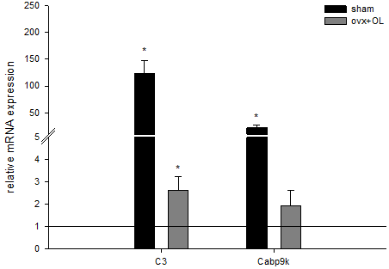
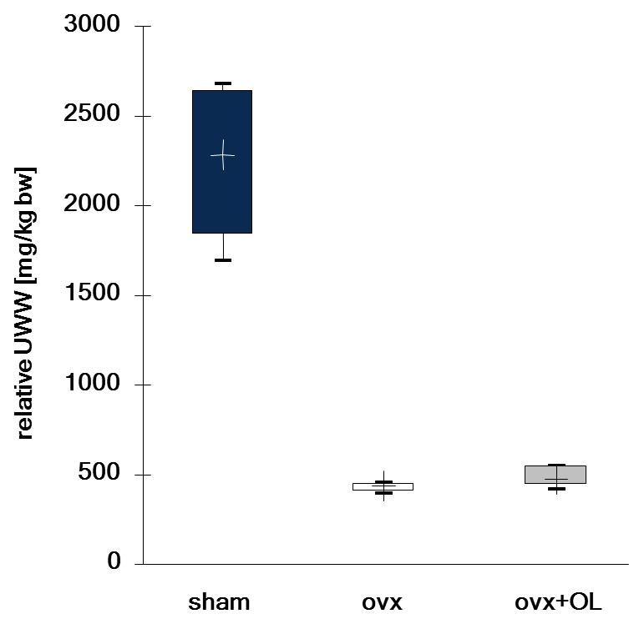
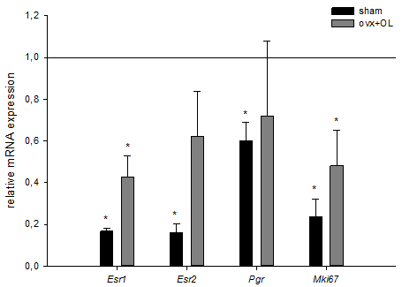
Estrogenic responses
Impact of a functionalized olive oil extract on the uterus and the bone in a model of postmenopausal osteoporosis Keiler AM, Zierau O, Bernhardt R, Scharnweber D, Lemonakis N, Termetzi A, Skaltsounis L, Vollmer G, Halabalaki M. 2014 Eur J Nutr. 53:1073-1081

Slide 18
Week 0
sham
 | sham | ovx | ovx + OL
BV/TV [%] | 30.2±8.7 | 17.4±1.6 [<0.001*] | 18.4±2.2
Conn.D [1/mm³] | 32.6±14.5 | 15.6±3.6 [0.034*] | 18.5±4.2
Tb.N [1/mm] | 3.05±0.73 | 2.40±0.11 | 2.43±0.29
Tb.Th [mm] | 0.122±0.005 | 0.110±0.007 [0.015*] | 0.111±0.005
Tb.Sp [mm] | 0.308±0.105 | 0.386±0.010 | 0.392±0.057
ovx
Week 10
Impact of a functionalized olive oil extrac on the uterus and the bone in a model of postmenopausal osteoporosis Keiler AM, Zierau O, Bernhardt R, Scharnweber D, Lemonakis N, Termetzi A, Skaltsounis L, Vollmer G, Halabalaki M. 2014 Eur J Nutr. 53:1073-1081
ovx+E2
Abbreviation | Description | Unit
BV/TV | Bone volume/ total volume | %
Tb.N | Number of trabeculae | 1/mm
Tb.Th | Thickness of trabeculae | mm
Tb.Sp | Distance between trabeculae | mm
Conn.D | Connectivity | 1/mm³
T-BMD | Trabecular bone density | mg/cm³
Keiler et al. 2012, Lab Animal 46: 237-244

Slide 19
Summary and conclusions oleocanthal
Estrogen-like activities of oleocanthal
  Distinct, but weak relative binding affinities to both ERs
  Weak, if any, activity in reporter gene assays
  Strong inhibition of E2-induced reporter gene activity
  Enhancement of ERα dependent activities of E2 in cellular systems expressing both ERs. In other words, weak mixed agonistic properties of E2 are shifted to a strong, pure ERα agonistic response in the presence of oleocanthal.
In vivo activities of oleocanthal
  Oleocanthal in a uterotrophic assay in vivo: No uterine response, no bone effects
    Fortification with Vit D3 leads to enhancement of response in a mouse model (Tagliaferri et al. 2014, PLOSone)
  Weak estrogen-like gene regulatory properties in the uterus
Conclusions
  Oleocanthal clearly interferes with the activity of E2 on the level of the ERs.
  Enhancement of ERα-mediated responses of E2 in a heterodimeric receptor situation of ERα and ERβ represents a new functional quality.
  The observed activity is shared amongst dialdehydic polyphenol derivatives from olive oil.
  Bioavailability??????

Slide 20
Outlook: cancer prevention
Bone protective in the model of the inflammation-induced bone loss
  Oleuropein: Puel et al., 2006
  Hydroxy-/tyrosol: Puel et al., 2008
  Olive oil: Saleh et al., 2011
Hormonal activities?
Tumor prevention?
  AMPK inhibitory activity
    HPEA-EDA: Khanal et a. 2011
  C-Met-Inhibition and breast cancer
    Oleocanthal: Akl et al. 2014
  Inhibition of MIP-1α in multiple myeloma
    Oleocanthal (Sotece et al. 2013)
Oleacein: 3,4‐DHPEA‐EDA (Oleacein) Synonyms: 3,4‐DHPEA‐Elenolic acid Di‐Aldehyde; Oleuropein‐aglycone dialdehyde (Decarboxymethyl oleuropein‐aglycone major form)
Oleocanthal: 3,4‐HPEA‐EDA

Slide 21
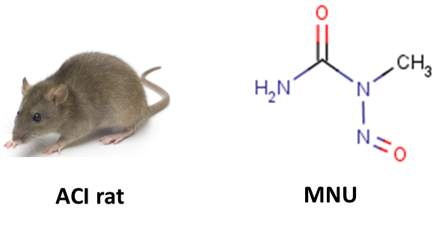

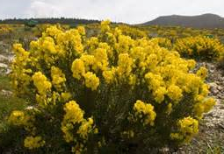
Animal | Inductor | Duration
ACI rat | E2 releasing device | > 300 days
Sprague-Dawley rat | Methylnitrosourea MNU | ≈ 150 days
Prevention:
SHAM animals extract added to chow
No stimulation of estrogen dependent tumor growth,
(Manuscript in preparation)
Cancer prevention of cyclopia extracts
(Visser et al. 2016, JSBMB)
Arrival animals
MNU
50 mg/kg KG
Analysis of Tumors
Determination of body weight and tumor growth
Determination of food intake
PND40
PND 49, 52
PND 84
PND 220
Estrogenicity:
Ovex animals extract added to chow

Slide 22
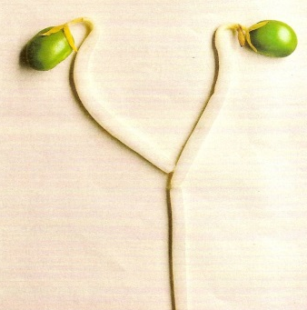
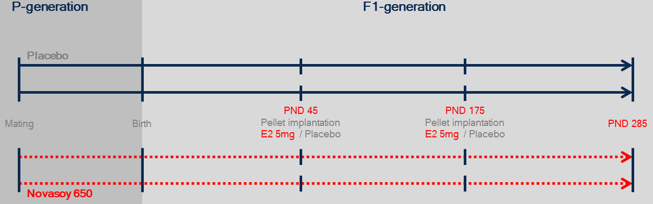

Animal | Inductor | Duration
ACI rat | E2-Pellet | > 300 days
Sprague-Dawley rat | Methylnitrosourea MNU | ≈ 150 days
 | Placebo diet | sISO diet
 | E2 silicone | E2 silicone
Tumor incidence | 8/10 | 6/10
Total number of tumors | 37 | 12
Tumors per tumor-bearing animal | 4.5 ± 1.8 | 2.0 ± 1.3 (p=0.018)
Tumor wet weight [g] | 3.1 ± 1.5 | 7.7 ± 4.6
Terminal tumor volume [cm³] | 6.8 ± 4.8 | 19.0 ± 12.2
Tumor specific growth rate | 0.15 ± 0.11 | 0.11 ± 0.07
Möller et al., ATOX, 2016

Slide 23
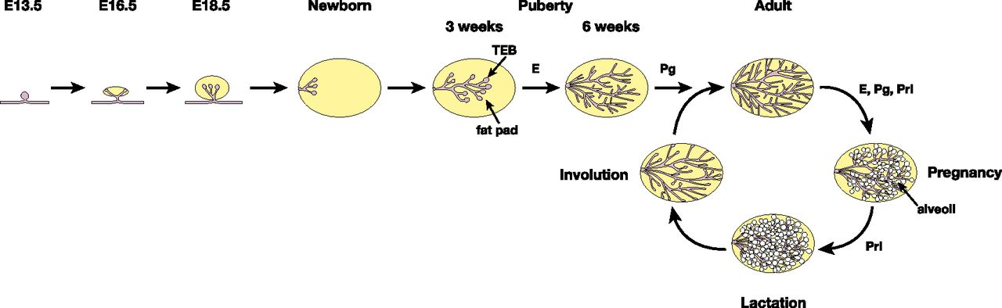
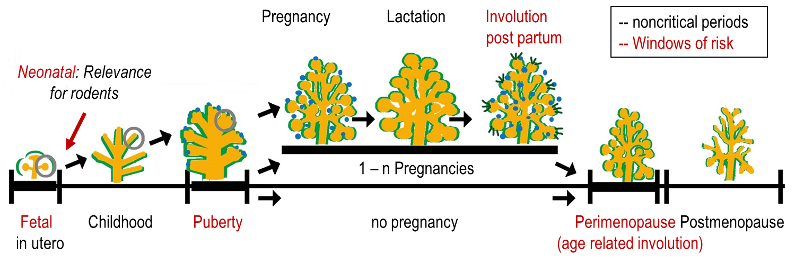
Critical Windows – high risk time periods
Visvader J E , and Stingl J Genes Dev. 2014;28:1143-1158
Adapted from Martinson et al. 2013 Exp Cell Res; 319:1671-8

Slide 24
Outlook: breast cancer prevention
Bone protective in the model of the inflammation-induced bone loss
  Oleuropein: Puel et al., 2006
  Hydroxy-/tyrosol: Puel et al., 2008
  Olive oil: Saleh et al., 2011
Bone protection in models of hormone deficiency related bone loss?
  Hormonal activities?
Role of olive oil polyphenols in the prevention of hormone dependent cancers.
Oleacein: 3,4‐DHPEA‐EDA (Oleacein) Synonyms: 3,4‐DHPEA‐Elenolic acid Di‐Aldehyde; Oleuropein‐aglycone dialdehyde (Decarboxymethyl oleuropein‐aglycone major form)
Oleocanthal: 3,4‐HPEA‐EDA

Slide 25

























Prof. Dr. D. Scharnweber
Dr. Michael Muders
Prof. Dr. Gisela Degen
Dr. Clarissa Gerhäuser
Prof. Dr. Leane Lehmann
Molekulare Zellphysiologie & Endokrinologie
Antje Beyer Carolina Blum
Pia Bräuer Susanne Broschk
Lotta Dittmann Nicole Dressel
Janina Helle Anne Heller
Annekathrin Keiler Georg Kretzschmar Matthias Langner Renate Linke
Frank Möller Sebastian Müller
Katrin Richter Miriam Stürzer
Jannette Wober Oliver Zierau
Prof. Dr. Sabine Kulling
Prof. Dr. Patrick Diel
Prof. Dr. Judy Bolton
Prof. Dr. Maarten Bosland

